Slide 1


BEST PRACTICE: BRAZIL
Safe study
Apr’23

Slide 2



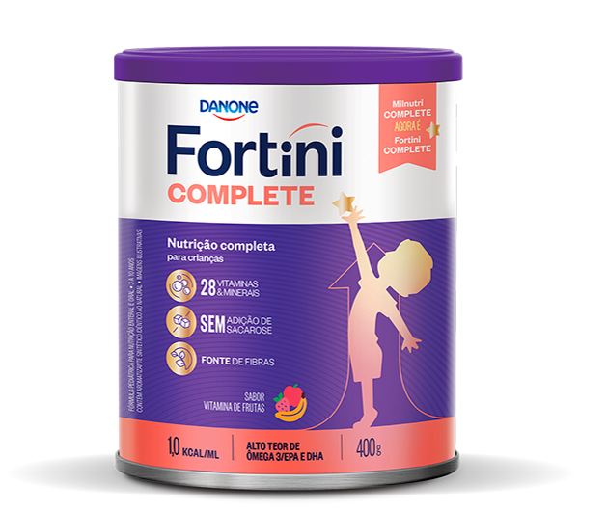
SAFE STUDY
6M
DETERMINE IF THE SUPPLEMENTATION WITH FORTINI COMPLETE IN PICKY EATERS HAS AN ADDITIONAL BENEFIT COMPARED TO THE NUTRITIONAL GUIDANCE.
Patient referred by physicians and/or nutritionists
35
Evaluate the difference between the groups in relation to:
Weight
Height
INTERVENTION
CONTROL
Body Composition
18
17
BMI
Appetite
Physical Activity
DIETARY COUNSELLING
+
FORTINI COMPLETE 400ML
DIETARY COUNSELLING
General health perception
Incidence of diseases

Slide 3
RESULTS
02
03
04
01
ANTHROPOMETRIC
PARAMETERS
BODY COMPOSITION
NUTRITIONAL
ADEQUACY
GENERAL HEALTH PERCEPTION
Increased weight and height of children
Did not change the BMI or change the % fat mass of the children
improved body proportion
Decreased percentage of dietary inadequacy
Increasing levels of calcium, iron, zinc, and vitamins A, C, D and B12
Did not increase the number of infections
Increased appetite according to parents' perception
BRAZIL

Slide 4
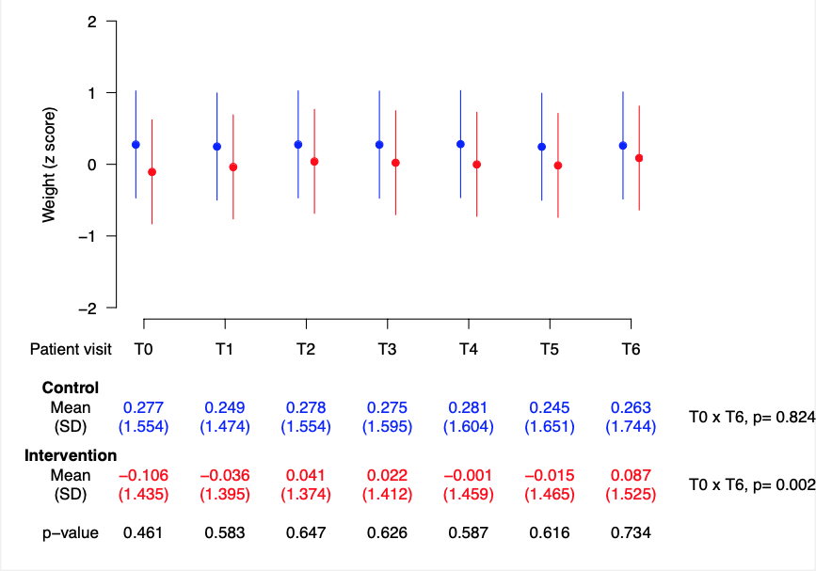
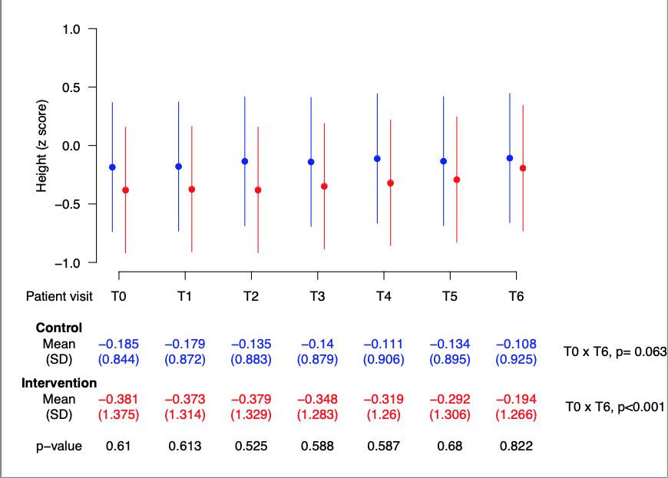
01
ANTHROPOMETRIC PARAMETERS
BRAZIL

Slide 5
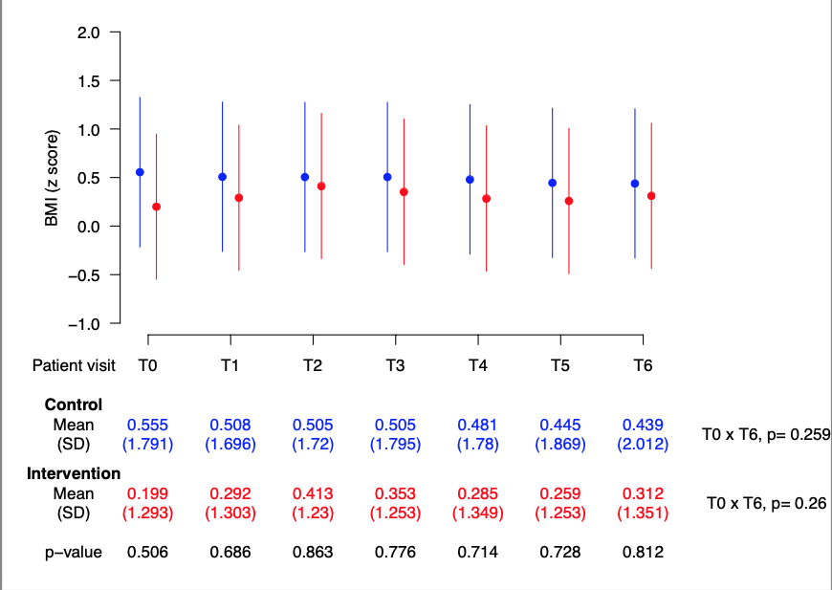
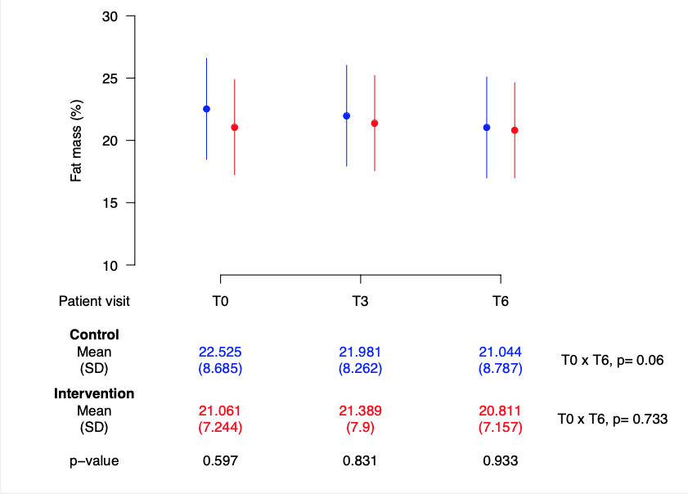
02
BODY COMPOSITION
BRAZIL

Slide 6
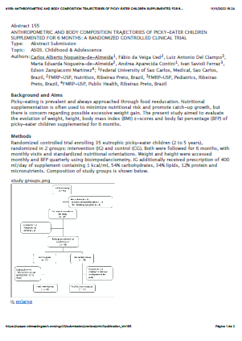




SAFE STUDY
NEXTS STEPS
NUTRITION AND GROWTH
CHILDREN MDPI JOURNAL
LASPGHAN
Oral presentation
Submitted in january
Rio de Janeiro - Brazil
Abstract 155
ANTHROPOMETRIC AND BODY COMPOSITION TRAJECTORIES OF PICKY-EATER CHILDREN
BRAZIL

Slide 7


SAFE STUDY
6 MONTHS THAT CHANGES THE FUTURE
Campaign to consumers and HCPs
6 out of 10
have feeding difficulties
50% of the parents have concerns about the kids eating habits even when the kids are growing well.
NUTRITIONAL REEDUCATION
FAMILY SUPPORT
77%of the parents adopt inappropriate attitudes to overcome this challenge as quickly as possible.
BRAZIL
50% of the picky eaters do not receive an adequate intervention.
30% just use the supplement for one month
SUPPLEMENT
Nogueira et al. 2022

Slide 8

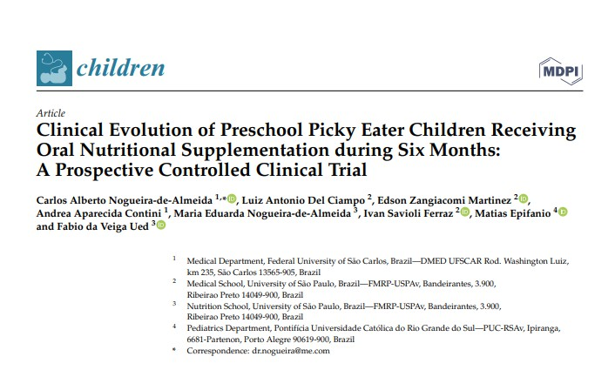


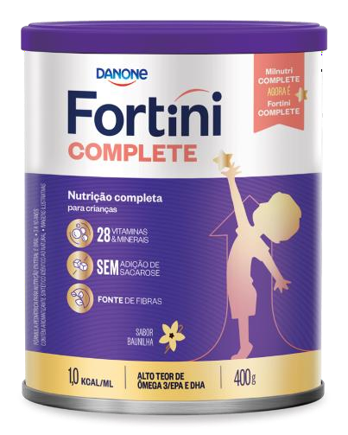


SAFE STUDY IS NOW PUBLISHED
Design:
6 months intervention study with Fortini Complete vs Nutritional guidance alone
Objective:
To understand if supplementing Fortini Complete in picky eaters has an additional benefit vs the nutritional guidance alone
Topline results:
Increased kids' weight, not by gaining fat, but due to an increase in stature/height, as shown by BMI z-score and body fat percentage
Decreased inadequate micronutrient intake
Showed a significant improvement in appetite
BRAZIL

Slide 9






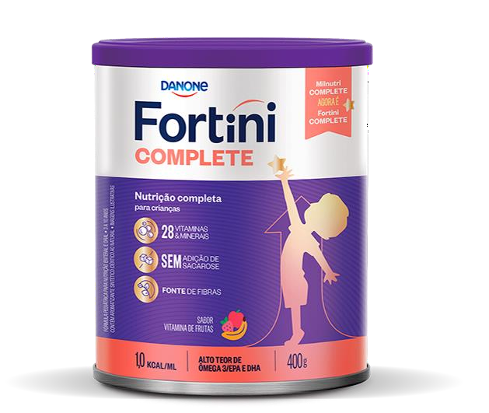
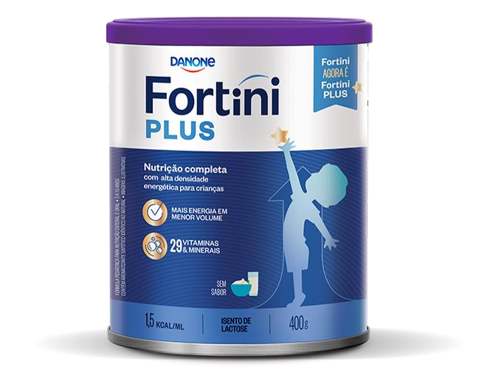
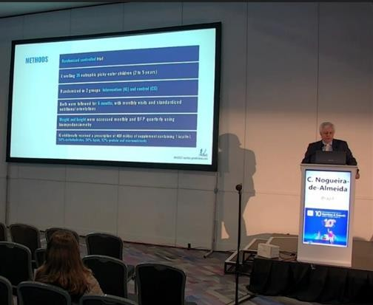

SAFE STUDY
6 MONTHS INTERVENTION WITH FORTINI COMPLETE
NUTRITION AND GROWTH
Oral presentation
LASPGHAN
Rio de Janeiro - Brazil
NEW STUDY IS KICKED-
OFF
More to come
8 weeks intervention study
PARIQUERA-AÇU: city with low HDI in Brazil
Global funding
BRAZIL

Slide 10

THANK YOU!

