Slide 1


BEST PRACTICE: USA
Fortini Infant HCP Influencer Campaign
June’23

Slide 2

WHY AN HCP INFLUENCER PROGRAM? WHY FORTINI? WHY NOW? HOW?
WHY INFLUENCERS?:
Consumers are more skeptical than ever
WHY FORTINI?:
Opportunity for increased awareness
WHY NOW?:
Product still in infancy with goal to test and learn
HOW?:
Consumers don’t trust branded messaging as much as recommendations from peers or influencers
Ratings and reviews are driving majority of purchases
Broad scale awareness and extended audience reach for <5% of A&P
Diversify channel mix
Tap into new HCPs and caregivers
Opportunity to increase awareness
Don’t have organic IG strategy as IG audience skews consumer and current brand focus is HCP – this program allowed us to capture IG audience with low level of organic effort
Program first of its kind at NNA! Huge win; many levels of approval
Strategic agency (Vivo) recommended influencer agency (CLEVER) to work directly with
Engaged DNA, local medical + regulatory to establish NNA influencer SOP
CLEVER identified influencers w/i own network; medical and marketing approved based on set of criteria
Fortini education packs sent to influencers
USA

Slide 3


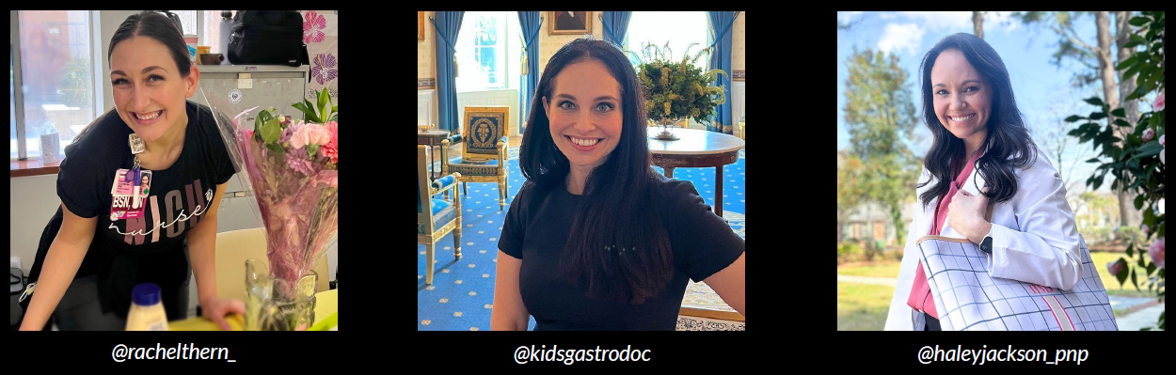
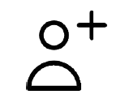

PROGRAM GOAL AND PROCESS
Objective:
          Increase awareness of Fortini Infant by having credible, HCP influencers share their thoughts on the evidence supporting the use of the product
        Campaign components:
          3 organic influencer posts on Instagram (5/1-5/10/23)
          2 weeks of paid media support on Instagram and Facebook (5/30-6/13/23)
        Influencer selection criteria:
HCP specialist managing FTT patients
10K+ Instagram followers; majority of audience HCPs
Professional account focused on credible and evidence-based content
USA

Slide 4
TOTAL PROGRAM IMPACT
9.8M
24.5K
13.2K
$60K
IMPRESSIONS
ENGAGEMENTS
CLICKS
COST
8M guaranteed
1.8M above guarantee
19K guaranteed
Engagement= comments, likes, reactions, saves, shares, tap backs (not clicks)
+18 new IG followers
To the Fortini landing page
Organic link clicks: 109
Paid link clicks: 13,114
Influencer cost: $22.5K
Paid support: $19.5K
CLEVER fee: $18K (30%)
USA

Slide 5
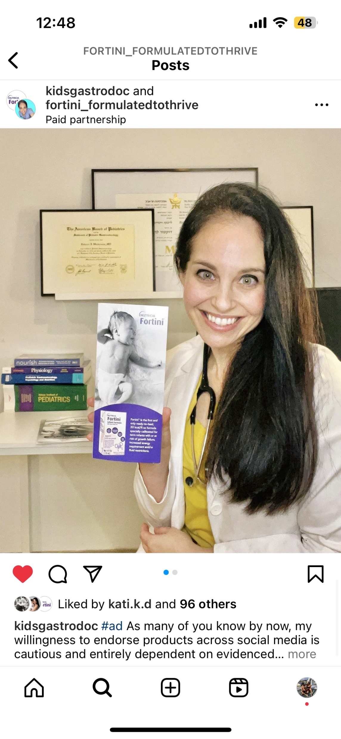
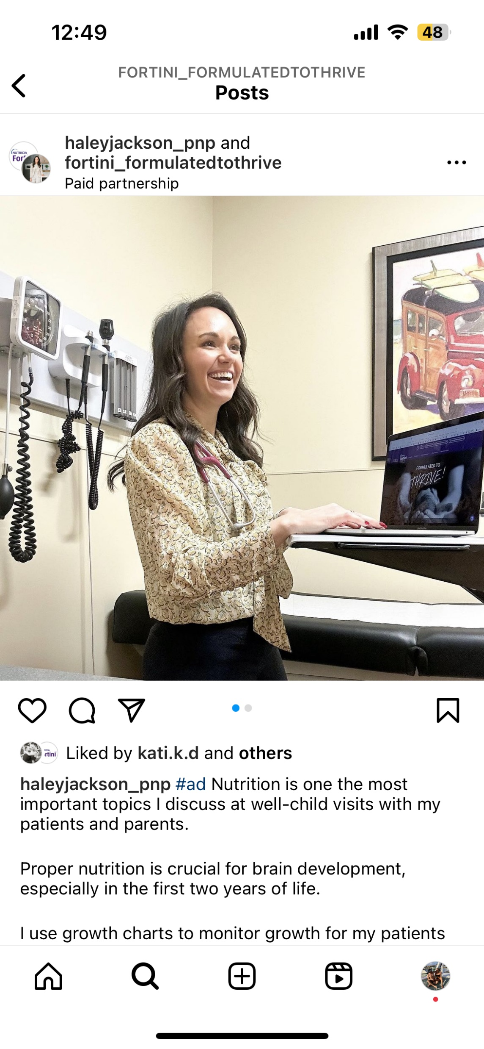
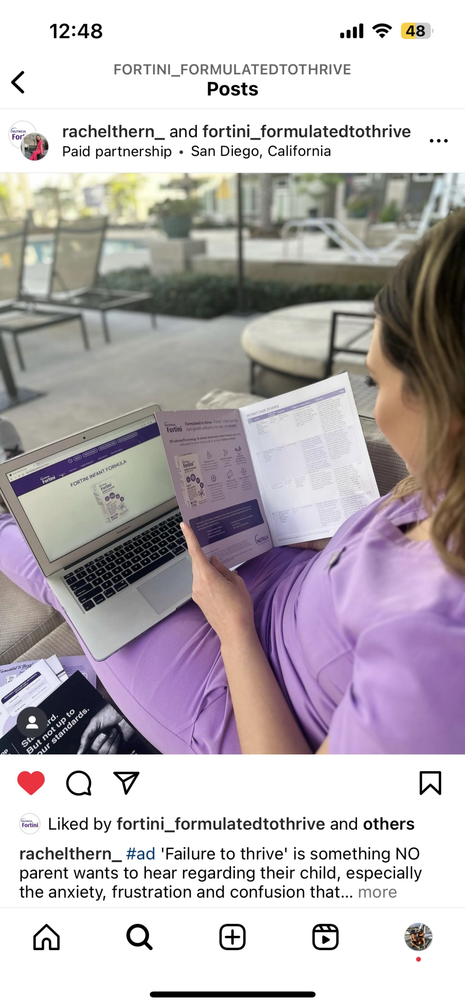
ORGANIC POSTS: DETAILS
Salesforce experienced barriers gaining access to Dr. Winderman – she’s now an advocate and has encouraged the local TM to contact her!
3 organic posts highlighting FTT, nutrition with FTT patients, and support of evidence behind Fortini
Content was intended for HCPs so required to include “#ad” and “talk to your doctor” in each post as to not confuse any parents/caregivers
At the time of posting, not all HCP influencers were recommenders of Fortini, but each are now bought in and are willing to recommend to their patient population
USA

Slide 6
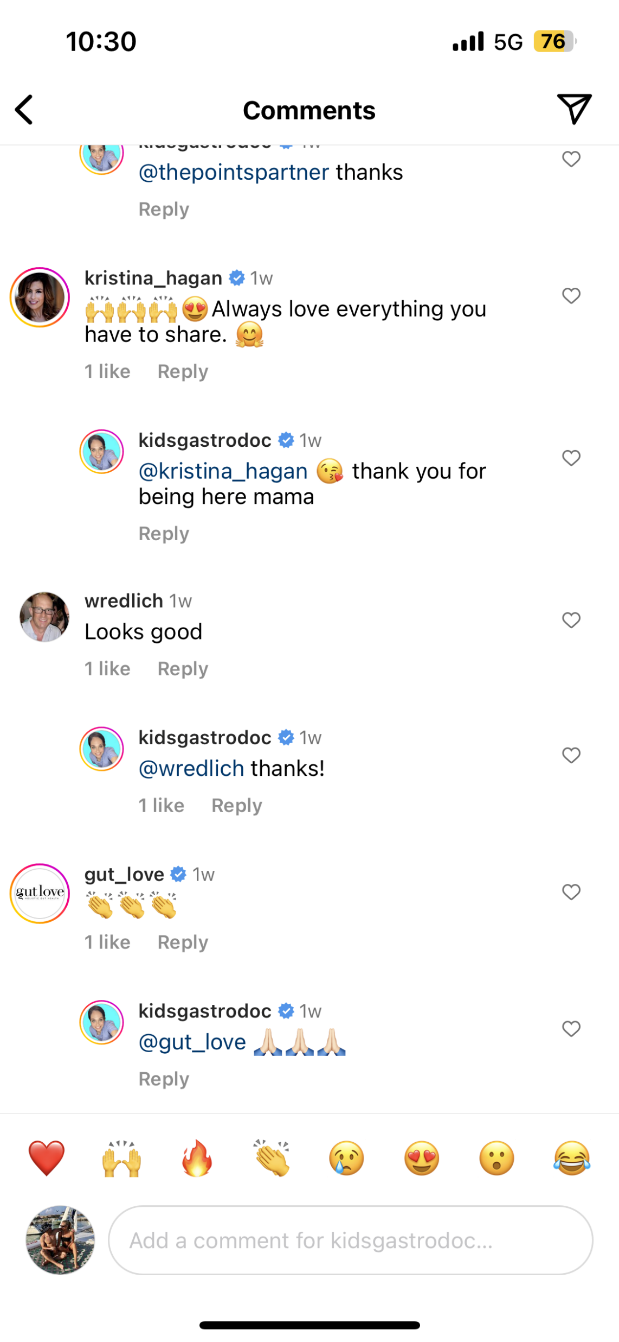
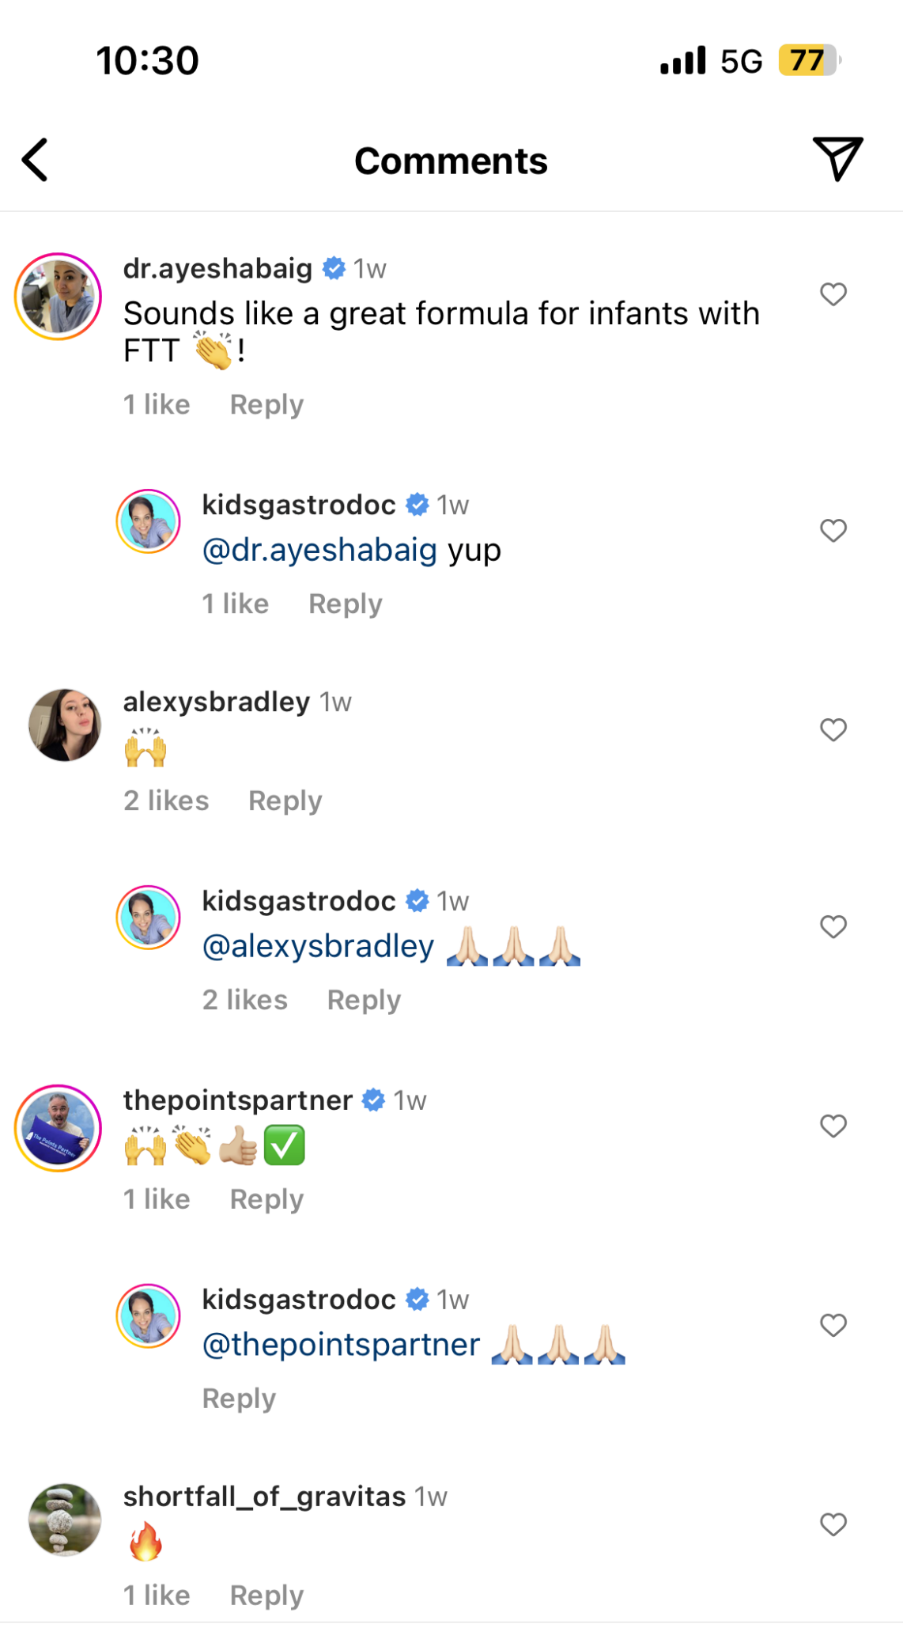
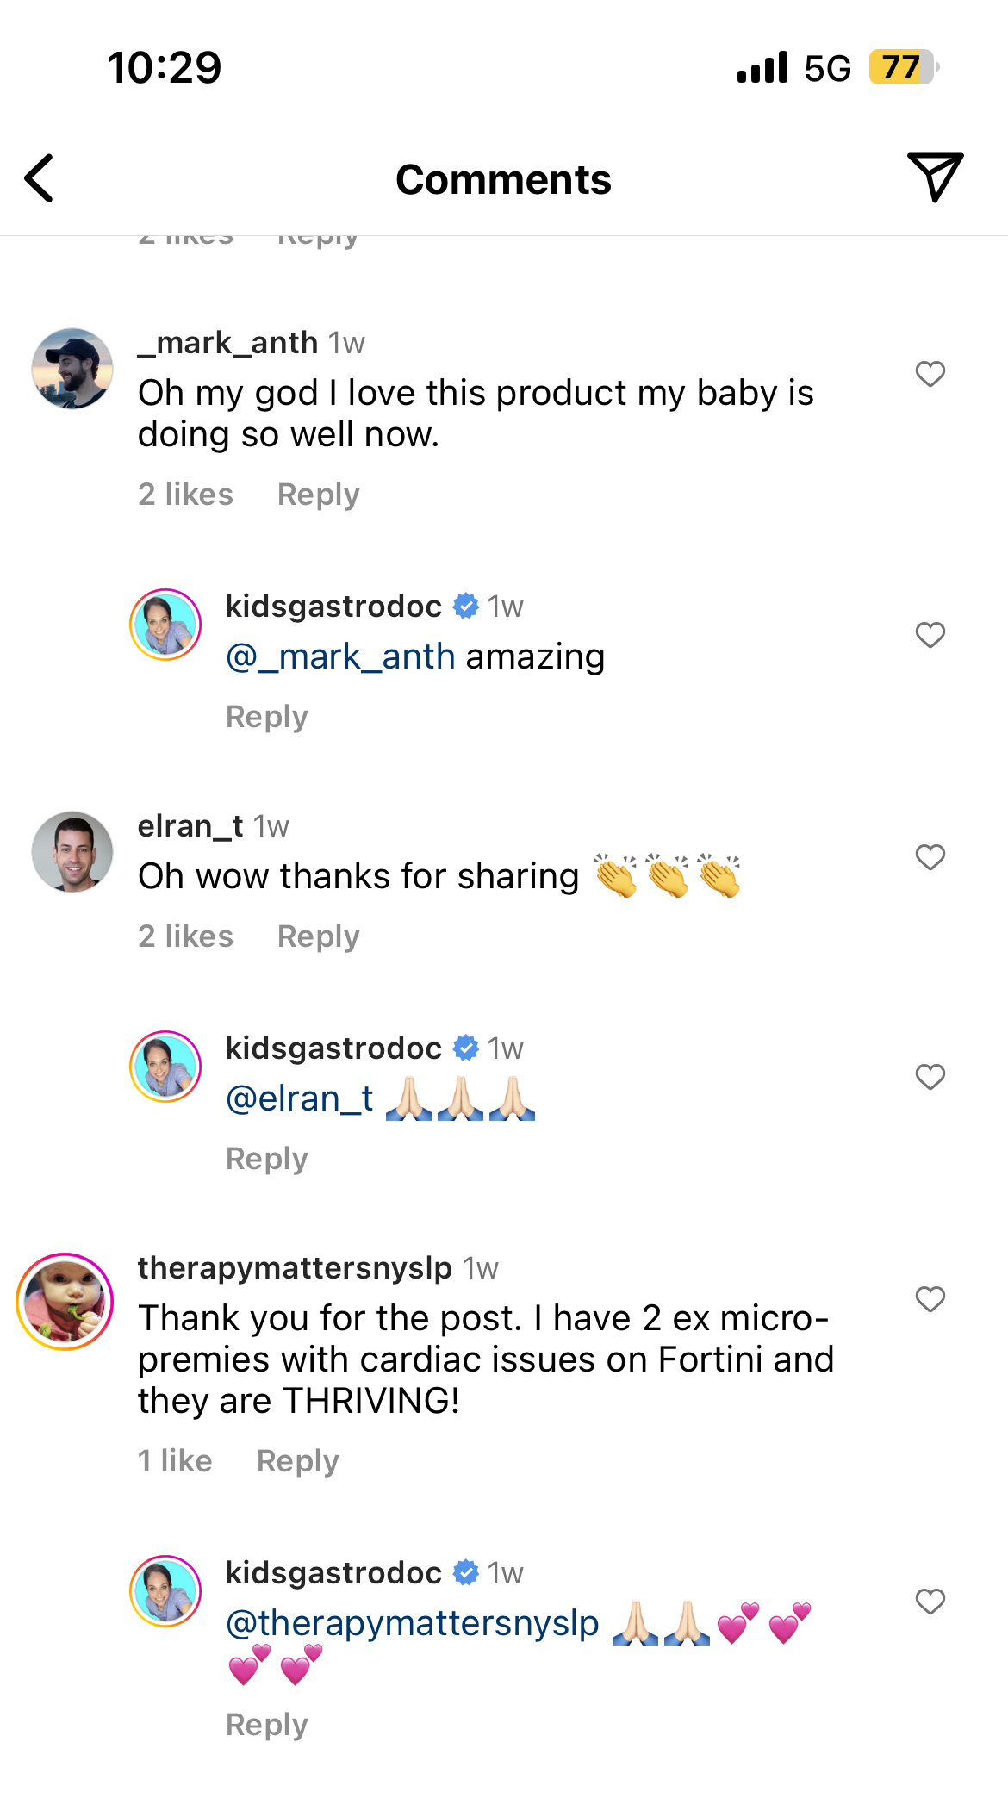
ORGANIC POSTS: COMMENT HIGHLIGHTS
USA

Slide 7
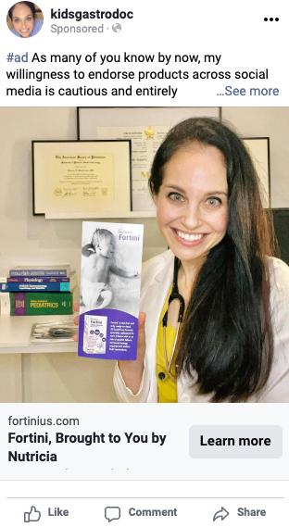
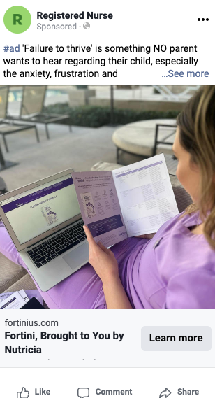
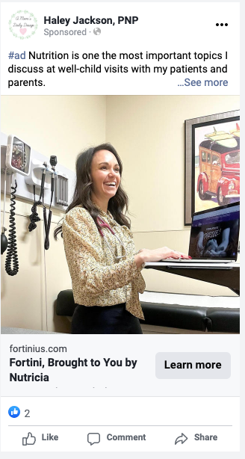
PAID MEDIA: DETAILS
Paid support targeting HCPs and consumers on IG and Facebook -- test engagement between two audiences
          HCP: interests, job title
          Consumer: interests, competitors
“Learn more” CTA driving to Fortini.com
USA

Slide 8
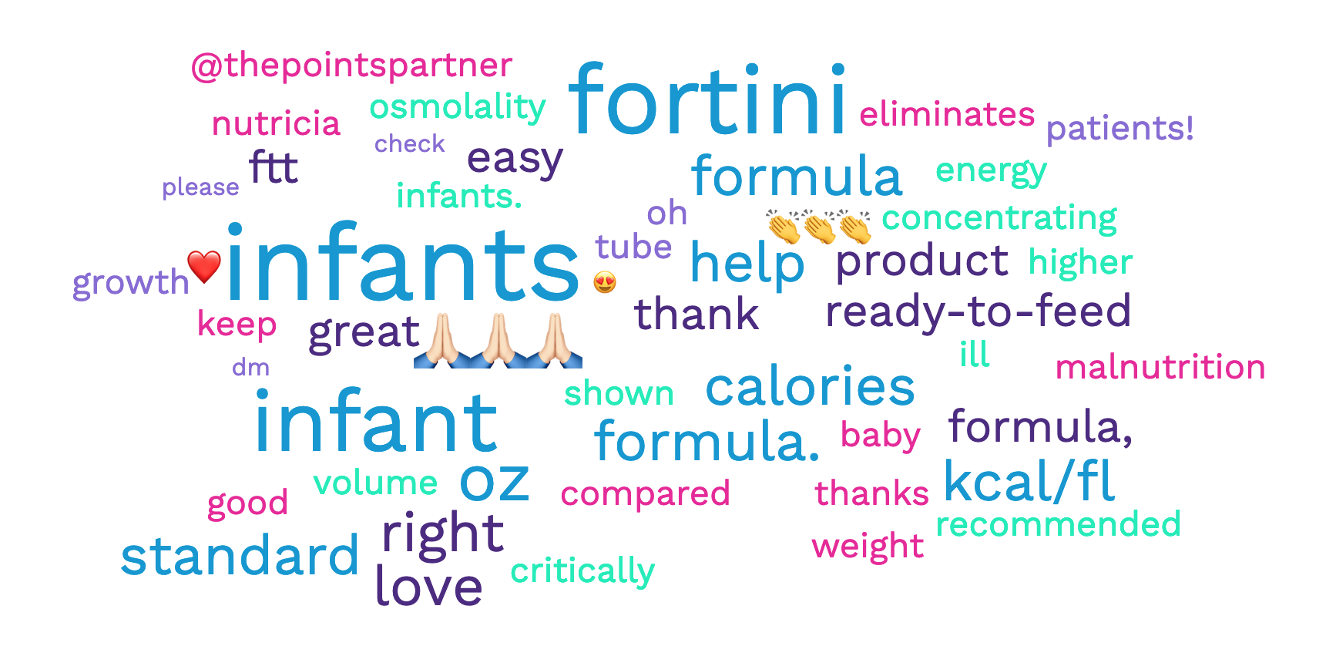
PROGRAM COMMENT ANALYSIS
Top commented words and emojis were analyzed:
The following themes were identified:
Product Efficacy: The comments indicate that users have found Fortini infant formula to be highly effective. There are reports of infants thriving on it, avoiding tube feeding, and helping in instances of Failure to Thrive (FTT). A user even called it a 'game changer' for providing needed calories.
Trust in the Brand: Some comments highlight trust in Nutricia, the company behind Fortini. One comment mentions another product from Nutricia (Neocate) that had helped their baby.
Product Innovation: There's an appreciation for product innovation within the comments, indicating that the audience appreciates the company's efforts to create specialized solutions like Fortini.
Ease of Use: There are repeated mentions of the ease of use of this product, particularly in a medical or healthcare setting.
Emotional Response: The comments show a strong emotional response to the product. Users express love for the product and gratitude for its effects on their babies' health. They also show excitement about the product and its benefits.
Encouragement & Positivity: There's a consistent theme of encouragement and positivity running through the comments, with numerous emoticons expressing approval and applause.
USA

Slide 9
PROGRAM LEARNING, RECOMMENDATIONS, AND NEXT STEPS
Insight:
Paid support results show strong interest from a more general consumer audience
Action:
Insight:
IG audience shows higher engagement in stories and videos vs. static images
Consider leveraging video content such as Instagram reels to give audiences a real-life look into different use cases or to encourage creators to authentically share their thoughts on the formula
Even though this program was intended for HCPs, able to engage directly with consumers
Action:
Expand influencer parameters – test general Peds and mommy/parent influencers in 2024 campaign
USA

Slide 10
BEST PRACTICE: USA
Congress of Paediatric Cardiology & Cardiac Surgery
September ’23

Slide 11

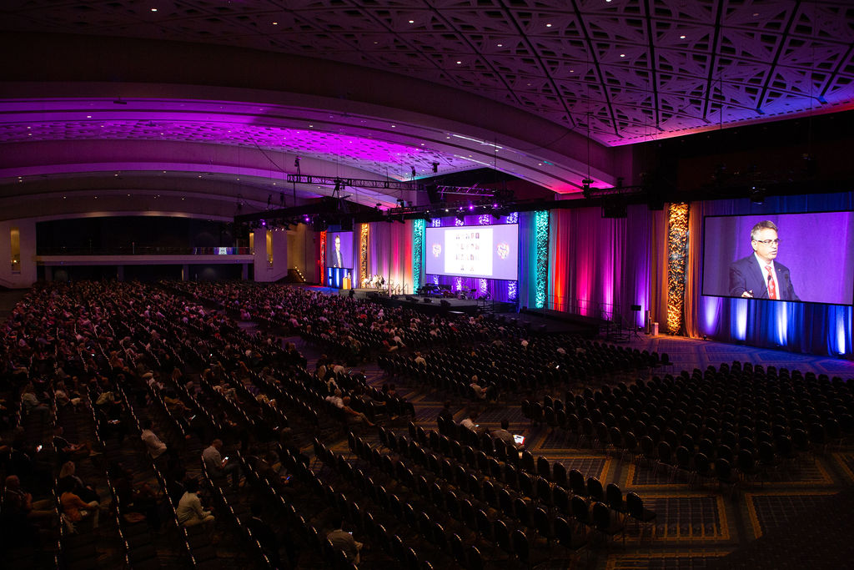
WHAT
“The Olympics of Pediatric Cardiology”
WHY
Peds Cardiologists are a key HCP target for Fortini to help manage infants at risk of failure to thrive for conditions such as CHD.
Objectives:
Drive broad awareness of Fortini Infant with pediatric cardiology community
Enhance consideration of Fortini usage with registrations for upcoming events
Generate interest and register Ped Cardiologists for our Advisory Board
Develop and capture leads to drive product trial, advocacy and case studies

Slide 12

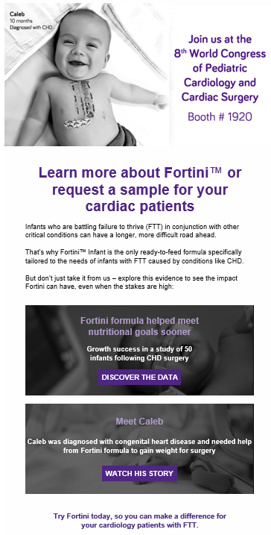
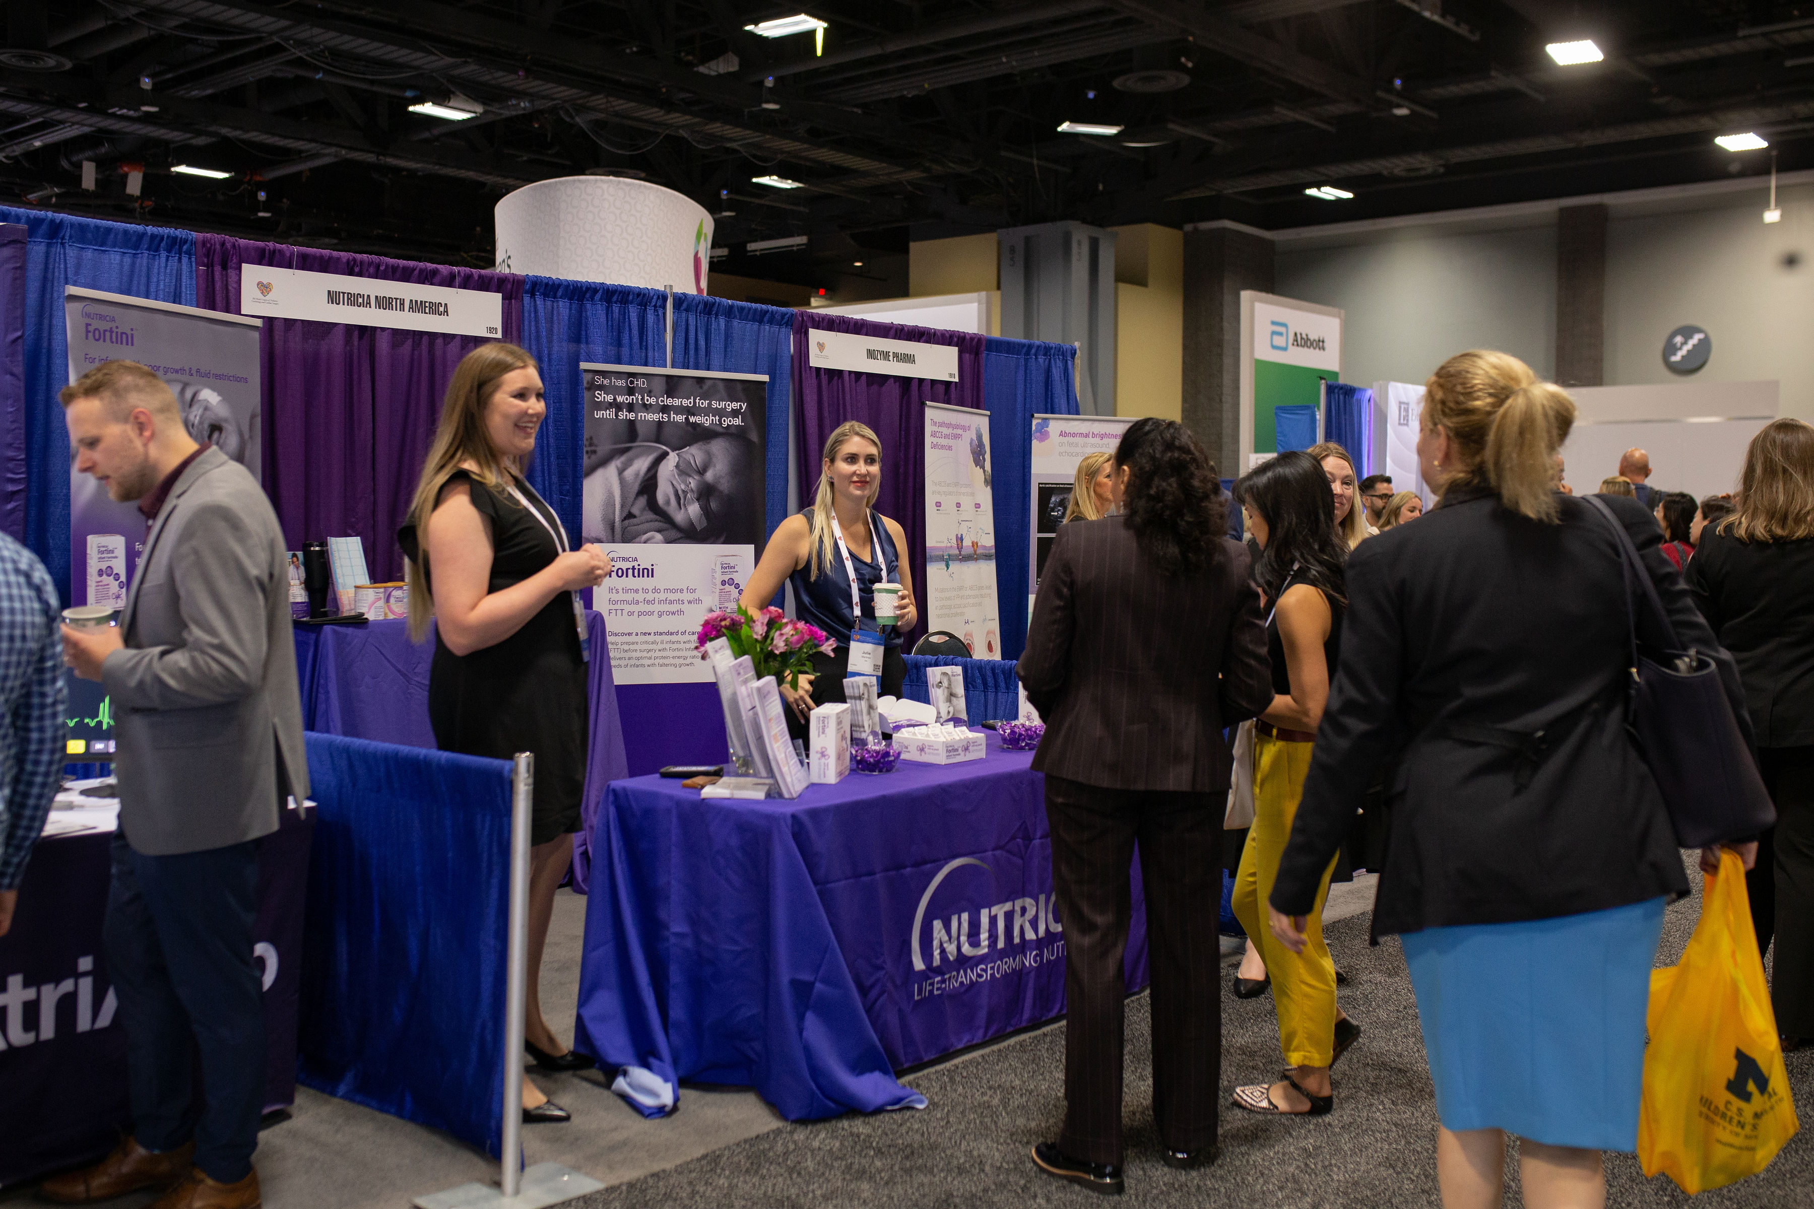
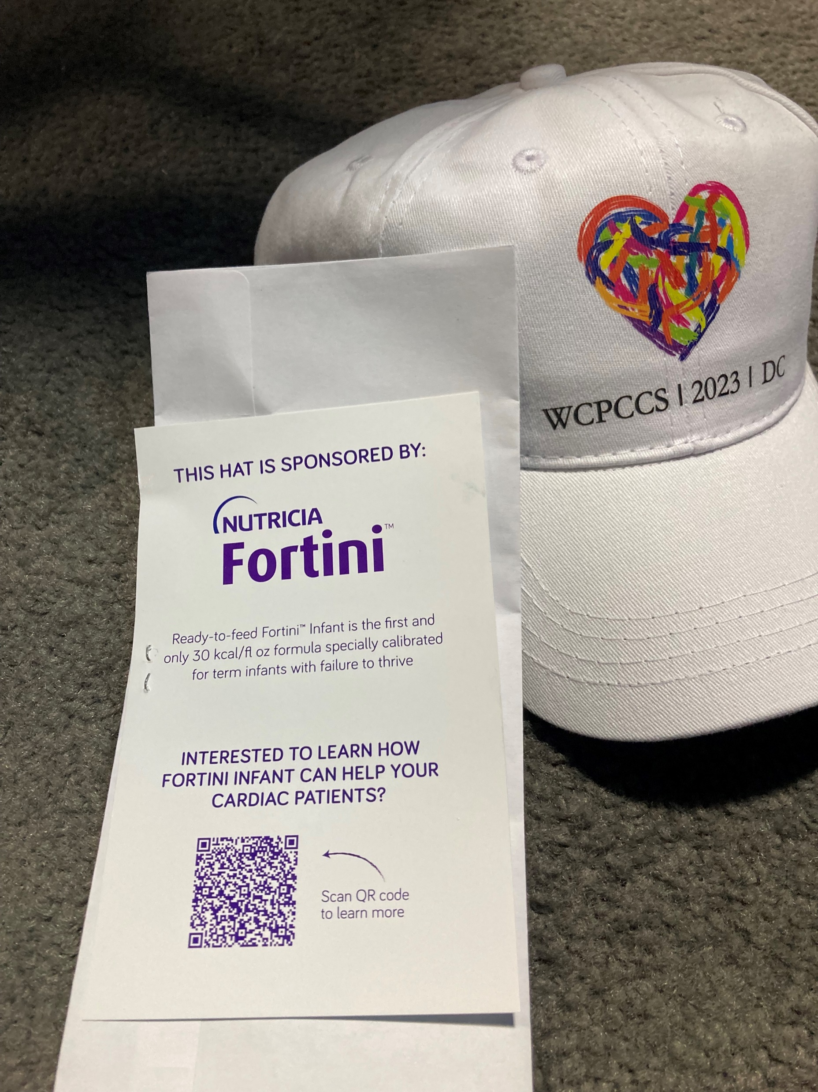
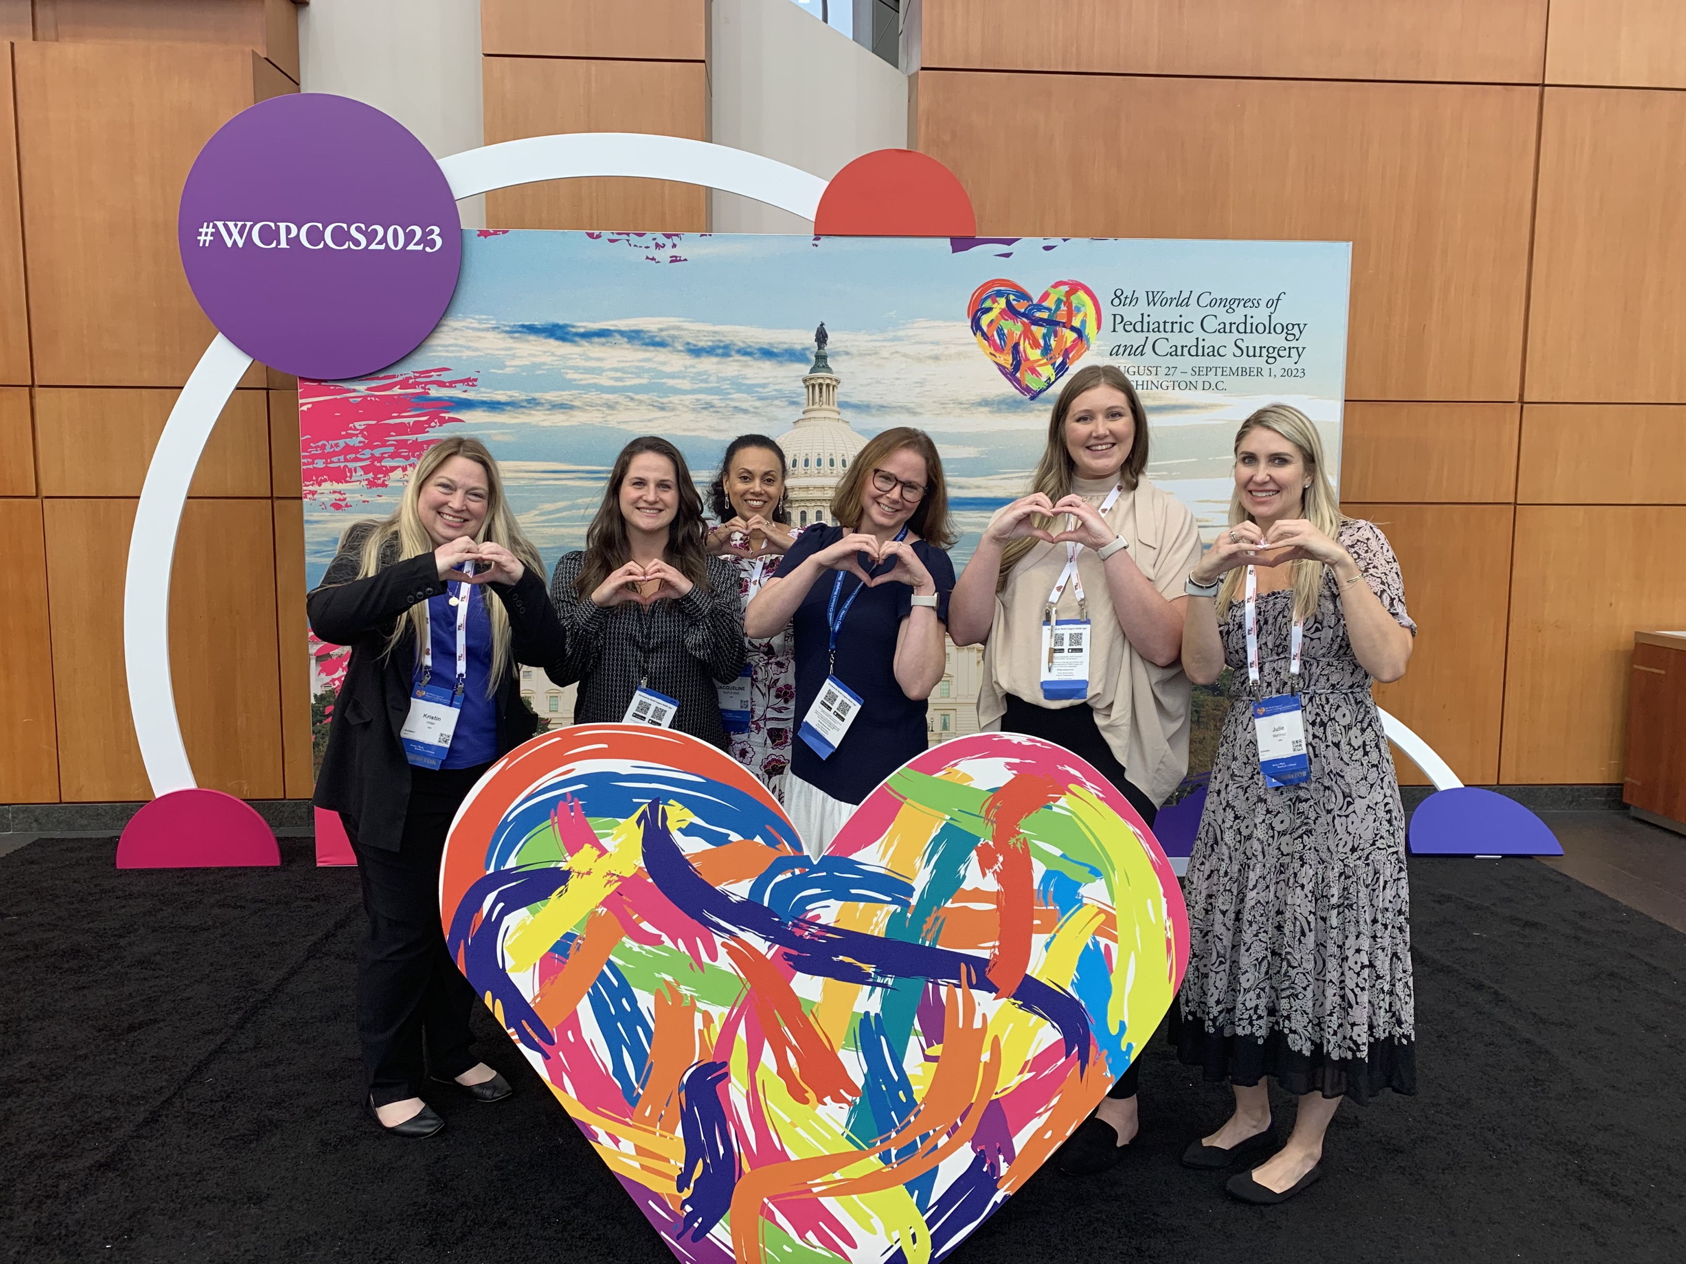
8th World Congress of Pediatric Cardiology & Cardiac Surgery 2023 (WCPCSS) – Washington, DC – Aug 27th – 31st
HOW
Nutricia Team activities & results:
Dedicated email campaign to WCPCSS attendees and Nutricia contacts pre & post congress
Exclusive Fortini sponsorship of hats to 2,000 HCP game attendees
High-traffic booth engagement over 4 days, generating 120+ leads*
Recruited 5-6 potential HCPs for Ad Board & identified KOLs for future development
Expanded presence to new audience within the Pediatric Cardiology care team
Drove qualified registrations for future Cardiology virtual event
USA

Slide 13
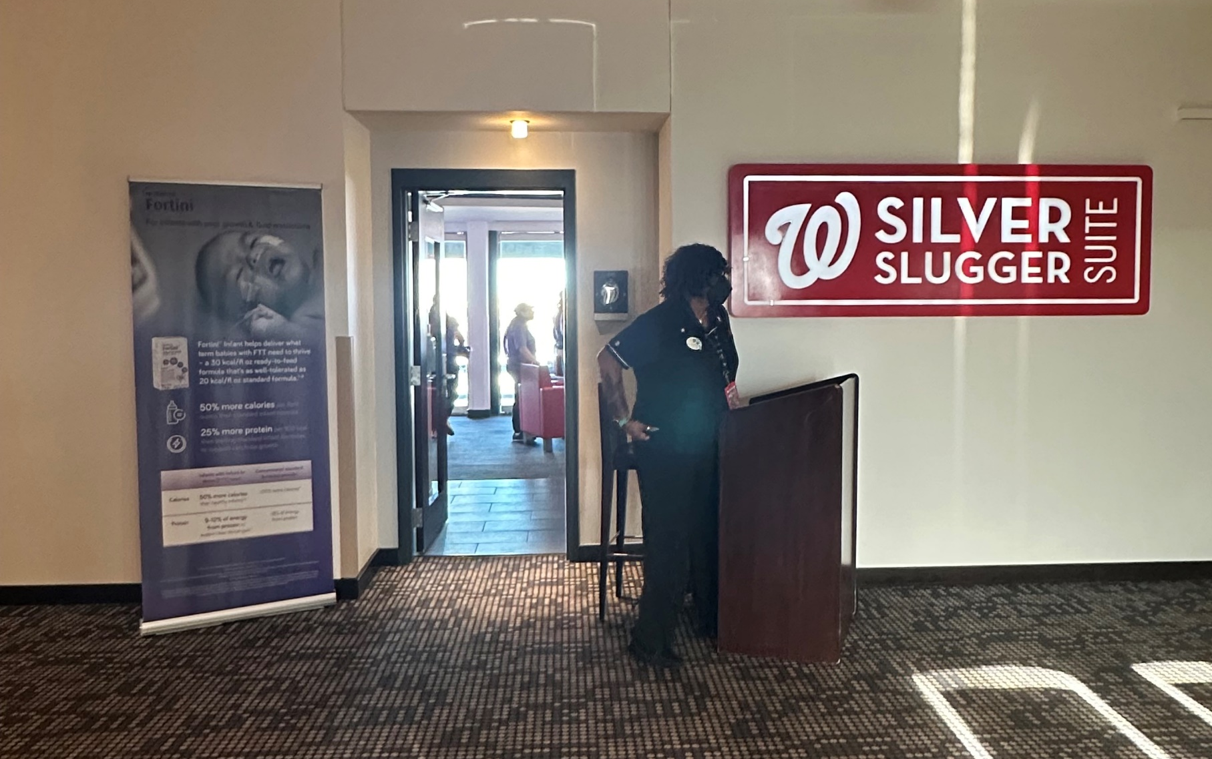
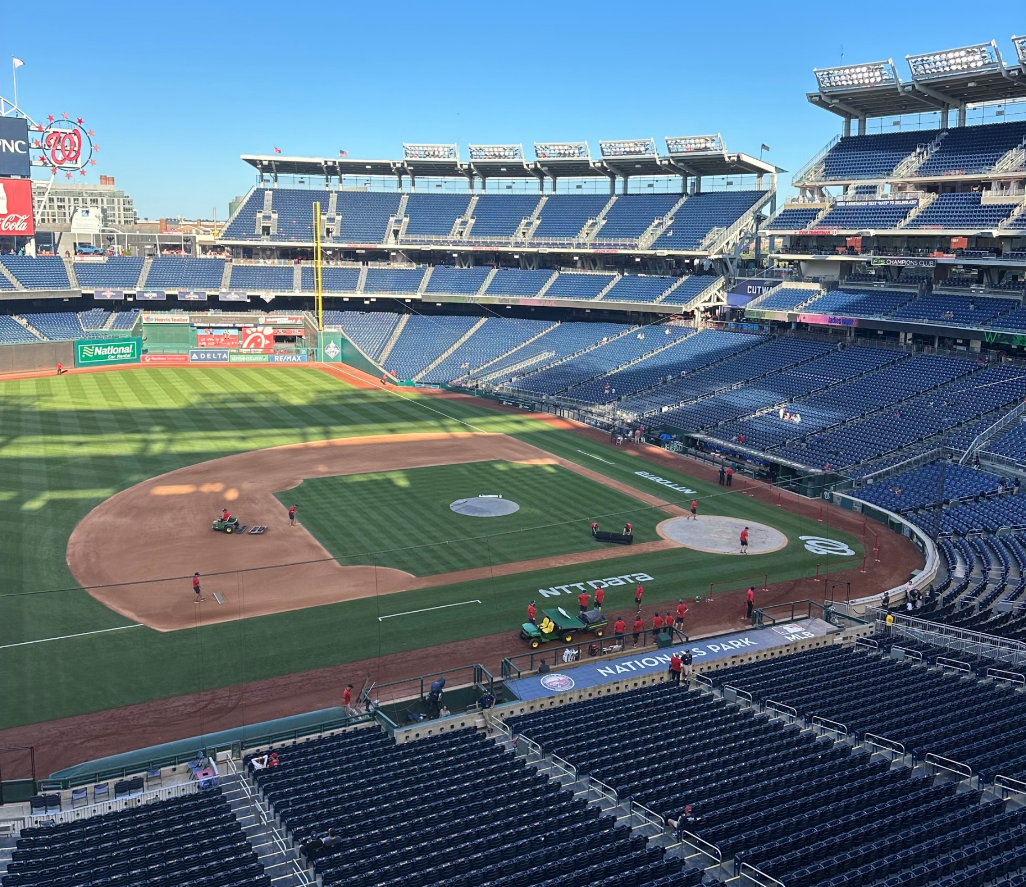
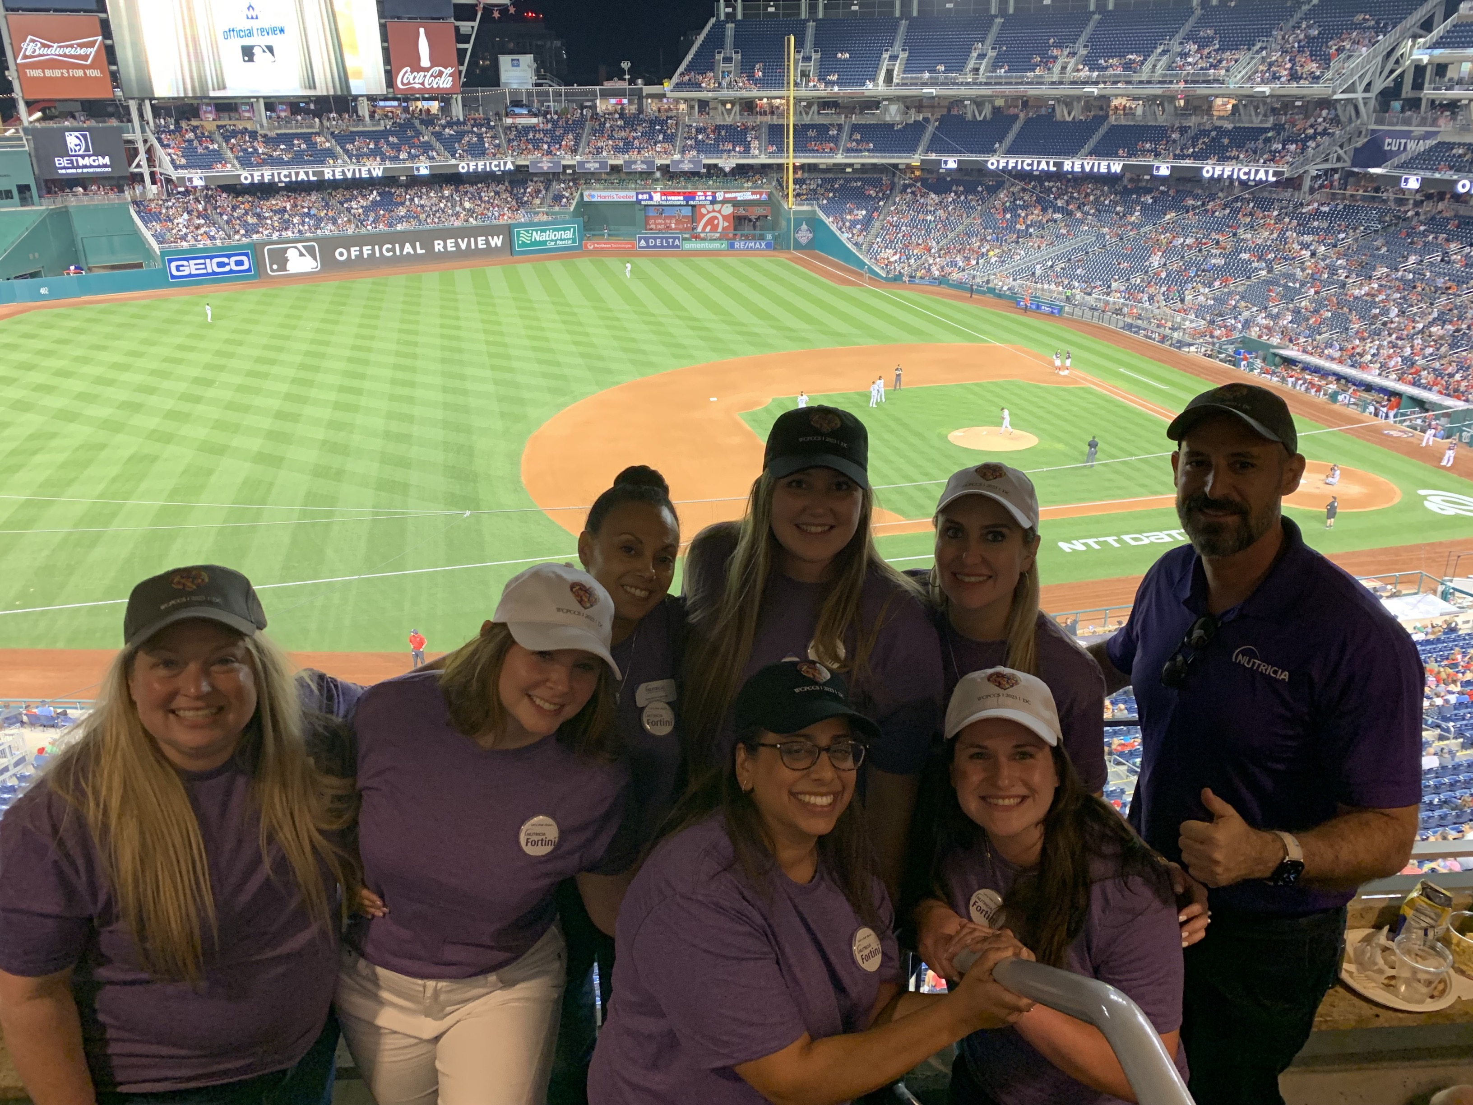
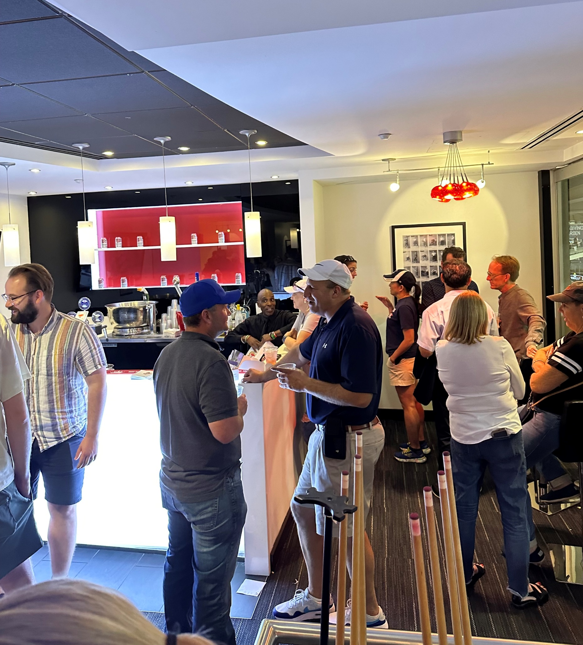
HOW
Exclusive networking event – night at the nationals game
First-of-its kind networking event hosted by Nutricia & supported by Congress organizers to connect with top Pediatric Cardiology teams in the US
Result: 50+ engaged HCP contacts in attendance → opened the doors for new relationships and unique opportunities for Fortini on-going
Don’t be afraid step outside the box for new ways to engage with HCPs!
USA

Slide 14
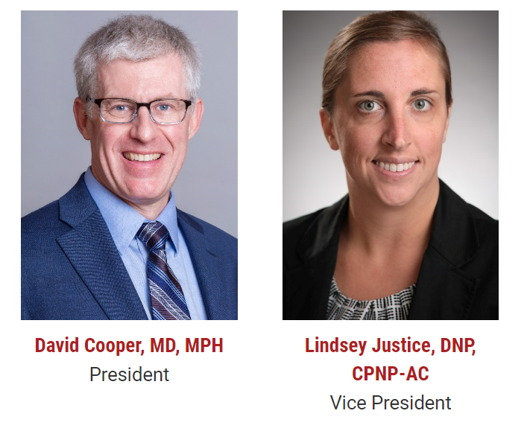
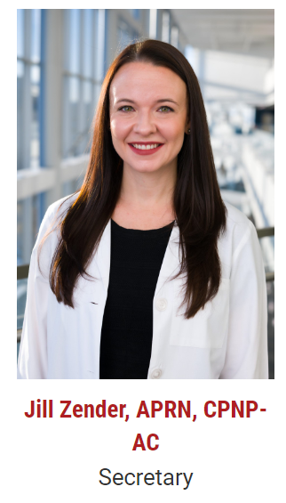

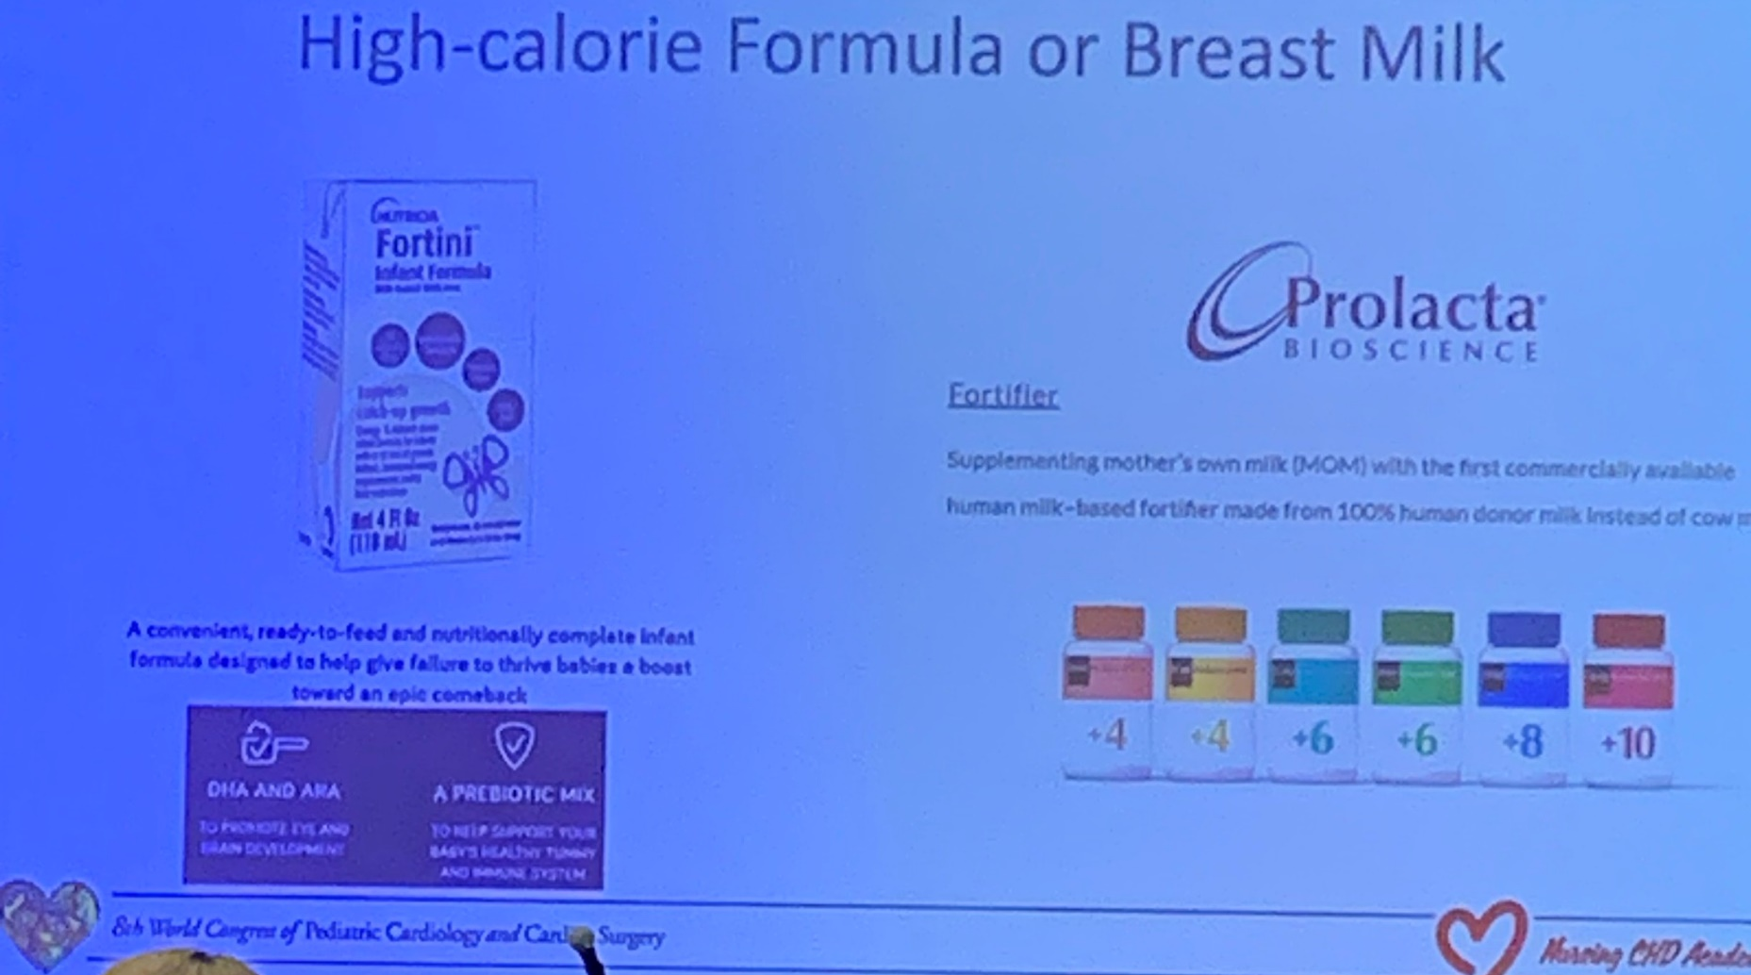

WHAT’S
NEXT?
Highlighting A Few follow-ups and connections from WCPCSS
Unique opportunity to present Fortini
Fortini medical team invited to visit and deliver education on Fortini to Pediatric Cardiology clinicians and further expand our network at one of the top children’s hospitals in the country
Next Steps: Continue to strengthen our connections with a key target audience and with the leading society for Pediatric Cardiologists
Connect with NP KOL
Fortini opportunistically highlighted for use in CHD Single Ventricle infants – product used during Early Experience program at CH Wisconsin
Next Step: Develop the relationship & grow our connection through our advocate
USA

