Slide 1


BEST PRACTICE: TURKEY
Increase Penetration with Fortini
June’23

Slide 2

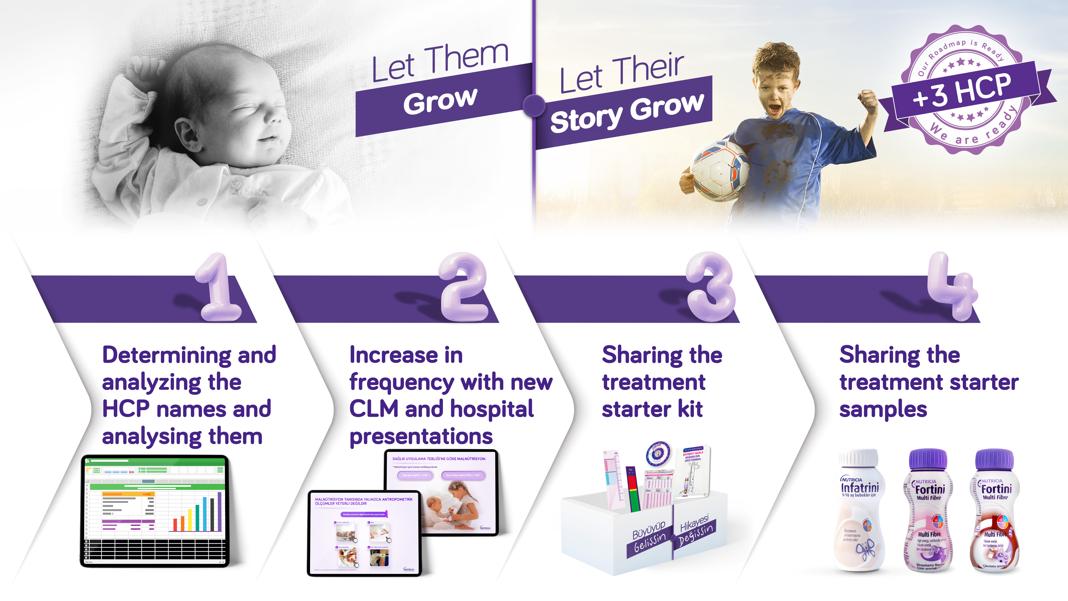
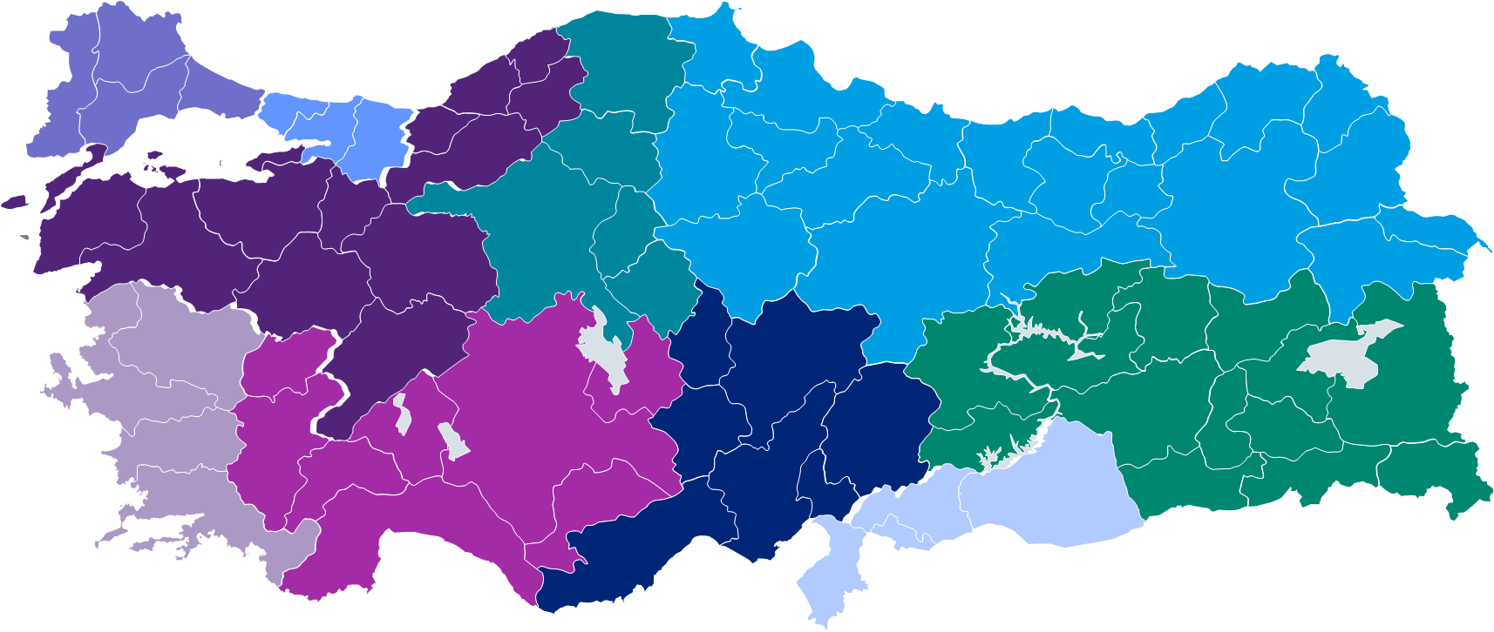

INCREASE PENETRATION W FORTINI
TUrkIYE
GAIN NEW +3 HCPS PROJECT
INSIGHT
        %80 of the enteral nutrition business comes from %20 of the HCP’s
        Limited HCP interested w MN due extra time & effort need
        Limited screening after #1age due to workload
        Increase screening rates and reach more children by making screening easier for HCP’s and drive parents for weight/height tracking
        For showing MN treatment is not a difficult road and not that time consuming, providing the equipments for diagnosis is important.
INITIATIVE
30
21
18
18
18
18
21
21
18
12
OUTCOME
KEY LEARNING
By implementing a planned message strategy, showing MN treatment is not time consuming and creating tension among HCPs who do not prioritize malnutrition, we can gain potential volume and expand the market.
Gain New HCPs
Weekly Diagnosis
Monthly Patients
Potential Volume
195
1
780
45 K LT
Coverage
Working Hours
Yearly Patients
Monthly Volume
%5
%5
%5
%10
Nimet Aslan nimet.aslan@nutricia.com
Hande Gaser Tekin hande.gaser@nutricia.com

Slide 3
SEGMENTATION
30
21
18
18
18
18
21
18
21
12
Weekly Diagnosis
Monthly Patients
Potential Volume
Total New HCPs
Weekly Diagnosis
Total New HCPs
1
780
45 K LT
195
1
195
TURKEY
Coverage
Working Hours
Yearly Patients
Monthly Volume
%5’i
%5’i
%5’i
%10’u

Slide 4


Slide 5
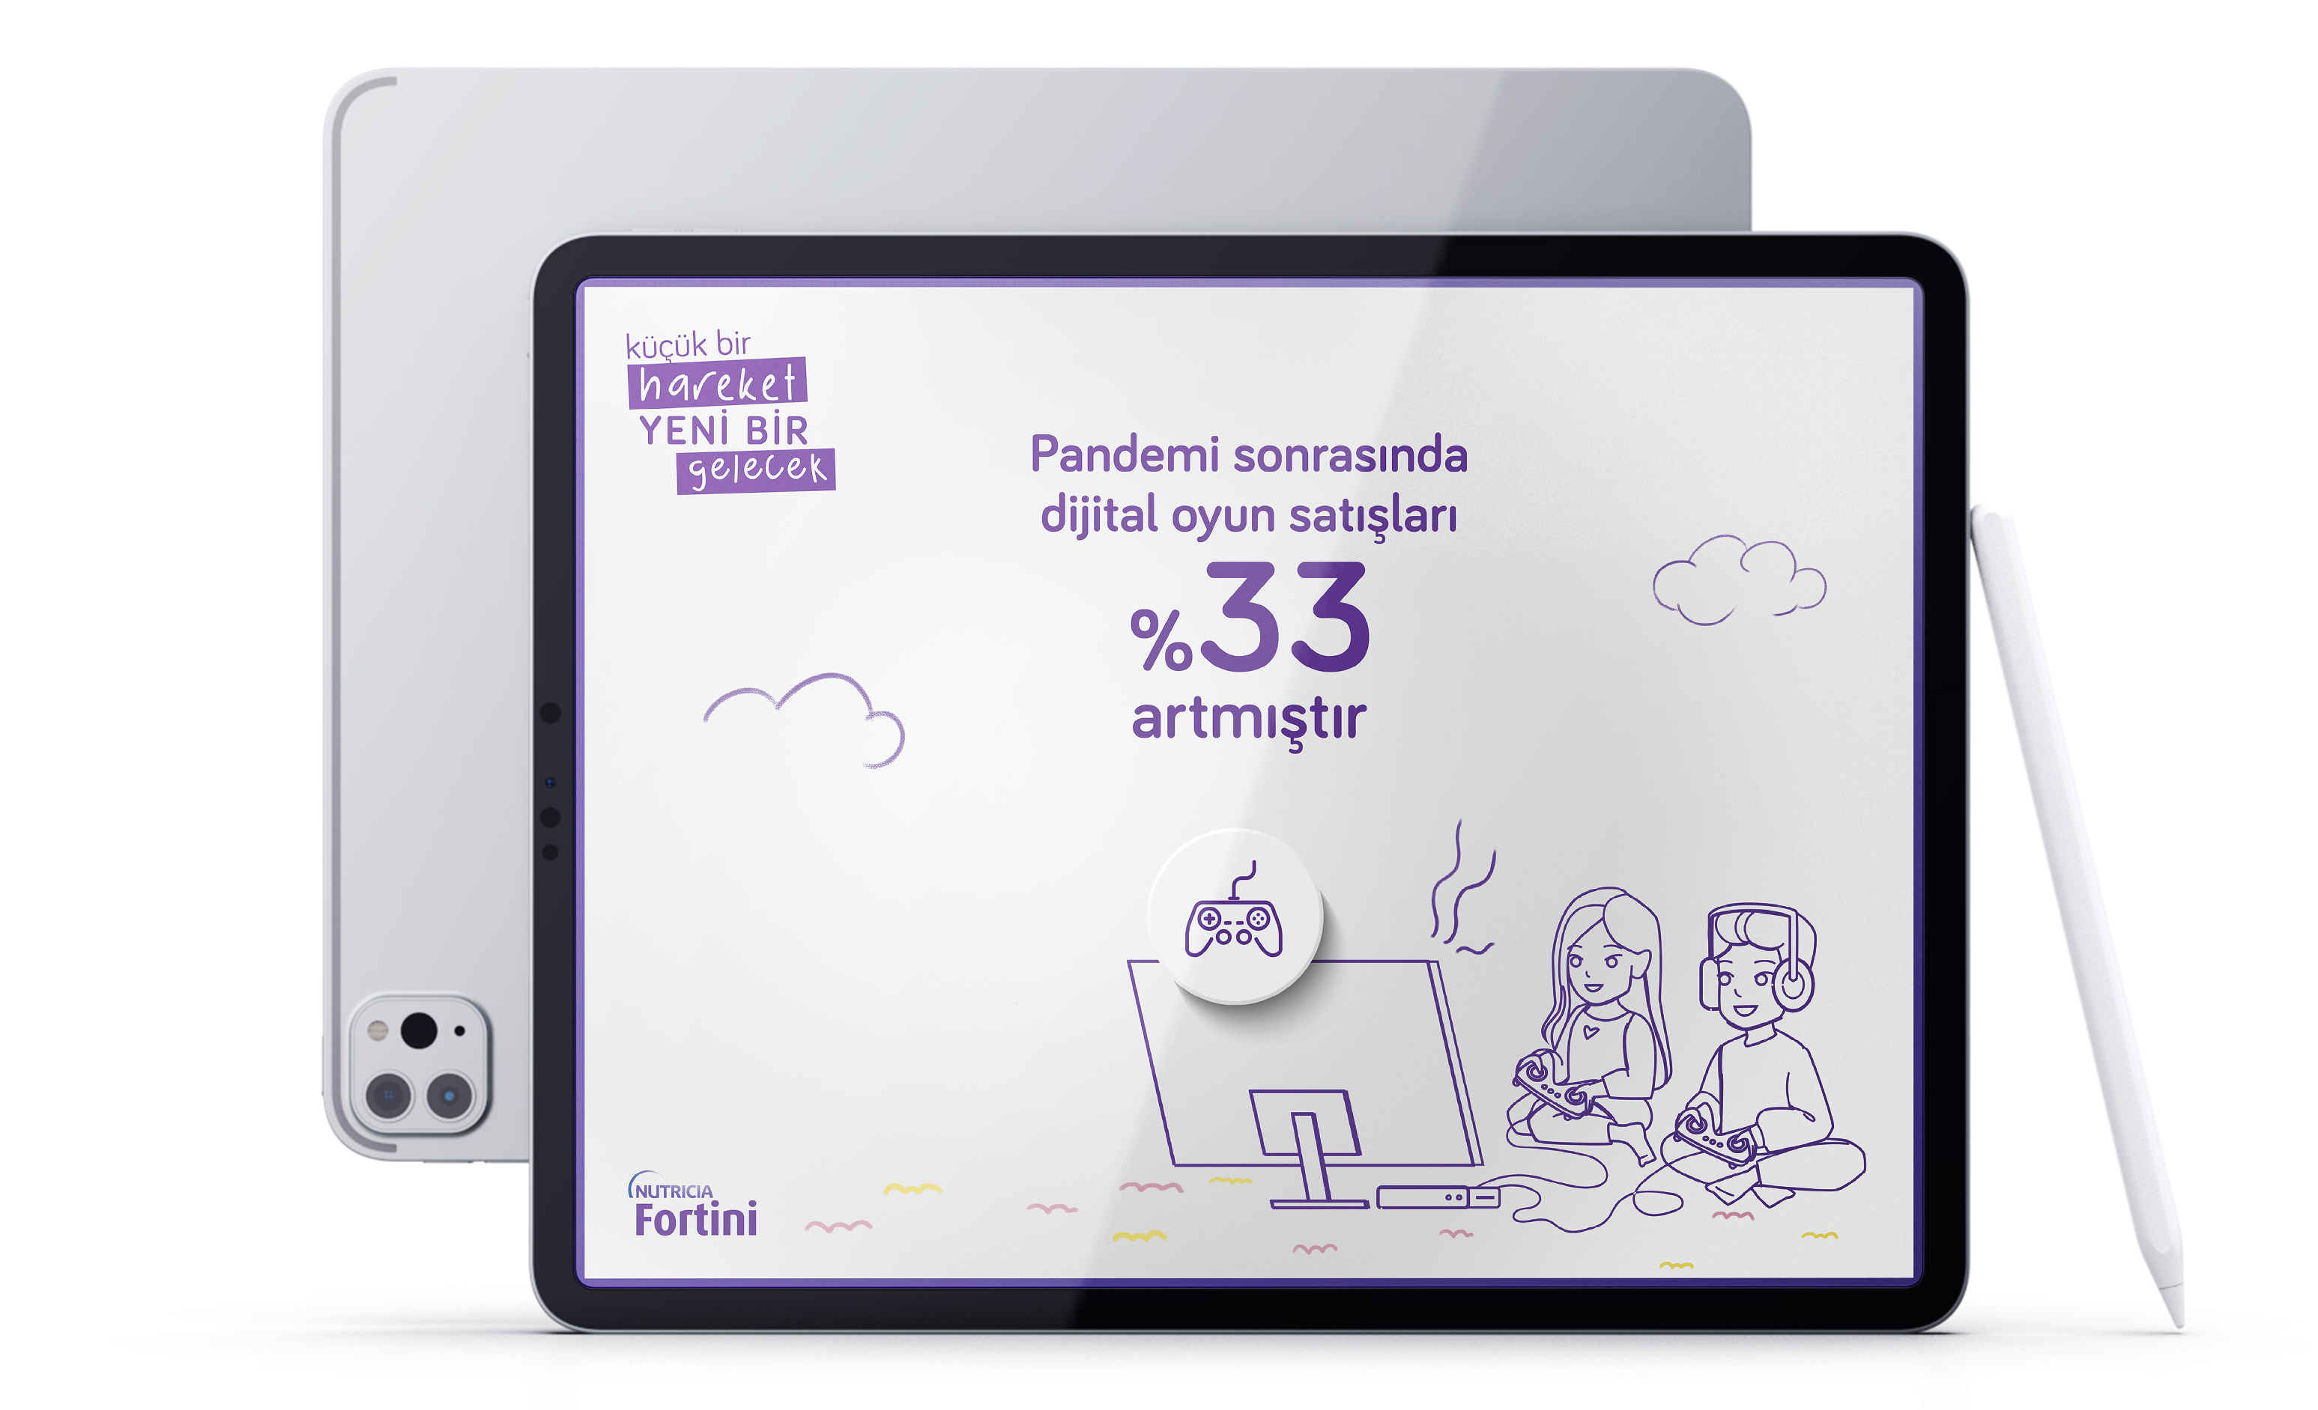
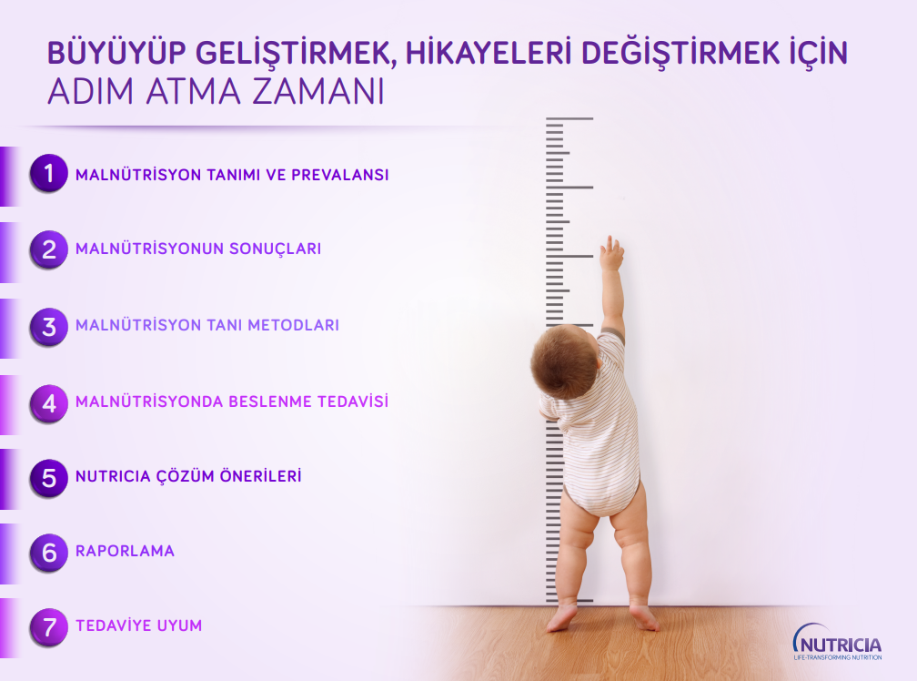
New communıcatıon materıals
MN definition and prevelence
Outcomes of malnutrition
Diagnosis methods
Nutrition methods
Nutricia portfolio
Prescription criterias
Adherence
TURKEY

Slide 6
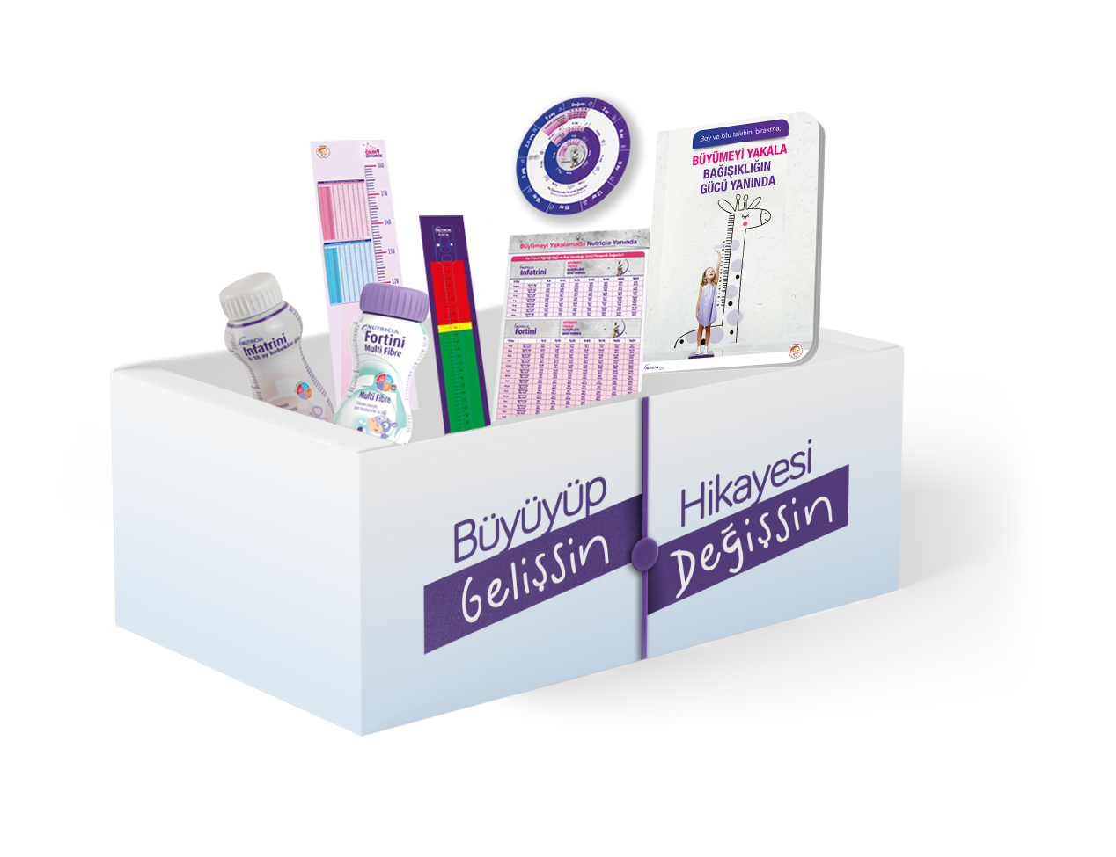
TREATMENT STARTER KIT
Diagnosis Materials
Persentile Materials
Treatment intiation Materials
Product İnforming Materials
TURKEY
Infantometer
Arm gauge
Head gayge
Persentil wheel
Persentil table
Persentil norebook
Blocknotes
Anamnesis form
Recipe booklet
Vademecum

Slide 7

TURKEY

