Slide 1


BEST PRACTICE: CHINA
Building the Fortini brand and increasing brand awareness

Slide 2
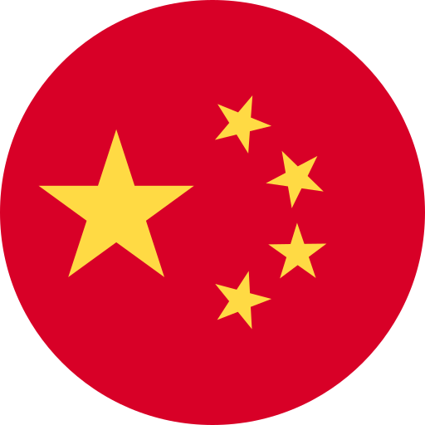

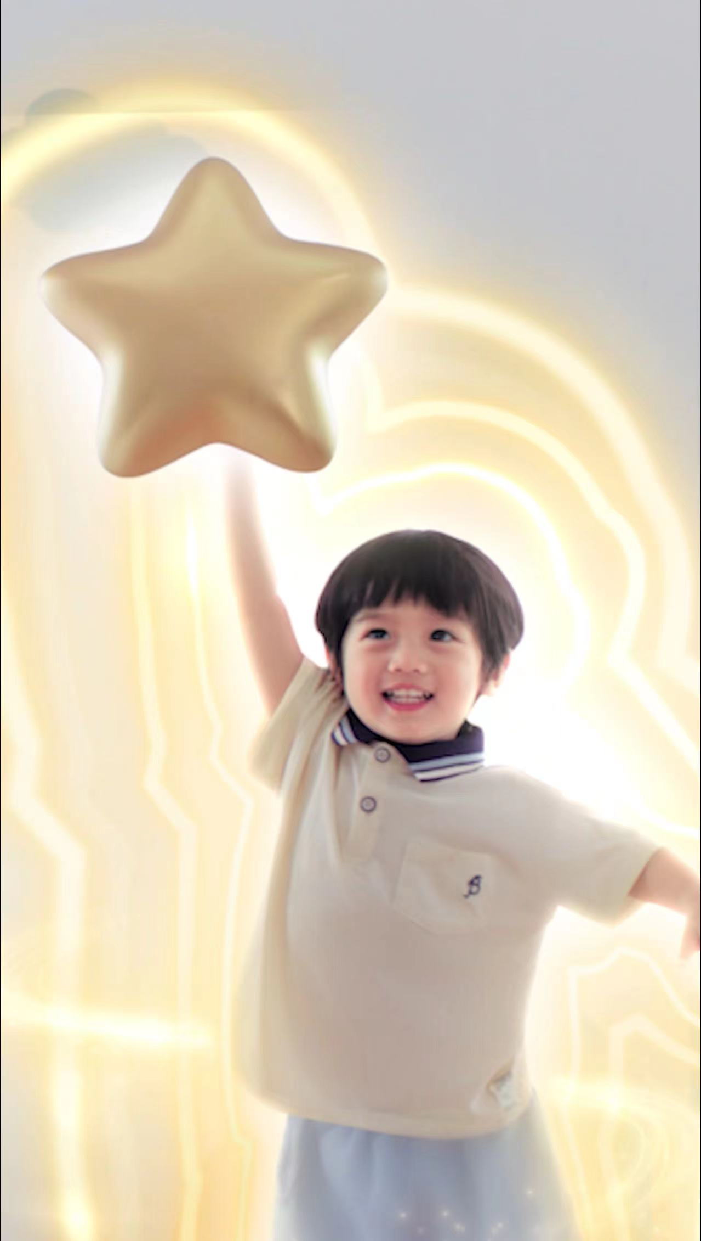

Fortini 1+ VI upgrade + BTS campaign
Result: GR +29%, MS( 27.3% historical high, +340BPS VS LM)
Background:
The challenge growth market is decreasing with YTD – 11.5% GR.
Intensive competition from 3+ children IMF with heavy media investment targeting with same TA;
Severe advertisement law regulation
Brand challenges: High reputation while low brand awareness + only online sales
Human insights: My kid is falling behind in growth. When he/she goes to kindergarten, I feel anxious about whether he/she is prepared. And I hope to find solutions to help get back on track.
How to build Fortini branding and increase the brand awareness and convert to sales?
Initiative:
NEW MSG: Sharpen the key msg to be different from IMF;
NEW IMAGE: new package with new VI/TVC + Testimonial video
NEW TOOL: consumer friendly growth tracker
4. NEW CAMPAIGN: back to school digital campaign
Key learning:
Fully leverage the medical equity to launch the consumer-centric marketing campaign to build the Fortini branding in the high- demand season.
Notes:
Limited chanel

Slide 3
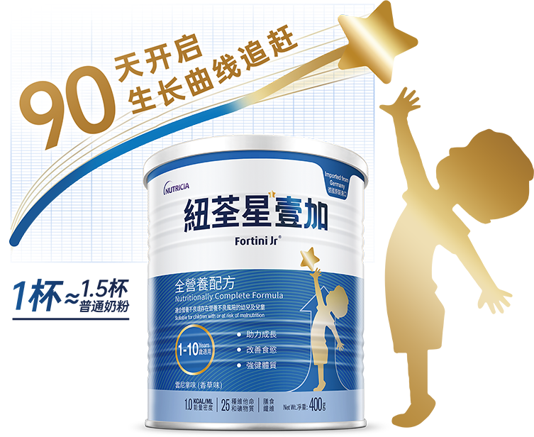
NEW BRAND ICONIC ASSETS AND MSG
Consistent msg and image in & out Msg across the consumer journey
Hospital
Chinese pediatrician use growth curve tool to diagnose the faltering growth
Consumer
lack of knowledge of faltering growth and scientific solution
Global
Brand NEW VI upgrade
Start catching up growth in 90 days
One cup ≈ 1.5 cup ordinary IMF

Slide 4
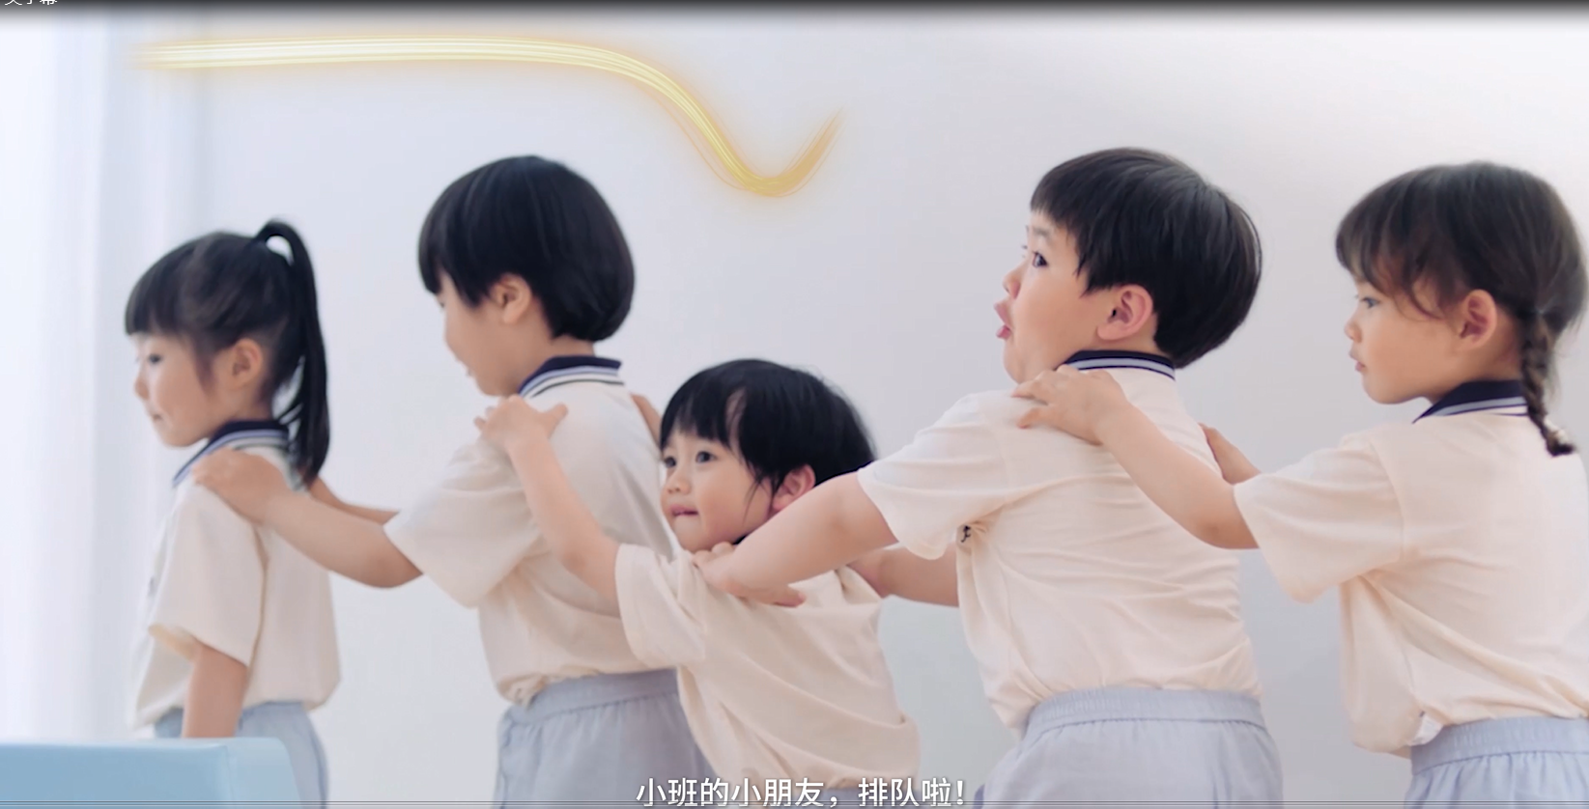
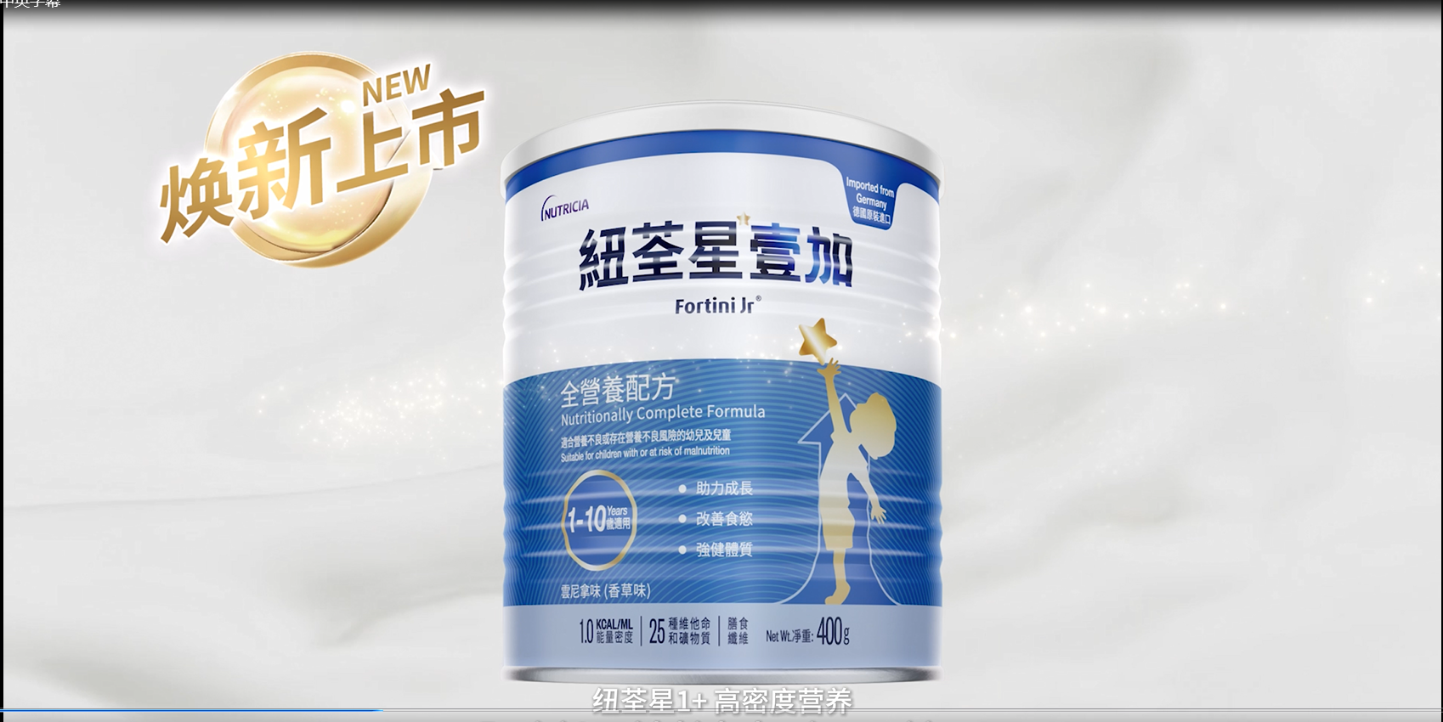
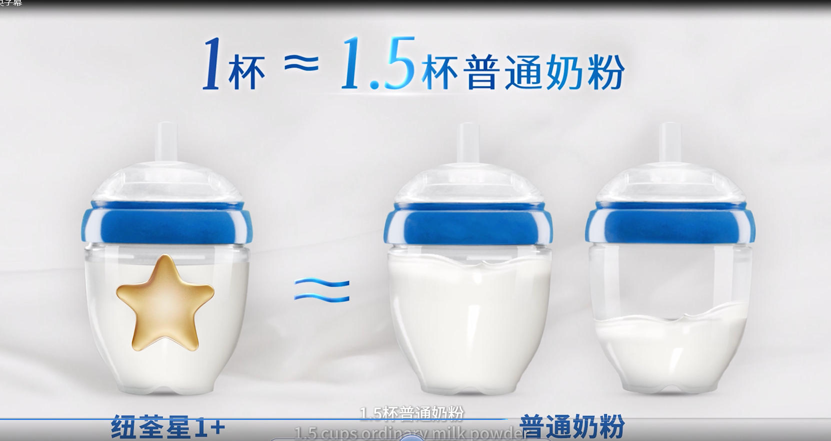
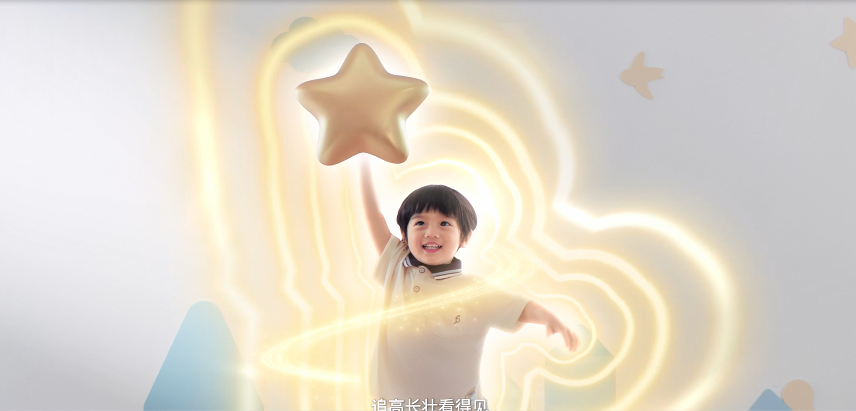
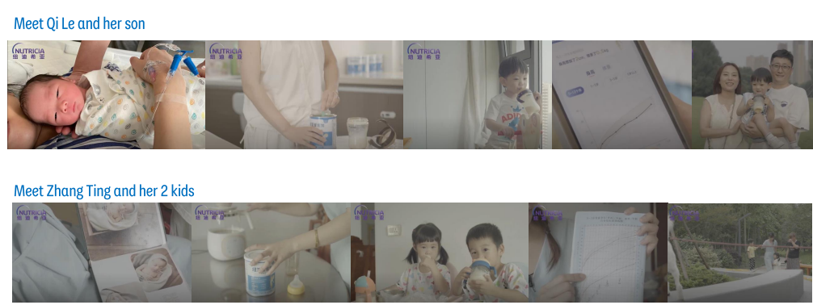
Brand Story
Consumer Story – testimonial video

Slide 5



BTS CAMPAIGN SOCIAL POSTER

Slide 6


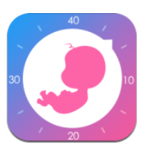

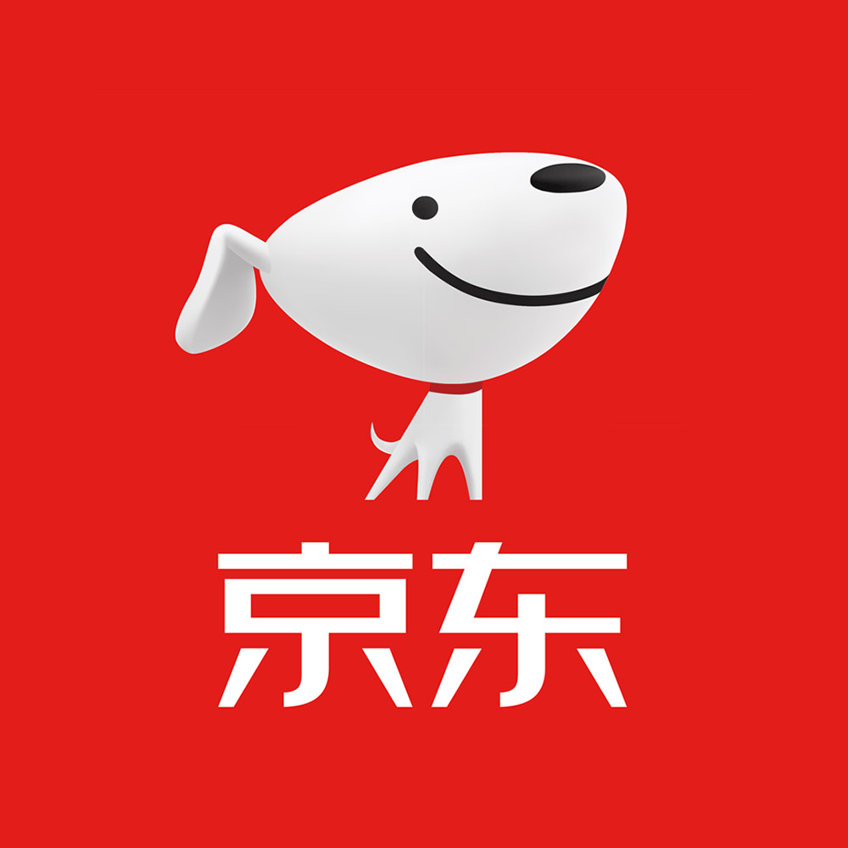
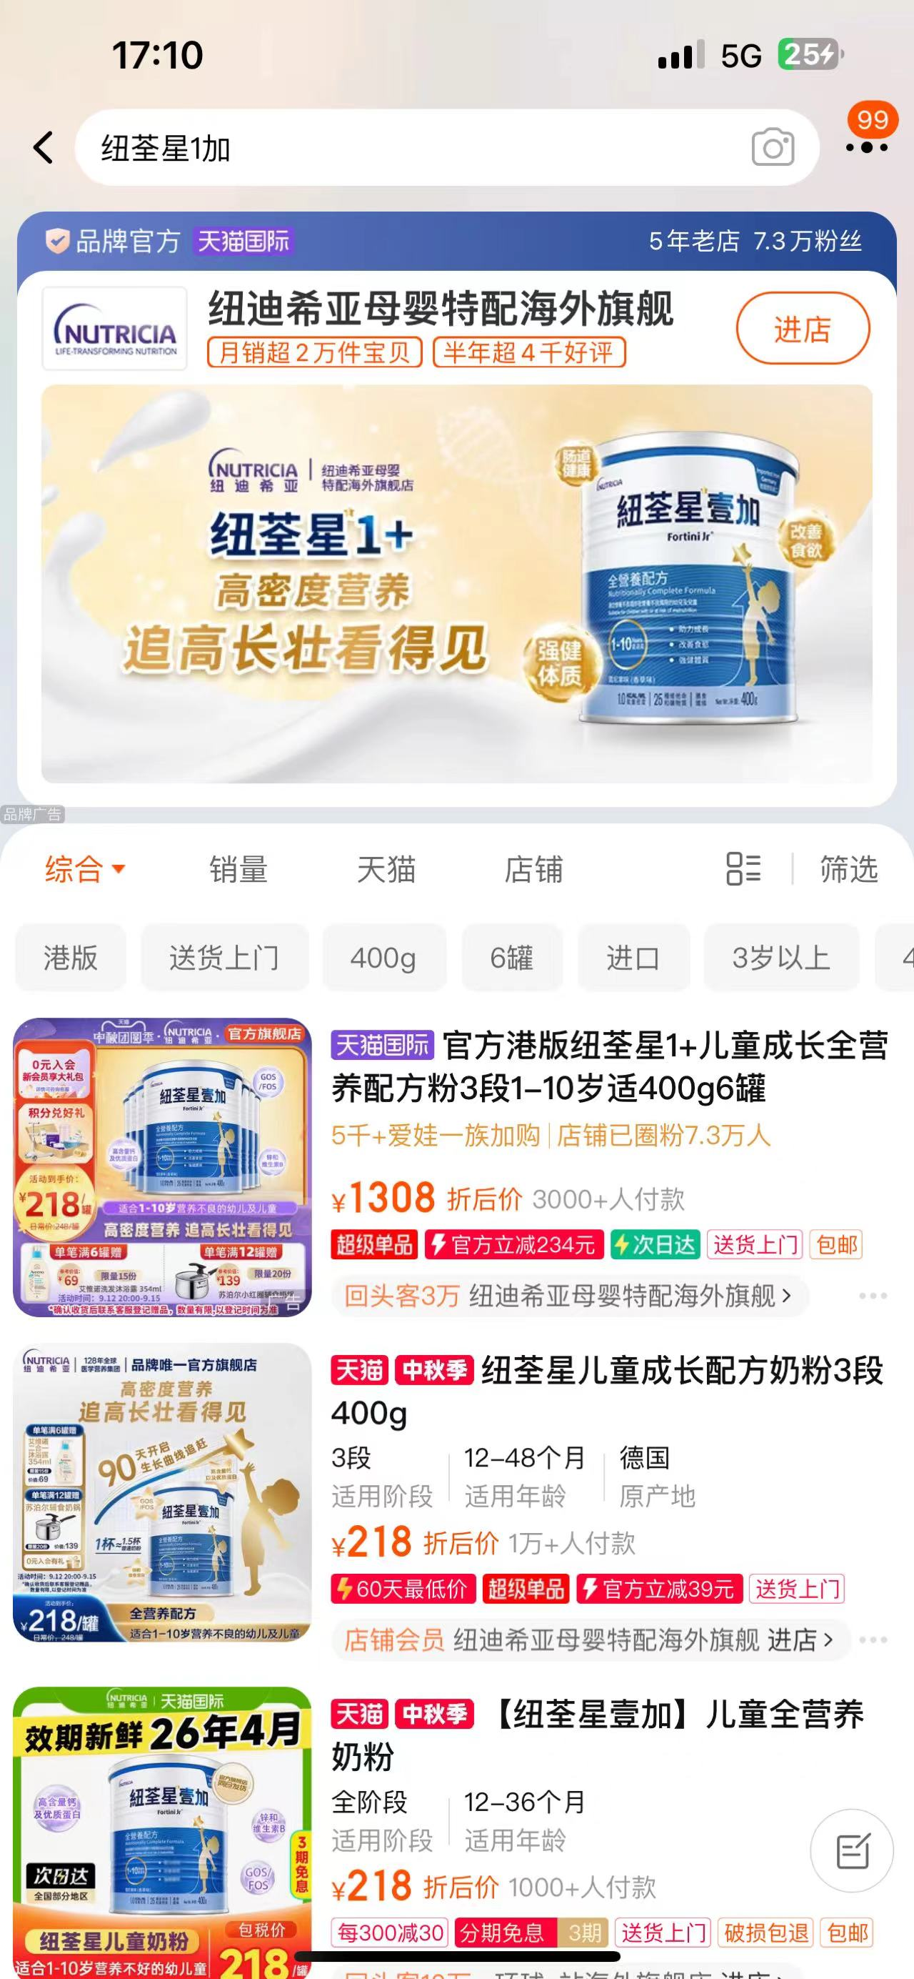
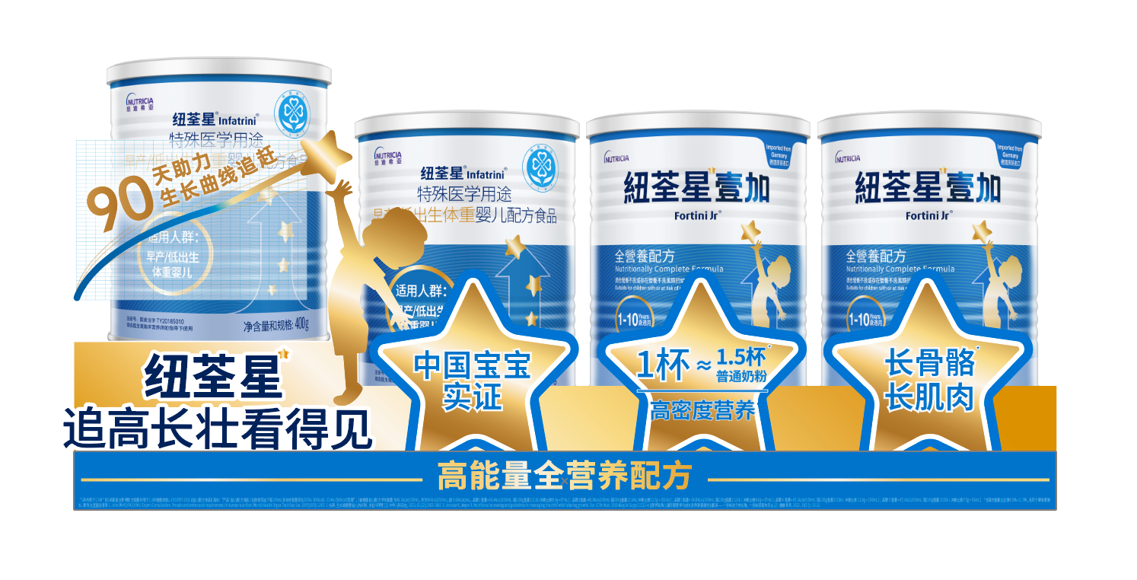
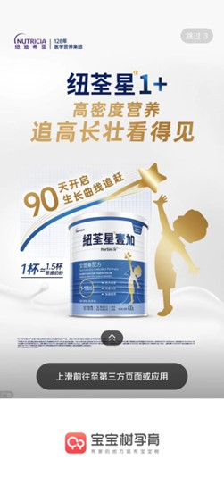
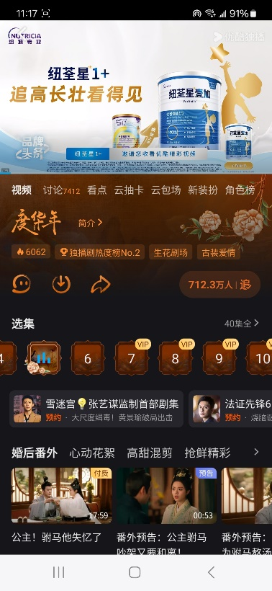

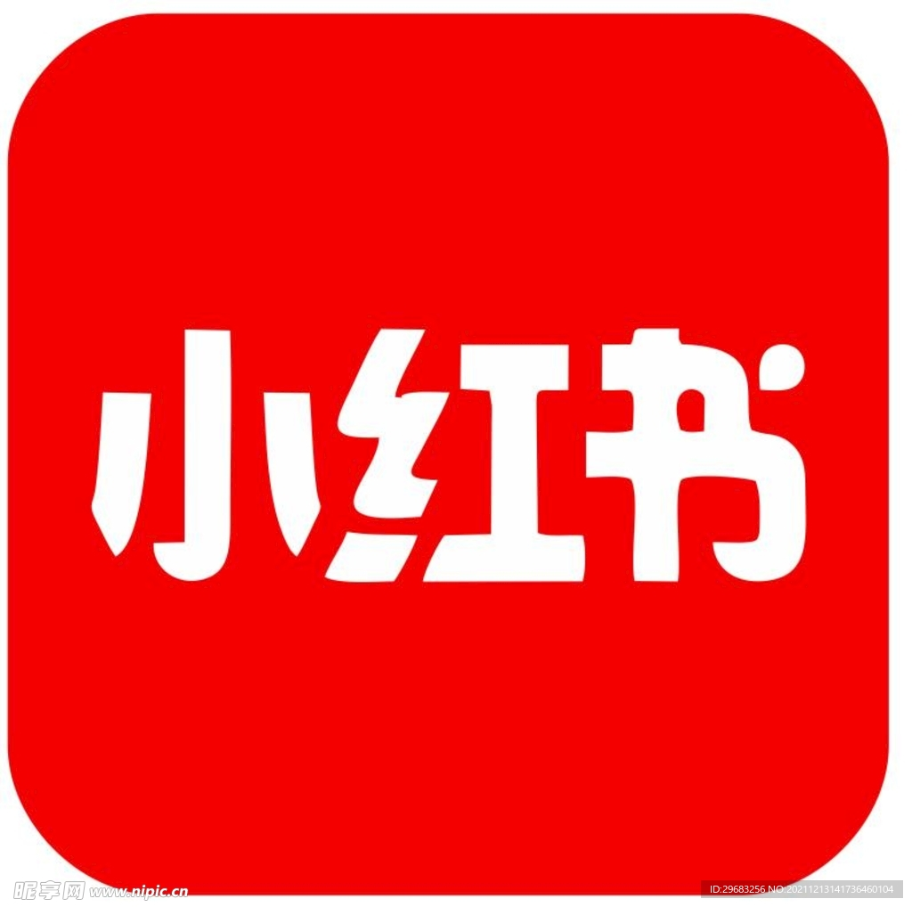
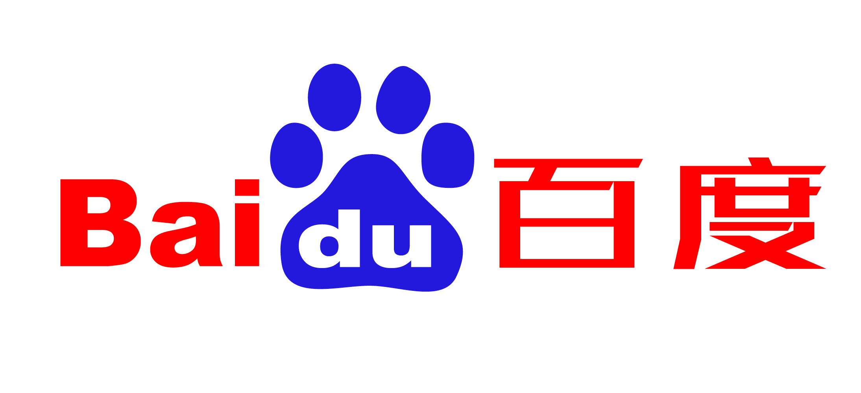


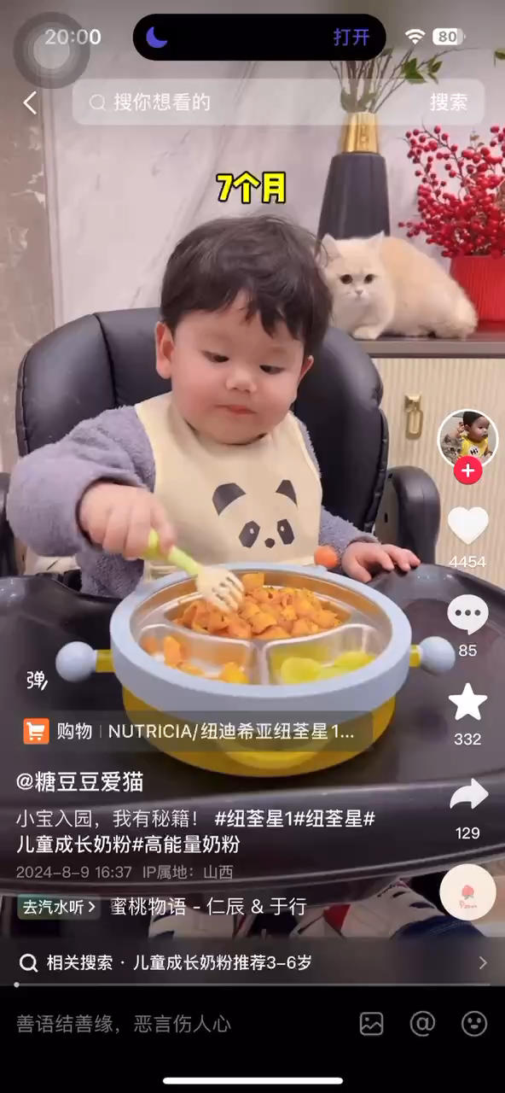
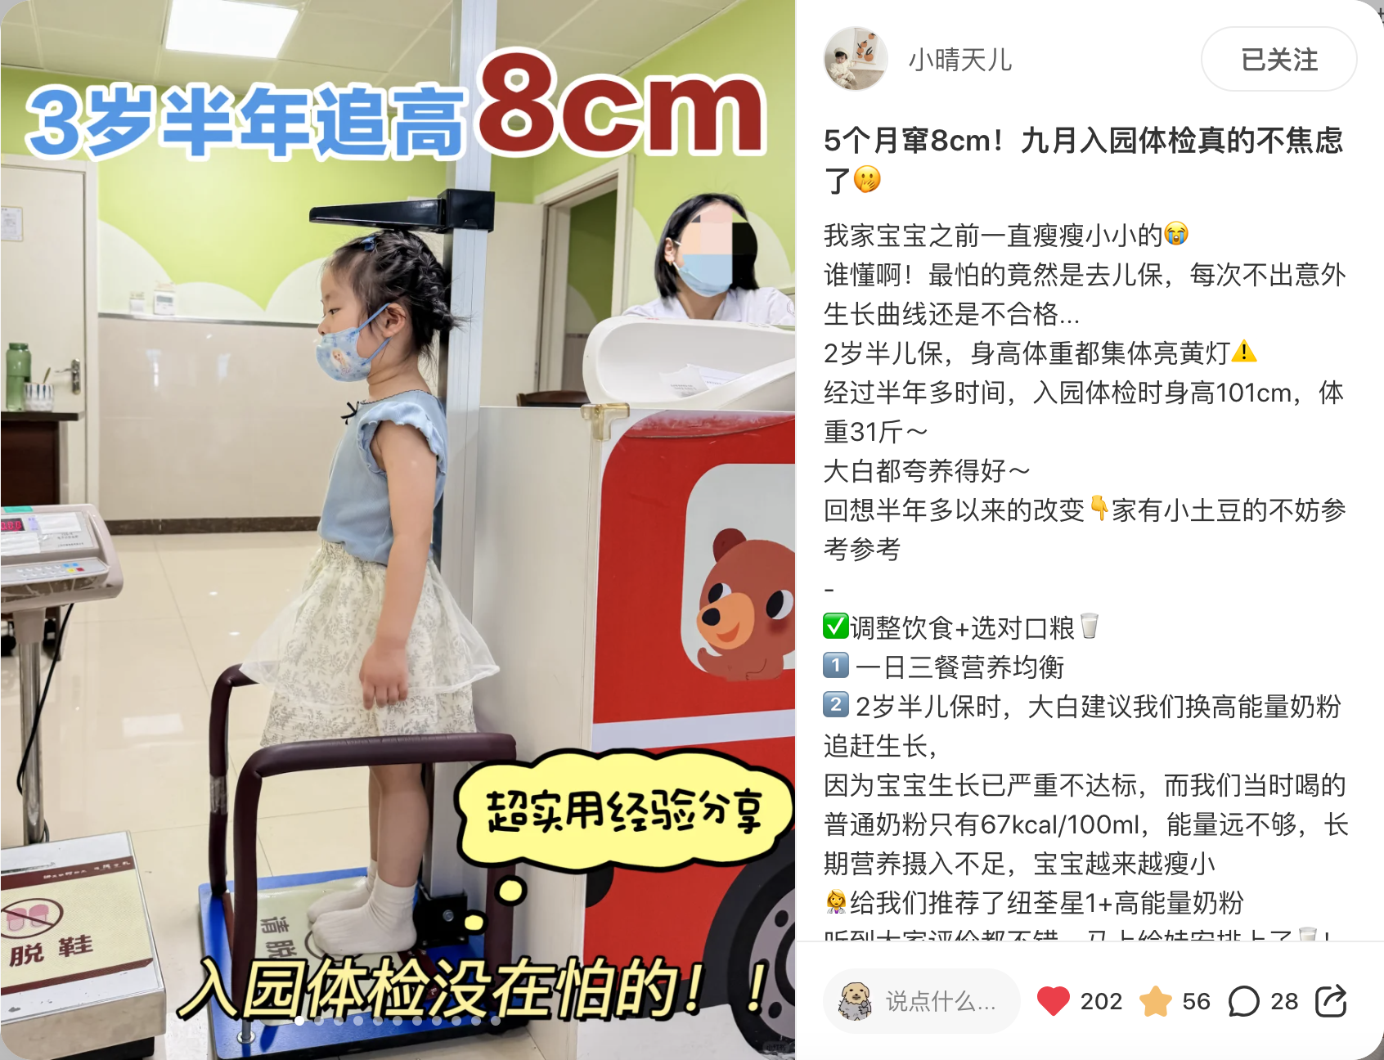
BTS SEASON CAMPAIGN HIGHTLIGHTS
Achieve total media impression 50 million+，clicks 4.6 million, EC traffic 0.6 million during back-to-school campaign*
、
Paid media adverting
OTV& BABY APP
Consideration
Action
Awareness
IN-store Excellence
(Online + Offline)
Mass media reach
KOL & HCP content
（vertical baby app & social media）

