Slide 1


BEST PRACTICE: DACH
ADHD activation through MCE campaign
2024

Slide 2
Type of initiation and TA focus | Strong holistic awareness MCE campaign with ADHD as hook for malnutrition
Need that was driving this / Objectives | Relevance: 1/3 of children have poor nutritional status at diagnosis Under medication, the risk increases further due to drug-induced loss of appetite and weight -> up to 50% are malnourished Loss of appetite and weight is the most common cause of early discontinuation of medication High public awareness for ADHD Biggest patient pool compared to other TAs (more than 182.000 patients, thereof 20.000 malnourished children) Goal: Pioneer in ADHD as market leader with our hero NutriniDrink Compact MF as focus product Approach: ADHD as hook for malnutrition Learning from field force that many community pediatricians see children with ADHD At the beginning of 2024, the TA was also extended to hospital pediatricians after feedback from sales force colleagues that not only is there interest in the new TA, but that children with ADHD are often treated in SPCs (social pediatric centers). Due to our other focus TA cerebral palsy, our sales force visited SPCs already. ADHD Roundtable: Gain insights at an interdisciplinary ADHD roundtable in March: patient journey, needs of HCPs and patients -> allow us to improve our campaigns and better target them to the needs of the HCP and patient group.​ Our biggest learning is that the experts also see the relevance of medical nutrition especially for ONS in this patient group, but they also see a big barrier in the prescribability of ONS due to high uncertainty among HCPs. Started to test the new target group psychiatrist through a mailing
Target audience | Community & hospital pediatrician, neuropediatrican, T&L new target group psychiatrist via mailing

Slide 3
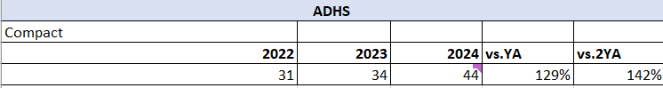
Budget and resources spent | Marketing & Medical A&P invest around 200k€, plus ADHD is part of the sales force call plan
Channels used | Sales force (hospital & community), media, print, mailing, ADHS Roundtable with HCPs
KPIs used to measure success | Development NutriniDrink Compact MF in k t (dry tons): Focus on NutriniDrink Compact MF for the following reasons. NutriniDrink Compact MF is ideal for ADHD patients: Small volume supports compliance Significantly higher energy and nutrient supply in just 4 weeks 300 kcal per 125ml bottle Mailing (after 5 weeks): Community pediatricians: 7888, 8% sample request, 1% newsletter registration T&L psychiatrists: 2400, 3% sample requests, 1% newsletter registration Benchmark for samle request around 2-3%
Outcomes
Duration of activation | Ongoing, still at the beginning in this TA
Insights and best practices learned | See above

Slide 4




Pioneering TA ADHD offers us great potential…
Drive HCP malnutrition awareness & intervention
up to 50%
MALNUTRITION IS A COMMON CHALLENGE IN ADHD PATIENTS
HIGH PUBLIC AWARENESS
FOR ADHD
PIONEER ADHD
AS MARKET LEADER

Slide 5


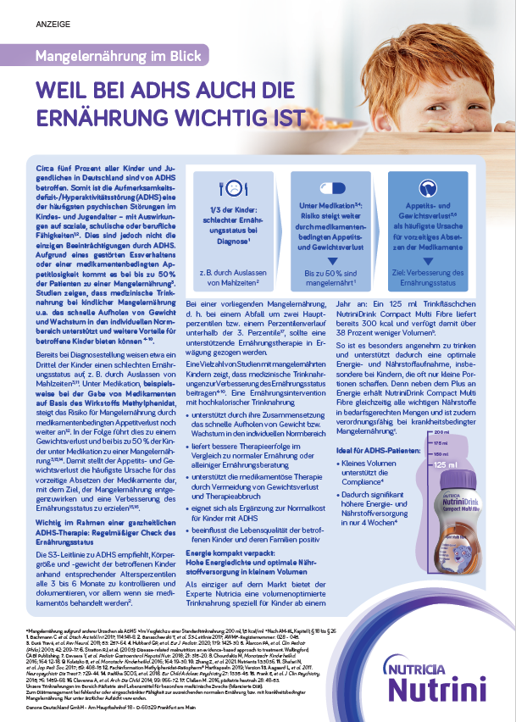
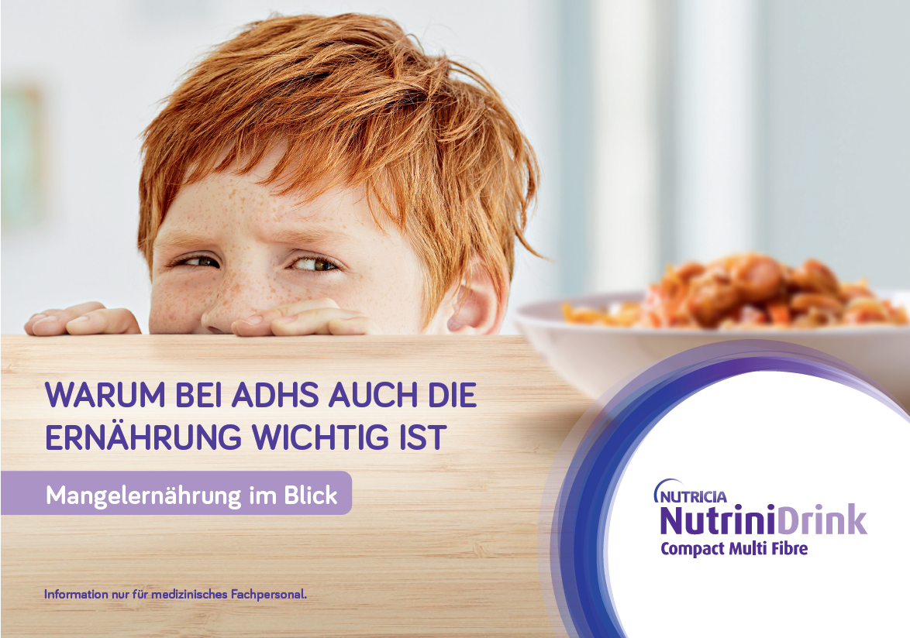


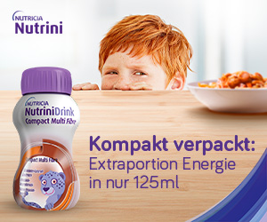

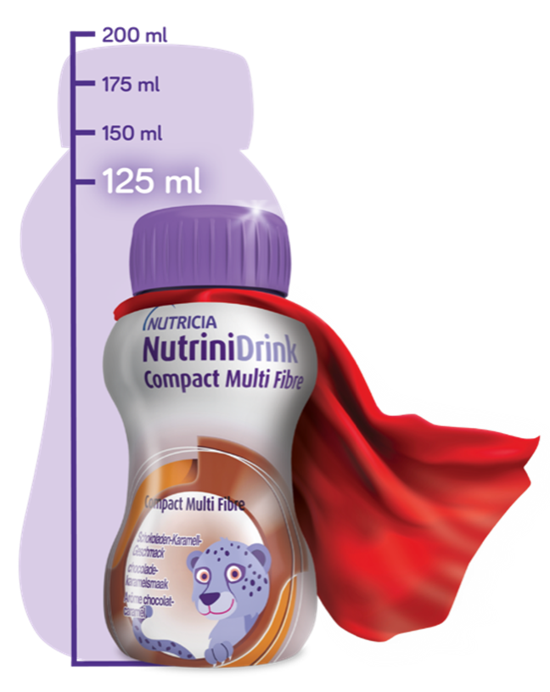



With our strong ADHD campaign we are ready to storm the HCP world
Drive HCP malnutrition awareness & intervention
Excellence in execution: Continuous optimization to maximize HCP experience & engagement

Slide 6

Drive HCP malnutrition awareness & intervention
Leveraging the potential of Existing & new target groups for ADHD
KEEP
ADD
START
COMMUNITY PAEDIATRICIAN
SPZ / NeuropAediatrican
PSYCHIATRIST
Continue to target
via Community SF
Add ADHD to call topics for SPZ & target via Hospital SF
T&L for psychiatrists via marketing measures
1st step: post mailing to further evaluate potential
HCP MCE campaign online & offline

Slide 7
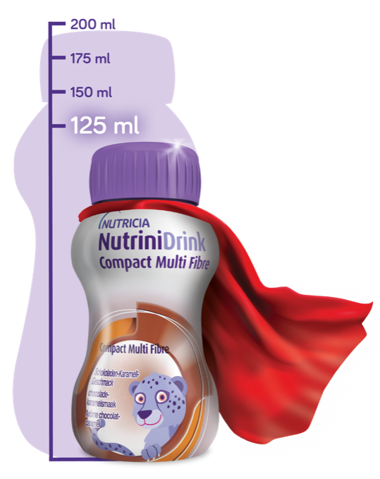
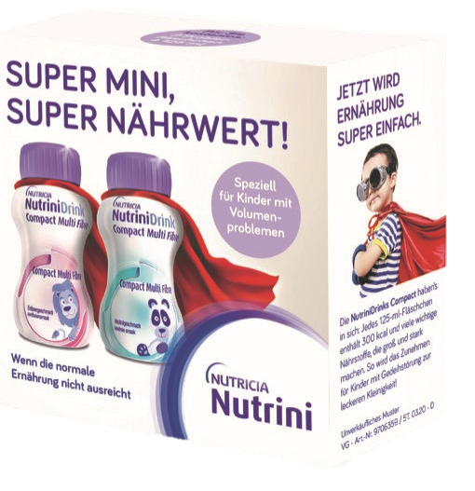
Drive HCP malnutrition awareness & intervention
… to Further leverage our Hero Product NutriniDrink Compact MF as unique Solution for ADHD children
+28%
Net Sales
Growth
YTD*
Most attractive
CO%
within Nutrini
USP
vs
competition
*nach AM-RL, Kapitel I; § 18 bis § 26
*Net Sales Compact MF YTD‘24 vs. 23

