Slide 1


BEST PRACTICE: DACH
Key success factors
Apr’24

Slide 2


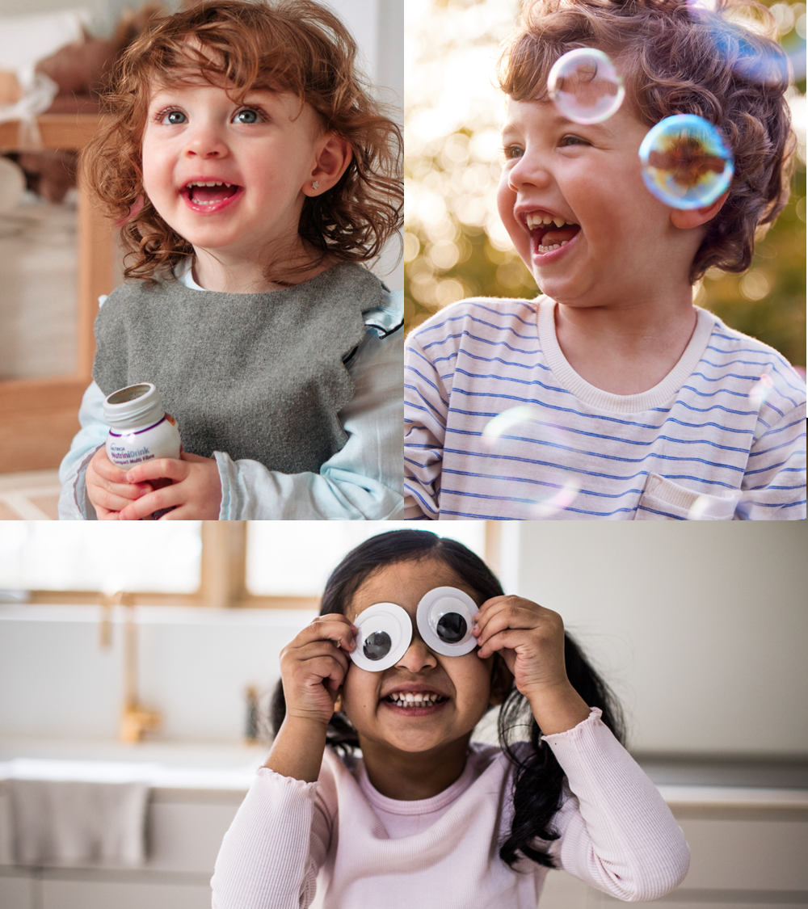




Top success factors
1
Push screening & awareness for malnutrition
Educate HCPs & parents on nutr. therapy
Offer superior portfolio & services
2
3
Frame followed
Clear choices of therapeutic areas
Clear demand generation model
Clear focus on Direct Homecare
Step-changed capabilities
Mindset² #nolazyleader
OCE mindset & capabilities

Slide 3
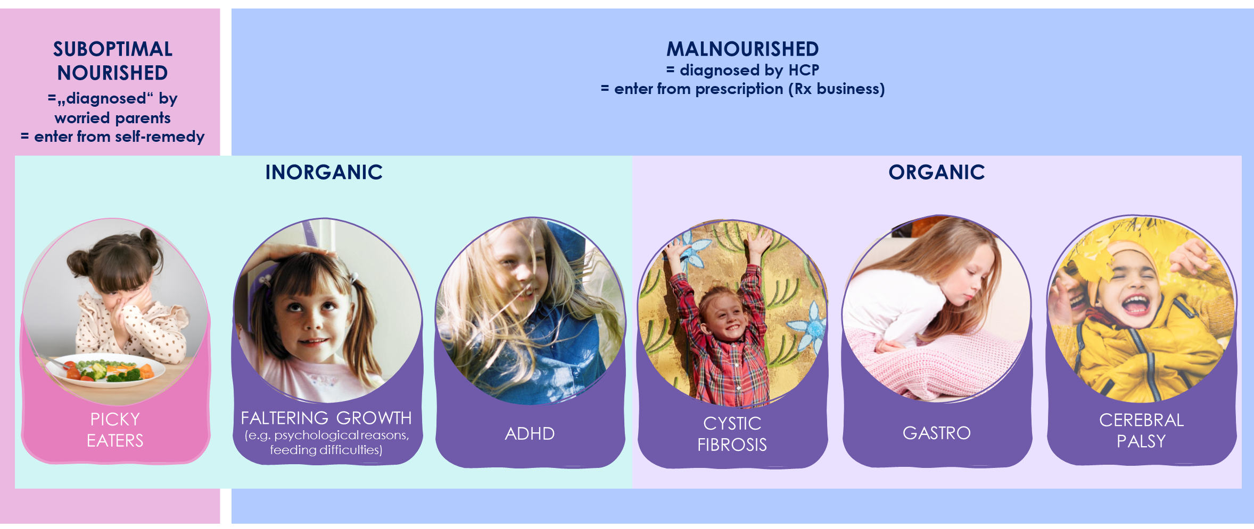
GROWTH CATEGORY IS DRIVEN BY TA ACTIVATION: continued BIG headroom in our strategic playing Fields

Slide 4



The clarity on the demand generation model helps us unlock further penetration
SCREENING
DIAGNOSIS
INITIATION
TREATMENT
Paediatrician Community & Hospital
Further HCPs involved: Gastroenterologist, Neuropaediatrician, Dietitian, other specialists
Lack of awareness for malnutrition;
No standard screening (hospital)
Lack of relevance & benefit of med. nutrition
No time for continuous care & support
Barriers
Lack of awareness of malnutrition signs
& how to identify
Emotional barrier & strong desire for normality
Compliance barrier:
lack of motivation
Barriers
Biggest growth opportunity
Drive regular screening for malnutrition
Boost HCP and parent awareness for malnutrition & importance of nutritional therapy
Drive awareness and preference for medical nutrition therapy
Nutrini as BOFC
Win more patients into own Homecare Service
Drive compliance and patient LTV

Slide 5
The clarity on the demand generation model helps us unlock further penetration: HCP coverage
SCREENING
DIAGNOSIS
INITIATION
TREATMENT
Paediatrician Community & Hospital
Further HCPs involved: Gastroenterologist, Neuropaediatrician, Dietitian, other specialists
HCP
Current HCP coverage
Universe
Num
Coverage
Coverage
of potential
Universe
Num
Coverage
Coverage
of potential
Outpatient Centers
Universe
Children’s Hospitals
340
317
90%
130
98
85%
Universe
CF
Ambulances
91
73
98%
Paediatric Practices
4,400
3,600
91%
Paediatric IC Services
400
20
30%

Slide 6




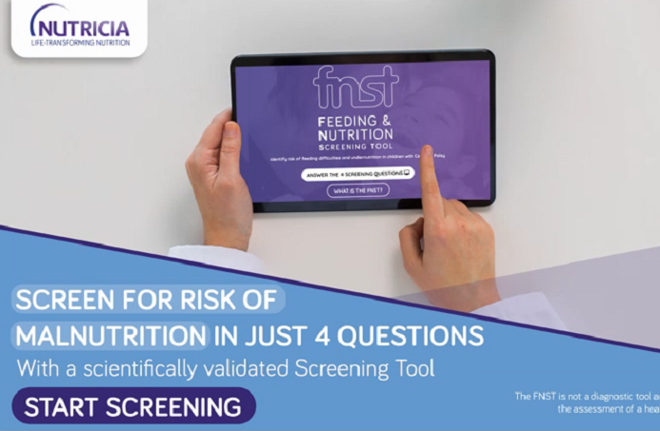
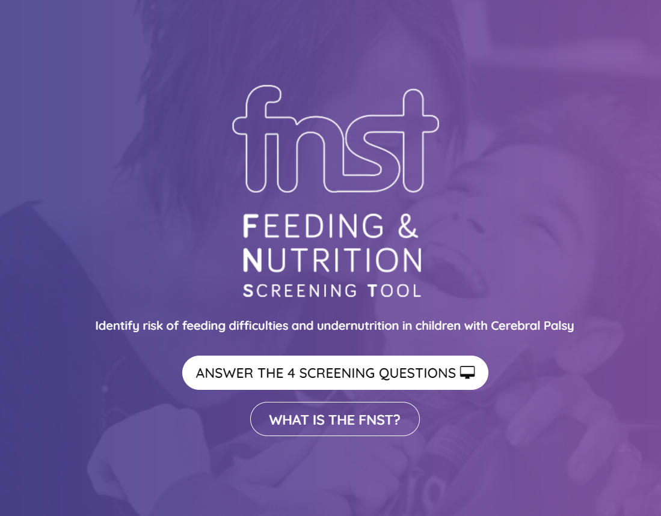
Drive Penetration by leveraging our unique validated screening tool FNST for our biggest TA cerebral palsY
Screening durch versch. Aktivitäten unterstützen, Tool als hook, Screening Days overall (generell) FNST dedicated für Neuropädiatrie weil größe ZG, USP ggü, competition validiertes Screeningtool in Zusammenarbeit mit KOL
Key Messages auf Folie
Kinder früher identifizieren & in unsre Reise starten
Switch zur Sondennahrung früher
-> Penetration treiben
Flow:
feeding and nutrition screening tool in collaboration with a KOL (FNST) dedicated for CP patients make it easy to assess nutrition status
CP wichtigste Zielgruppe mit dem größten Potenzial
Warum machen wir das? Mangelernährung unter CP Patienten entdecken bzw früher in unsere Reise bringen
Was erhoffen wir uns? Increase penetration
Weitere Medical Aktivitäten z.B. Fachpublikation zum FNST, Akademien, KOL Roundtable und CME accredited education tool
01 unlock penetration
Unique scientific screening tool delevoped in collaboration with leading KOL
Identify malnourished CP Patients in early stage
by
Simplify transition to tube feeding
NO REGULAR SCREENING &
LACK OF RESSOURCES

Slide 7

Grow Penetration By Meeting Patients desire for Normality….
01 unlock penetration
Aktuelle situation der eltern & HCP
Geht um normality, aktuelle hürden
Strong wish for normality
Too late/no intervention
as patients & parents often reject the use of med. nutrition
Med. nutrition is seen as artificial and far away from normal food
Believe that natural ingredients are
better tolerated
Parents want to fulfill their duty to care & feed their child
Increasing switch
to blenderized diet

Slide 8
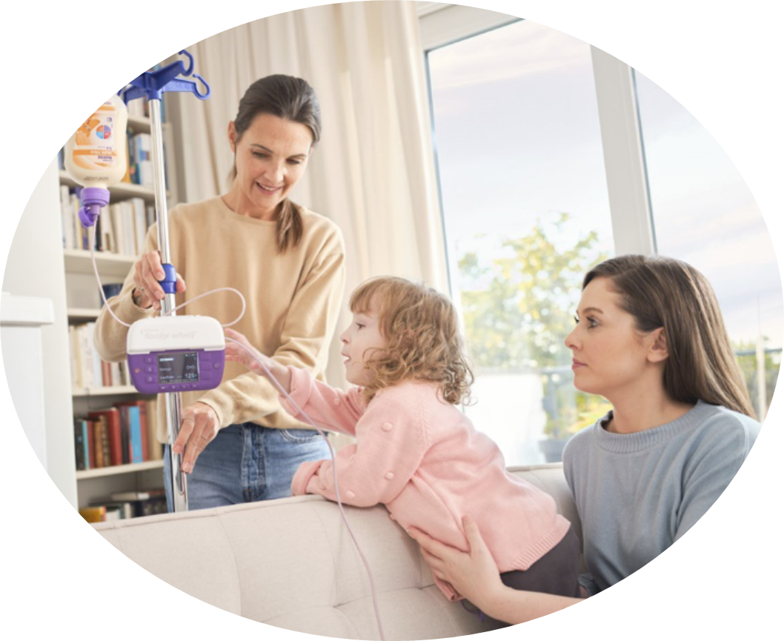




Unique Service with skyrocketing growth: Our ET Junior
02 MAKE NUTRINI FUTURE PROOF
Biggest growth driver
Unique service
+25%*
NEW
PATIENTS
Attractive
margin
sharpened value proposition in 2023
*Paeds new patients in ET Jr. MAT 05.24 vs. MAT 05.23

Slide 9

We will continue driving double digit growth for Nutrini in DACH by pushing penetration & strong TA Focus
2027
50,0 Mio€
+13,9%
+13,0%
2026
43,9Mio€
+11,9%
2025
38,9 Mio€
+ 15,0%
2024
34,7M€
Surpassing growth of Nutrison, Flocare, Milupa Milks, Neocate
2023
28,6M€
2022
25,2M€
MS
>88%
based on strat plan 24-27
Notes:
Based on strat plan May 2024, CAGR 12,9% (DEU)

