Slide 1


BEST PRACTICE: INDONESIA
Dual brand strategy
2024

Slide 2

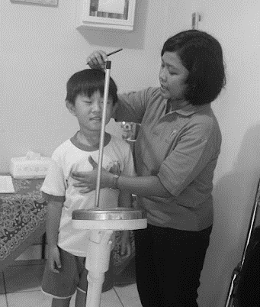

ID Faltering Growth Dual brand strategy
DRIVER: LEAD POINT OF INITIATION
Flag of country
PLAY TO WIN IN SPECIALIZED NUTRITION
2

Slide 3
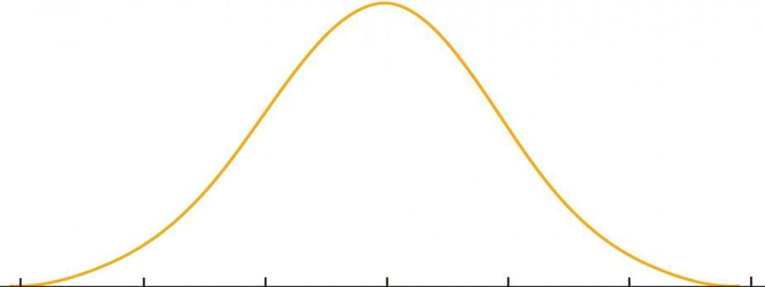

BIG HEADSPACE, BIG OPPORTUNITY: INDONESIA’S FOCUS IS ON ACCESSIBILITY, DIAGNOSIS AND AWARENESS
Flag of country
CONTEXT & POWER QUESTION
4 M
Children with Stunting¹
1.3 M
37% Screened & Diagnosed²
130 K
10% NDF Rx³
104 K
80% Compliance⁴
3.5 M
85% Visit to HCF²
2
3
1
4
Initiation
Extending the journey
Indonesia Stunting Journey
Awareness (Origination)
Screening & Diagnosis
Access to Treatment
3
2
Adherence
Key Drivers:
Moms care to children growth & development
Key Drivers:
HCPs are open for screening tool
10% HCP treatment using FSMP; 90% Core IMF
Consumer Barriers³:
Taste
Price
No perceivable impact on child’s growth
Availability in retail channel
1a
1b
Private Market
Reimbursement Market
Key Drivers:
Clinically proven
In national guideline
Key Barriers:
NDF is last option
Key Drivers:
Stunting is national priority agenda
Key Barrier:
1st line treatment with local food & biscuits
Key Barriers:
Moms know the word stunting but not the manifestation
Key Barriers:
Wide coverage of HCPs and multisectoral touchpoint
HCP
Influence
Pediatrician (65%)
Midwives (35%)
General Practitioner (15%)
Other HCPs (5%)
*Dinkes: District of MoH
Ref: 1. SKI 2023; 2. ACS 2023; 3. Purple Study (IQVIA) 2024; 4. Devaera et al. PGHN, 2018
3

Slide 4
WE ARE IN THE RIGHT TRACK TO CAPTURE MARKET POTENTIAL WITH AGGRESSIVE TRAJECTORY
CONTEXT & POWER QUESTION
We aggressively aim for 50% market penetration by 2030 to capture huge potential business size
Total Faltering Growth Market Users Potential (Children)
~10x vs 2023
2030
150mE
To 1 mio Danone FG users
Double the size in 2Y
2025
36mE
Danone FG Users Growth
Danone Market Penetration
+50%
2023
7%
4%
9%
6%
16mE
+50% Vol Growth in 2024
6% Danone penetration vs headroom
+2% market penetration (9% vs 7% LY)
Assumption: Competitor Vol inc by 8%
From 100k Danone FG users

Slide 5

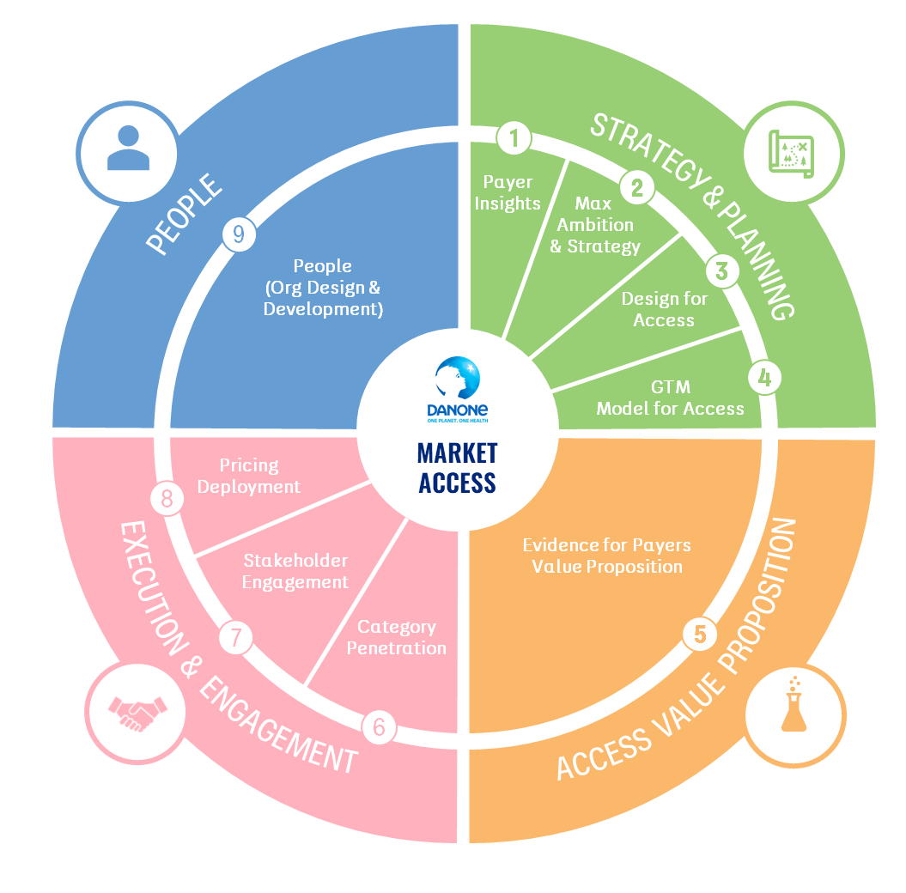
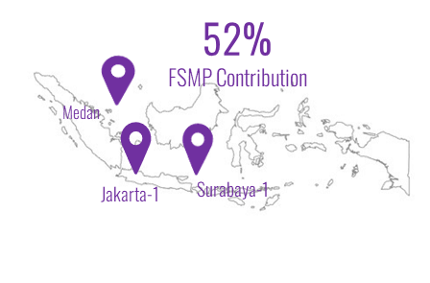

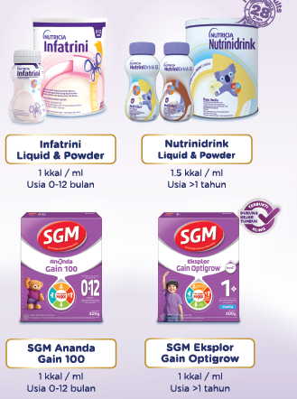




WE HAVE STRONG ASSET & CAPABILITIES DEVELOPMENT THAT ENABLE SOLID PERFORMANCE
Flag of country
INITIATIVE
OUR PEOPLE
OUR PRODUCT
OUR SYSTEM
OUR RTM MODEL
Strengthen Fundamentals
(FSMP Dedicated Reps)
Dual Brand Strategy:
The Most Complete Growth Portfolio in the Market
Market Access Capability Framework
MCE + HCEM 2.0
The highest score in Danone
WA Business
Landing Page
Email
Strong expansion in digital channel to drive brand adoption
Pilot: Dedicated FSMP Reps with more scientific content and tools
Sales Response Model (MMM)
Assess 9 key capabilities for Market Access to ensure “future fit”
All Investment
lead to positive ROI

Slide 6


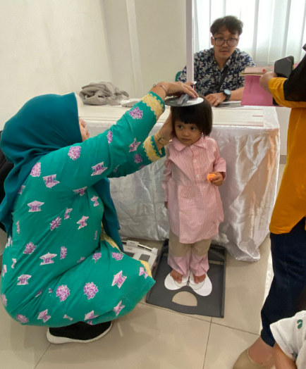
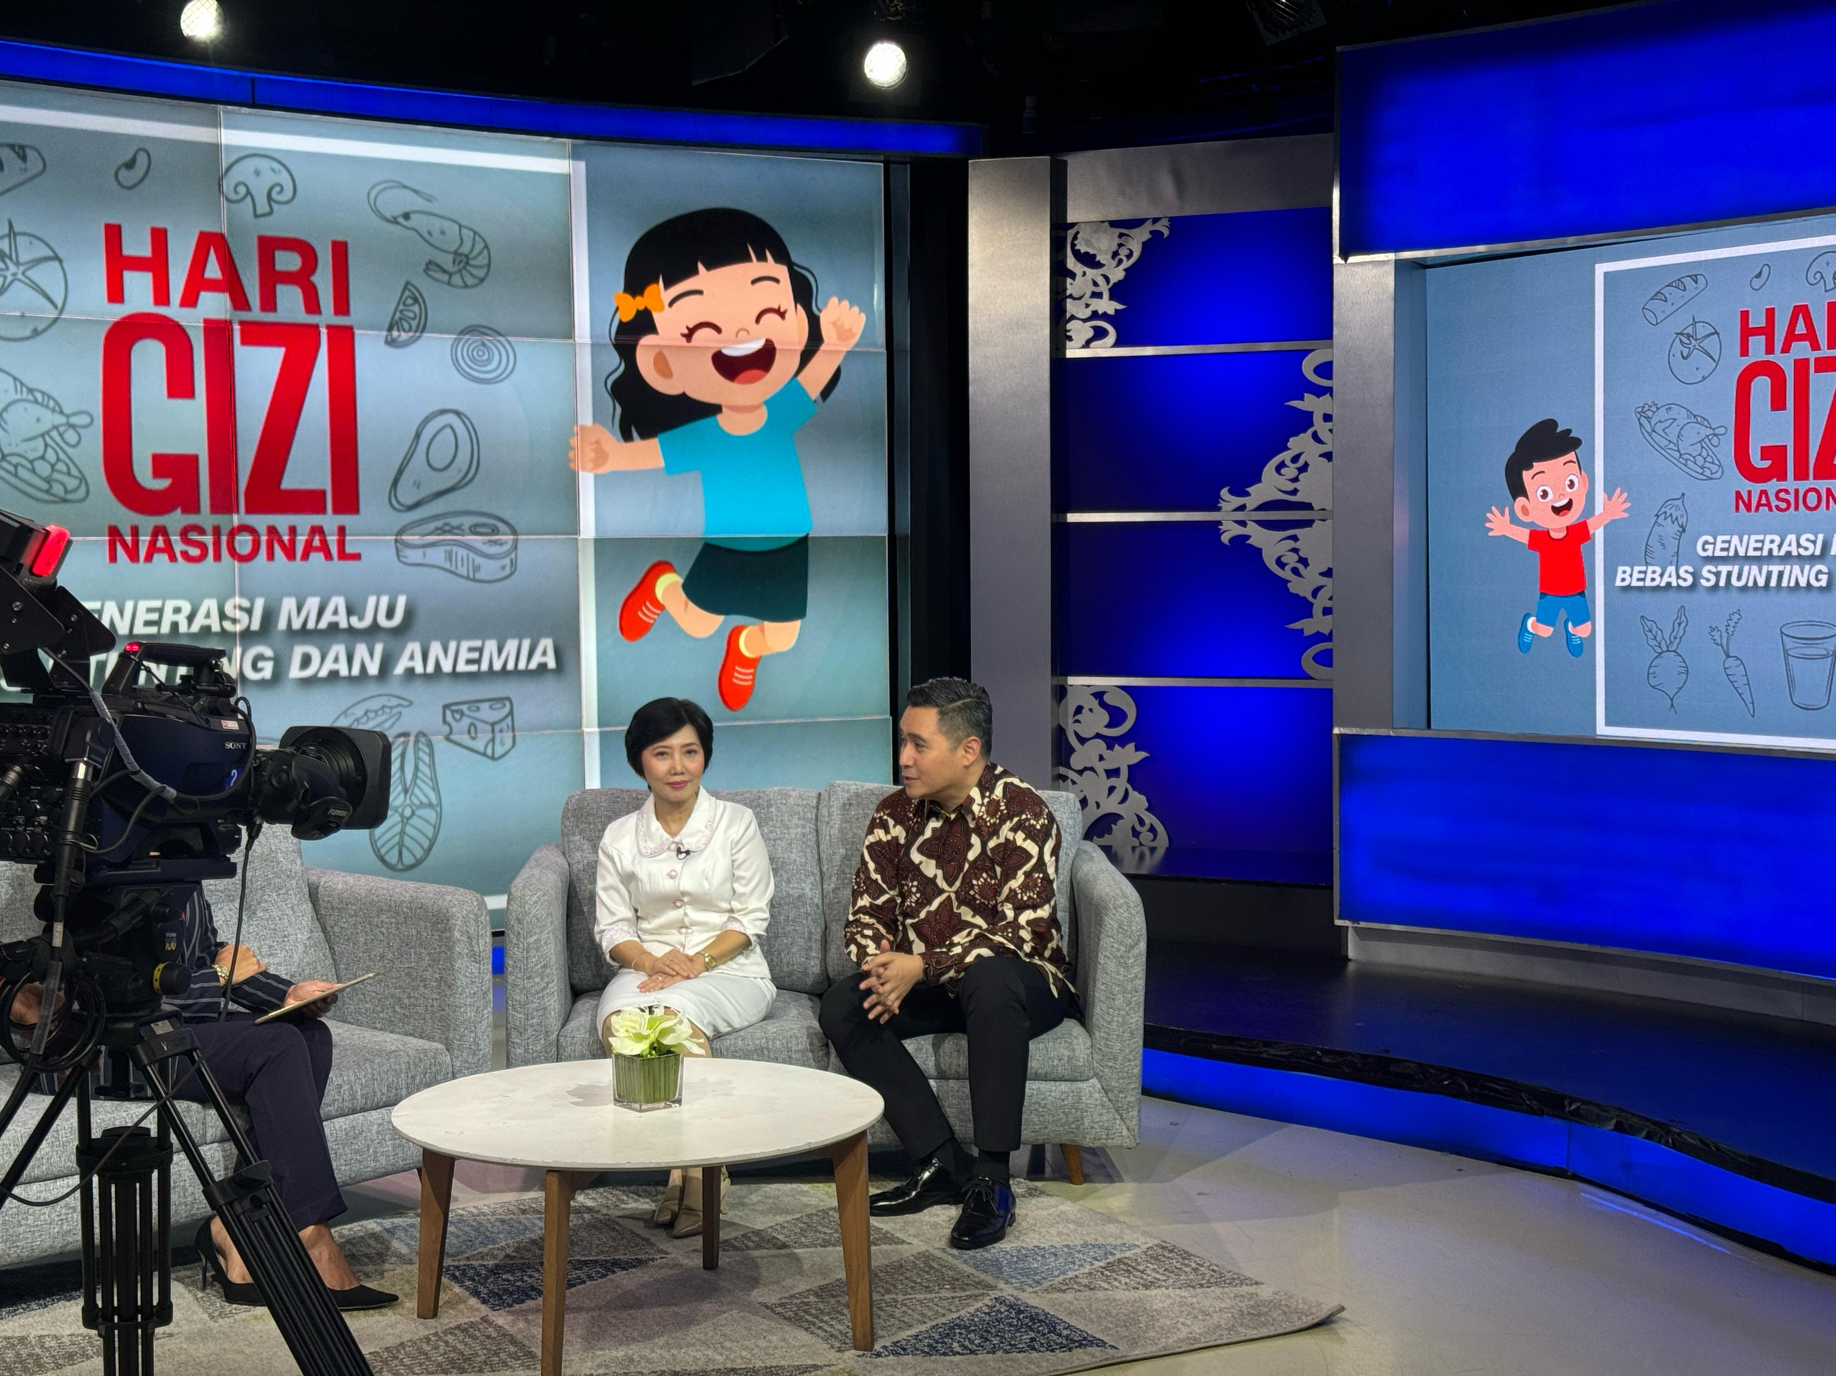
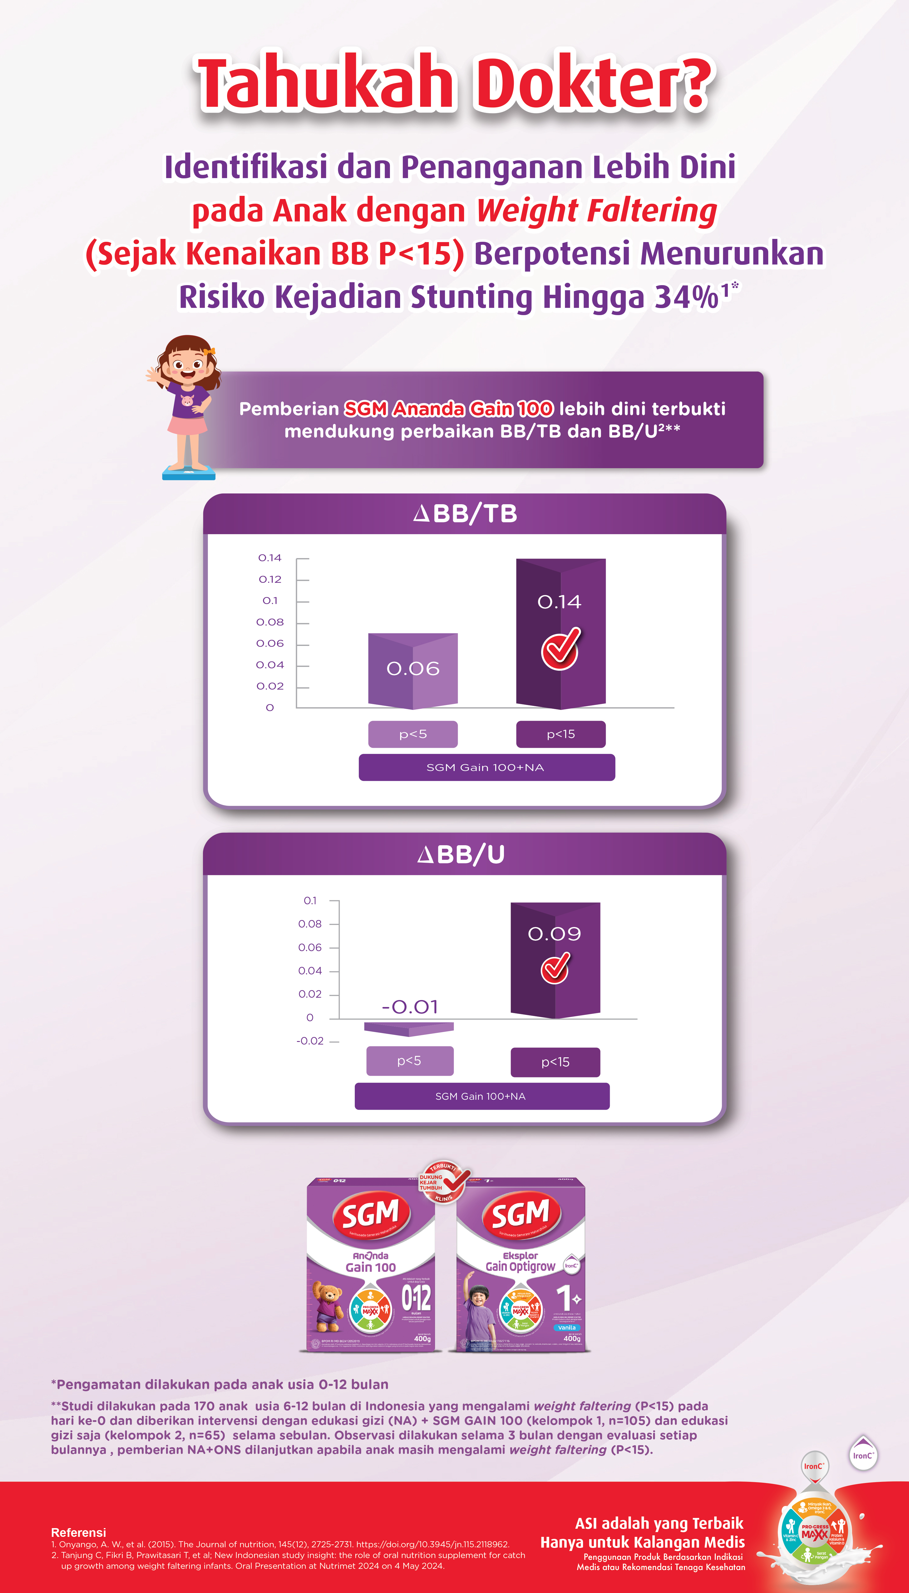



…AND WE WILL UNLOCK THE OPPORTUNITY WITH THE RIGHT STRATEGY
Flag of country
INITIATIVE
BE THE GOVERNMENT PARTNER IN FG MANAGEMENT TO ENSURE
NO INDONESIAN CHILD IS LEFT BEHIND
AWARENESS
SCREENING & DIAGNOSIS
ACCESS TO TREATMENT
3
2
1
BOOST STUNTING AWARENESS
DRIVE CALL TO ACTION FROM AWARENESS TO SCREENING
USE FSMP FIRST*
Increase HCP recommendation for FSMP product
Submission to National Reimbursement
Build awareness of Stunting
Drive Screening & Diagnosis through Multiple touchpoints
To reach >45K HCP and 10M Moms (out of 27M Moms) by 2030
To screen >4M children by 2030 (offline and online)
Target reach >4k Pediatricians
ENABLER: PRODUCT INNOVATION, MCE FUNNEL, PHARMACY TOUCH POINT ACTIVATION
* To use FSMP earlier instead of Core Milk

Slide 7

KEY LEARNINGS OF FG BUSINESS IN INDONESIA SO FAR
OUTCOMES & LEARNINGS
WHAT IS WORKING?
WHAT COULD BE IMPROVED?
NEXT ACTION
Building Scientific Credibility:
FG Mainstream: New clinical study on SGM Gain efficacy
FG Premium: New clinical study on effectiveness of 1.5 kcal vs. 1.0 kcal/ml
Differentiation & Positioning between
FG Mainstream & Premium in Hospital setting
Leverage Clinical Study Result into more massive HCP Communication
Current Communication & Activation vs. Pediacomplete
Win over PediaComplete with dual brand strategy
GMBS Activation with Dinkes: modeling project to increase screening that capture end to end funnel for consumer
PNPK education (referral & role of NDF) to HCP
Power Up Screening & Diagnosis both offline & online
Improve Product Feature through Tessa Project in FG Premium local renovation
Alignment communication & activation between Dinas Kesehatan & local pediatrician
Continue building advocacy to Dinas Kesehatan & other relevant stakeholders on the role of NDF

