Slide 1


BEST PRACTICE: INDONESIA
Infatrini & Nutrinidrink New VI Launch
Dec'24

Slide 2
Nutrinidrink
Liquid Delisting
From past years, ND show a good trajectory until in 2024…
ND Liquid delisting
+13%
+10%
-10%
+9%

Slide 3
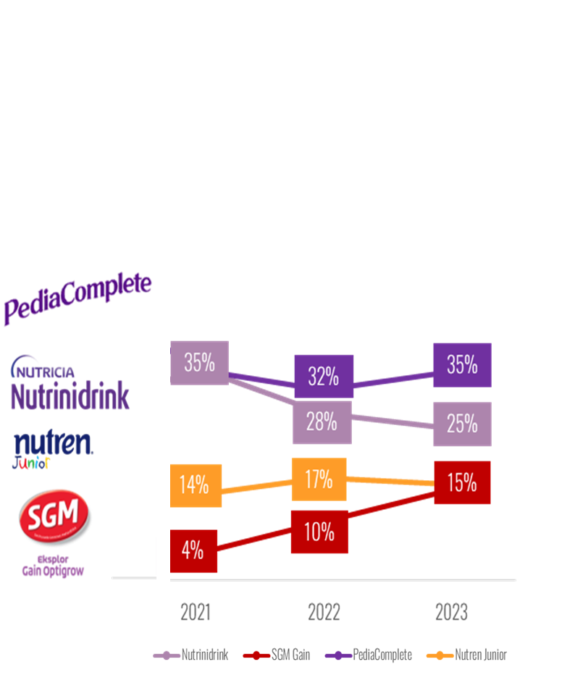
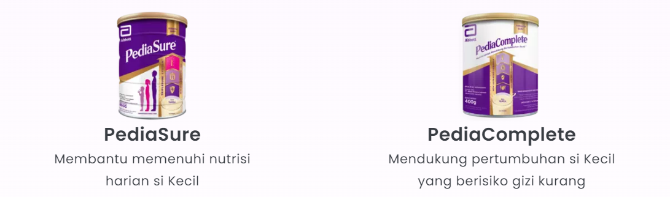
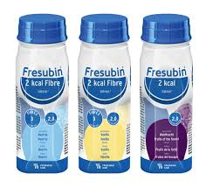
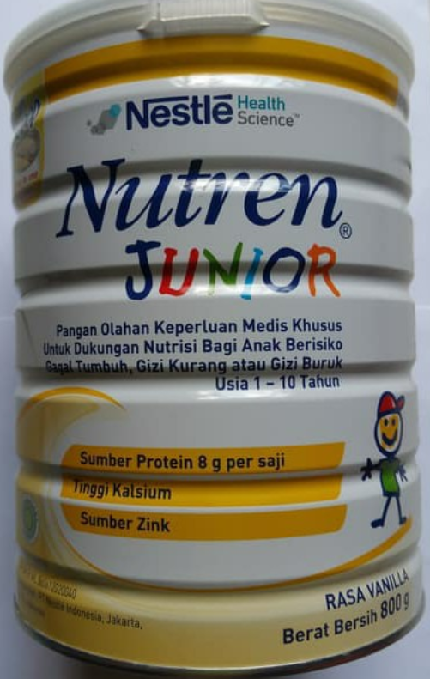
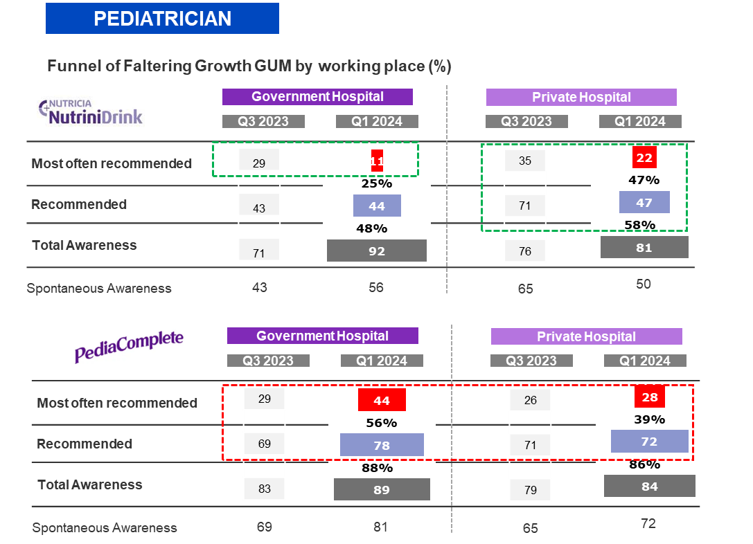

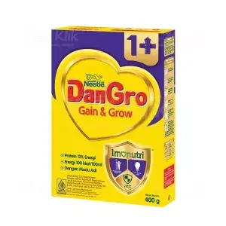
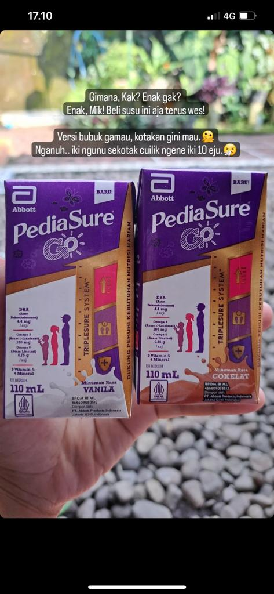
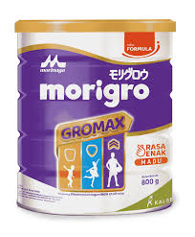
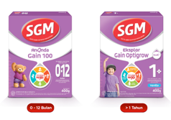

Nutrinidrink faces strong competition challenges:
Declining market share, perception, and new entrants.
MARKET SHARE
BRAND IMAGERIES
TOUGHER COMPETITION
ND #2 in market share but the trend are declining in past 2 years
PediaComplete have better Peds awareness & conversion to Recommendation
New entrants and well-established brands with superior products offering
Nutren Junior
Fresubin
Dangro
Pediasure Go
Morigro
Optigrow
NEW
ENTERANCE
SUPERIOR FORMULATION
LOWER PRICE
Notes:
New entrants and well-established brands with superior products offering

Slide 4

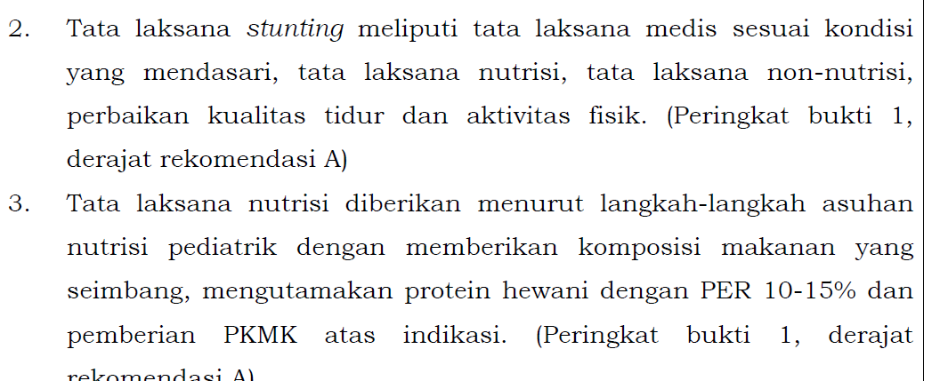
…. We also face increasing pressure from evolving regulations in Indonesia
PER (Protein Energy Ratio) REGULATION
HALAL REGULATION
Government Direction
PERMENKES RI No. HK.01.07/MENKES/1928/2022
Effective in 2024, nutritional treatment for stunting prevention should contain
PER 10-15%
Strengthened Indonesia Halal certification requirements

Slide 5
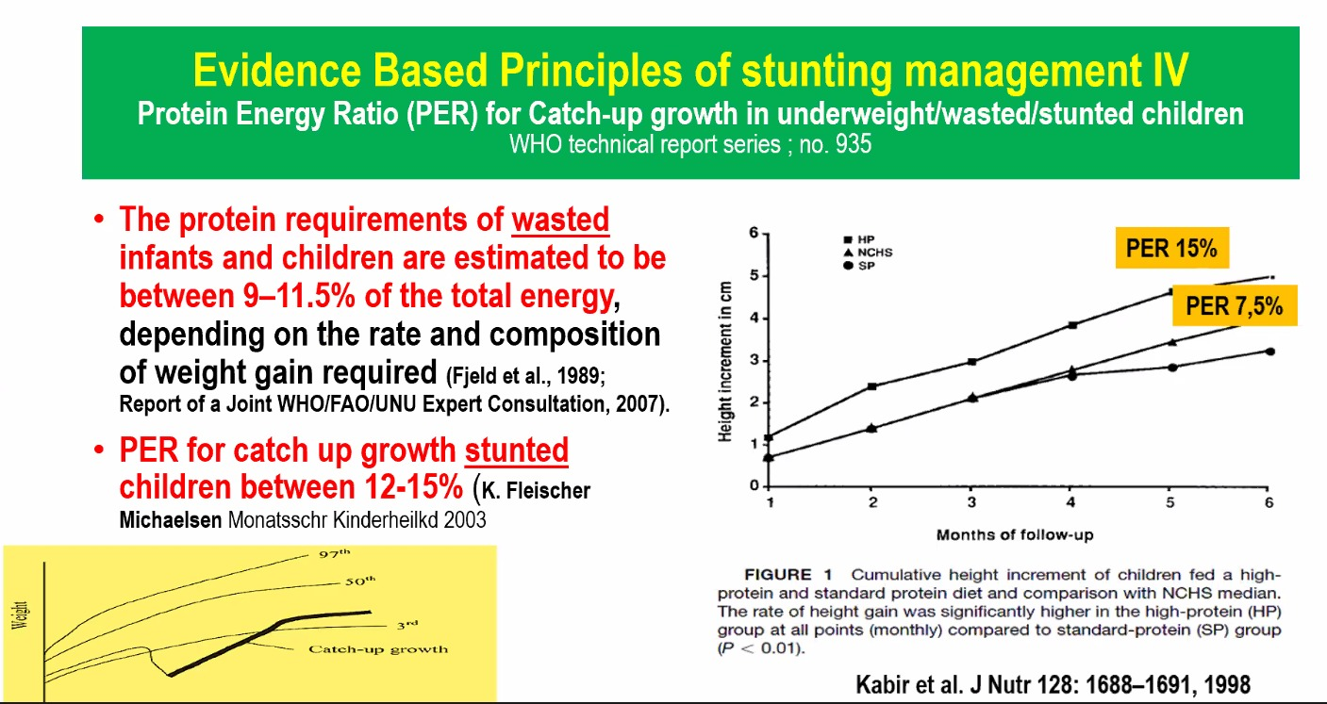
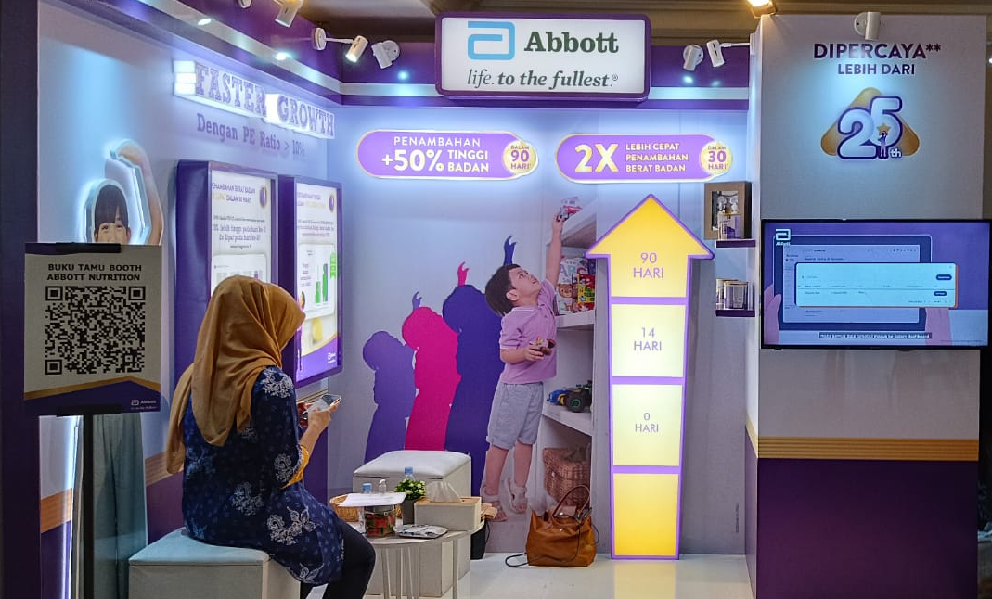
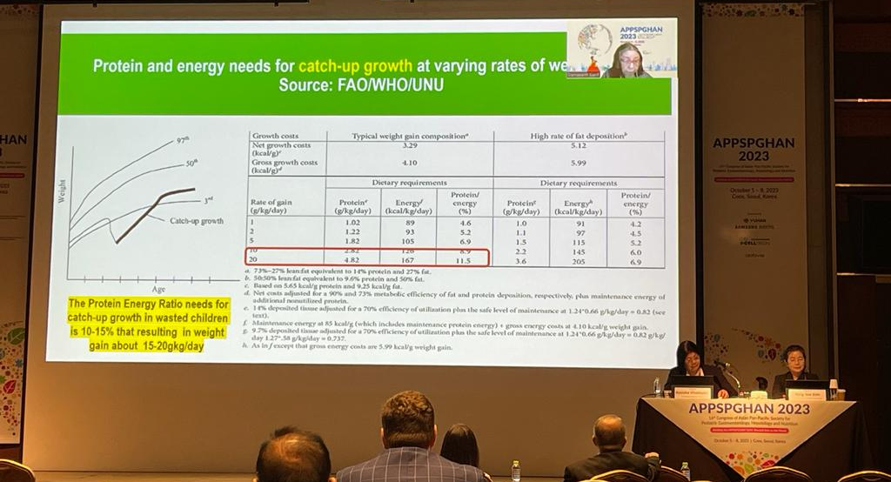
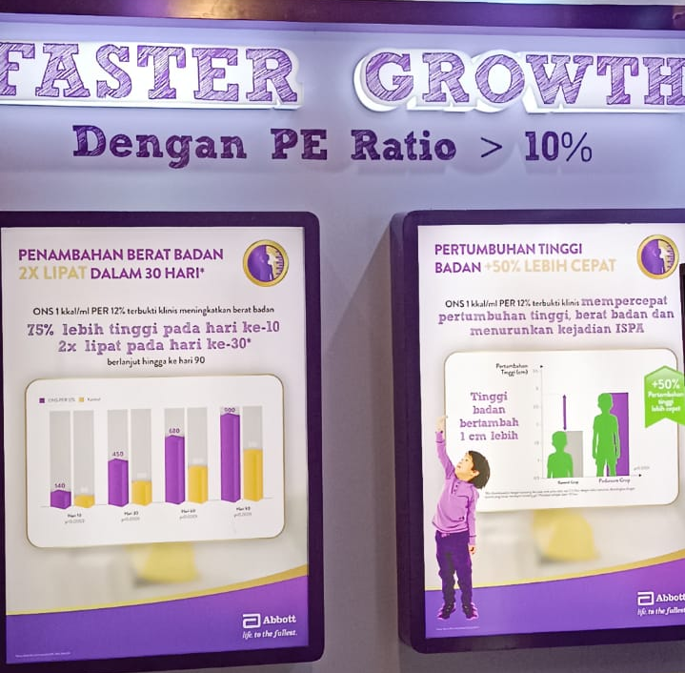
Pediacomplete and Dangro (Nestle) riding on NEW PER regulation aggressively
Active communication on PER 12-15% for catch up growth, presented by KOL in National & International Conference
Active communication on PER Superiority by Abbott in Local Scientific Conference
KOL & Peds endorse high level PER for catch up growth
91%
Source: HCP survey to 60 Peds (2023)
nutrinidrink has
the lowest per vs competitoR
 | Guideline | Pedia Complete | Nutren Junior | Dangro | ND
Energy |  | 1 kkal/ml | 1 kkal/ml | 1 kkal/ml | 1.5 kkal/ml
Protein (g/100 ml) |  | 3 | 3 | 3.2 | 3.4
PER | 10-15% | 12% | 12% | 13% | 9%
Peds agree PER is the most important parameter to reco NDF
Competitor Activity Abbott – SIT IDAI Jaya, Mar 2024
Source: APSGHAN 2023

Slide 6
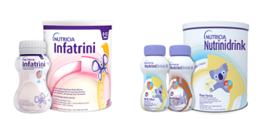



At the same time, Nutrinidrink faces another challenge as SES A & B Moms begin to downtrade
Similar features with SGM Gain Range
Can’t justify its premium price
Spill over effect from Public HOS
Similar Protein-Energy Ratio (PER) levels
2.4x
More expensive
vs.
No mf 6 in Powder formula
SGM Gain is recommended in Private HOS by Peds who also work in Public HOS

Slide 7


DECLINING MARKET SHARE & SALES
FIERCIER COMPETITION
REGULATION
PER
REGULATORY
Nutren Junior
Fresubin
Dangro
Pediasure Go
Morigro
HALAL
Optigrow

Slide 8
DECLINING MARKET SHARE & SALES
FIERCIER COMPETITION
REGULATION
PER
REGULATORY
Nutren Junior
Fresubin
With all these challenges,
How can Nutrinidrink continue to grow and achieve FG business ambition 5x in 2030?
Dangro
Pediasure Go
Morigro
HALAL
Optigrow

Slide 9


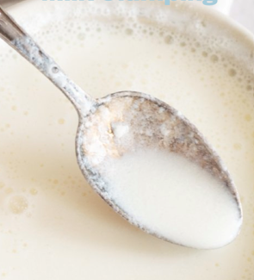
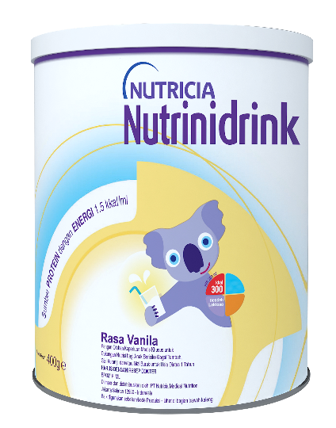
We renovate and premiumize Nutrinidrink by asking our HCPs and Consumers, 4 main challenges are…
INFERIOR TASTE
LOW PER LEVEL
LUMPY
UNATTRACTIVE DESIGN

Slide 10
…. So, we launch new initiative to tackle these challenges
Faltering Growth Ambition
Dual brand strategy to ensure no faltering growth children is left behind
Key Issues
Not winning vs. Pediacomplete: product features & brand imageries
JTBD in FG Premium
Establish IFND Supremacy
Tested & Validated in HCP Comm Test to
Independent Peds to have
SUPERIOR New Claim and Communication
10

Slide 11


