Slide 1


BEST PRACTICE: ITALY
Fortini as 1st ONS in eating disorders
May’24

Slide 2

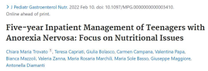
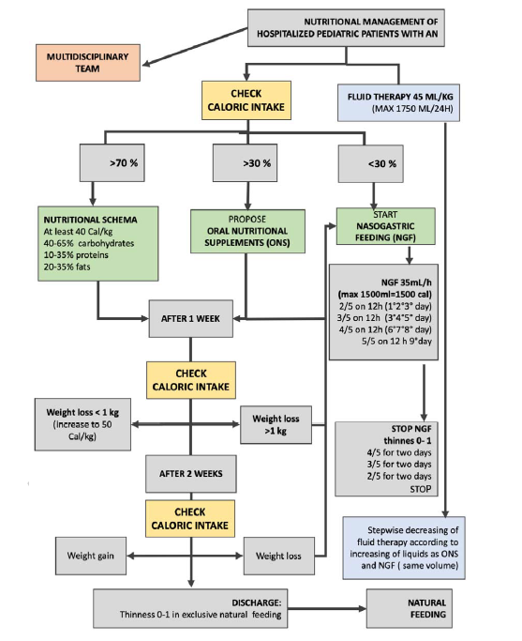


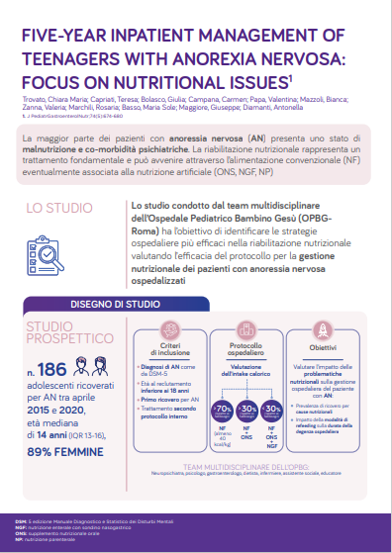





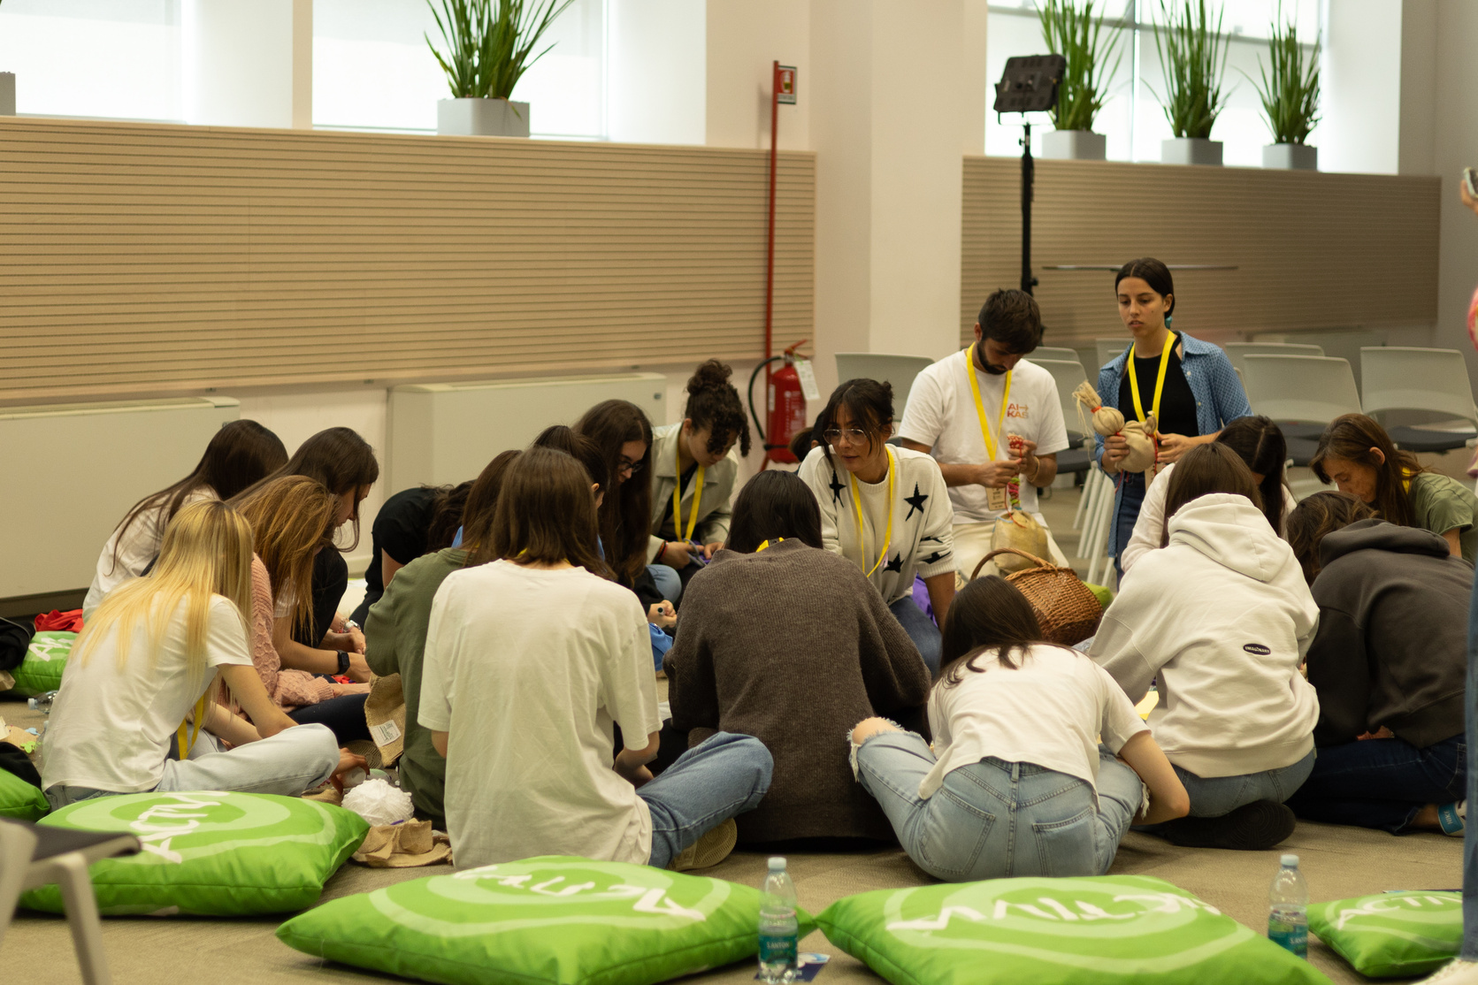
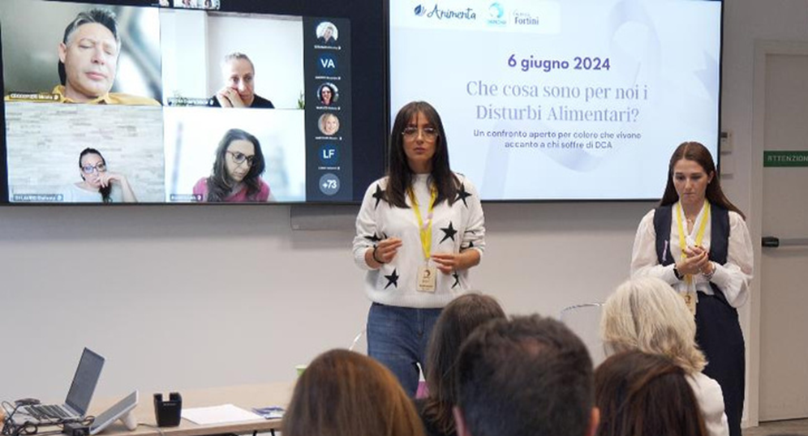


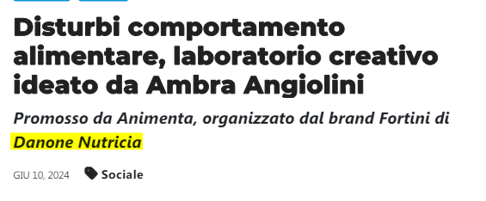

Fortini in Eating Disorders
CHALLENGED GROWTH
BE THE 1ST ONS IN RESTRICTIVE ED VIA 360° APPROACH
FORTINI
MEDICAL EVIDENCE & MARKET SHAPING
HCP SCOUTING & DETAILING
Real world clinical data generation
& Partnership with Scientific Societies
189 PED Centers Targeted
In Italy 3.6Mio people suffering from eating disorders (500K Anorexia & Arfid)
67% adolescents, 20% of patients < 14
+30% Hospitalizations after Covid period
2ND cause of death in adolescents
Sources: SISDCA (2021-2022)
ED are a “disease of the soul” that reveal a non-verbalized request for help by affecting the body.
late diagnosis and difficult access to treatment (>6months)
Multifunctional team is key (ped neurologist, Nutritionist, Pediatr)
Source: Animenta, national ED Patient ass.
PATIENT SUPPORT
25 creative labs & brand amplification campaign
360° strategy to lead DRM in Restrictive Eating disorders:
MEDICAL EVIDENCE & MARKET SHAPING: Real world clinical data generation with Ospedale Pediatrico B. Gesù (Rome), Partnership with KOLs and relevant scientific societies to develop a national consensus
HCP SCOUTING AND DETAILING: 189 ED ped centers targeted (90 already covered), tailored VALUE PROPOSITION, 5 regional events with Scientific Societies’ endorsement
DTP SUPPORT VIA PATIENT ASSOCIATION: 25 creative labs (>350 patiens) and amplification campaign to support people with ED (>4Mio contacts YTD June ‘24)
ED and anorexia are a real social issue in Italy
Fortini Compact perceived by HCPs as tailored product for patients with restrictive ED (low volume): room to expand penetration (TA sizing/EOC WIP)
HCPs need to optimize patient management to prevent/reverse short and long term health complications: need for national consensus and protocols
Strong need for awareness/support from parents and children with ED → Danone to be the 1st in this TA
NS growth YTD May ‘24:
All channels +134k€ (+28% vs py)
Ecomm: +140%
MS Value YTD April ‘24 (Only pharma):
+400bps
Alessandra Martegani (Head of strategy Tube, MD & Growth)
Alessia Grinzato (Medical), Maia Ottogalli (GS), Enrica Seregni (Media)
Sources: ISS, SISDCA (2021-2022), Animenta, ED patients association

