Slide 1


BEST PRACTICE: NORBAL
The Fortini welcome box
2020

Slide 2



THE FORTINI WELCOME BOX
A TOOL TO DRIVE ADHERENCE
IN THE NORDIC & BALTIC

Slide 3



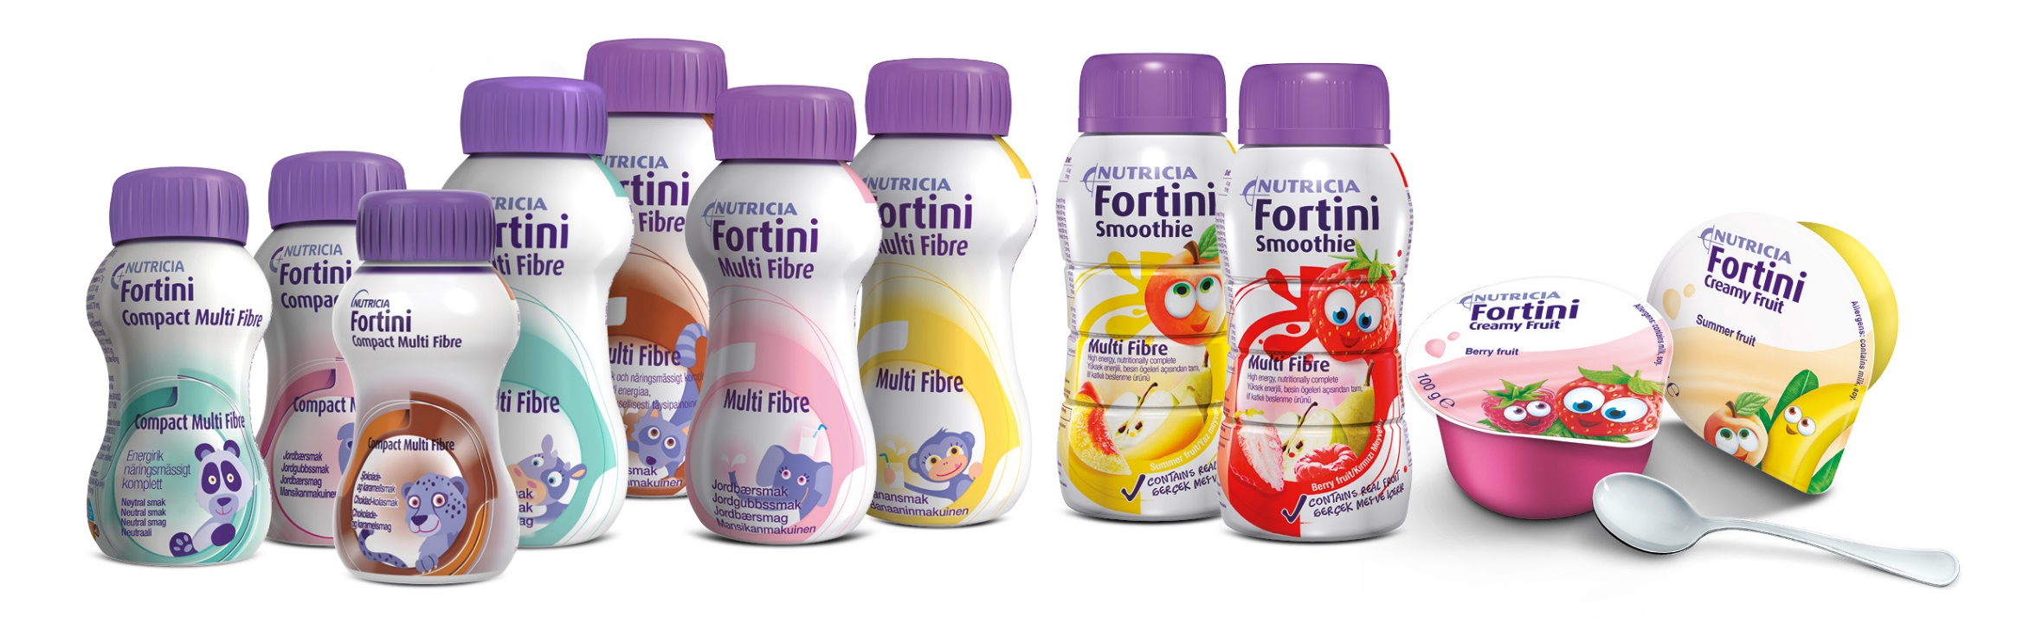
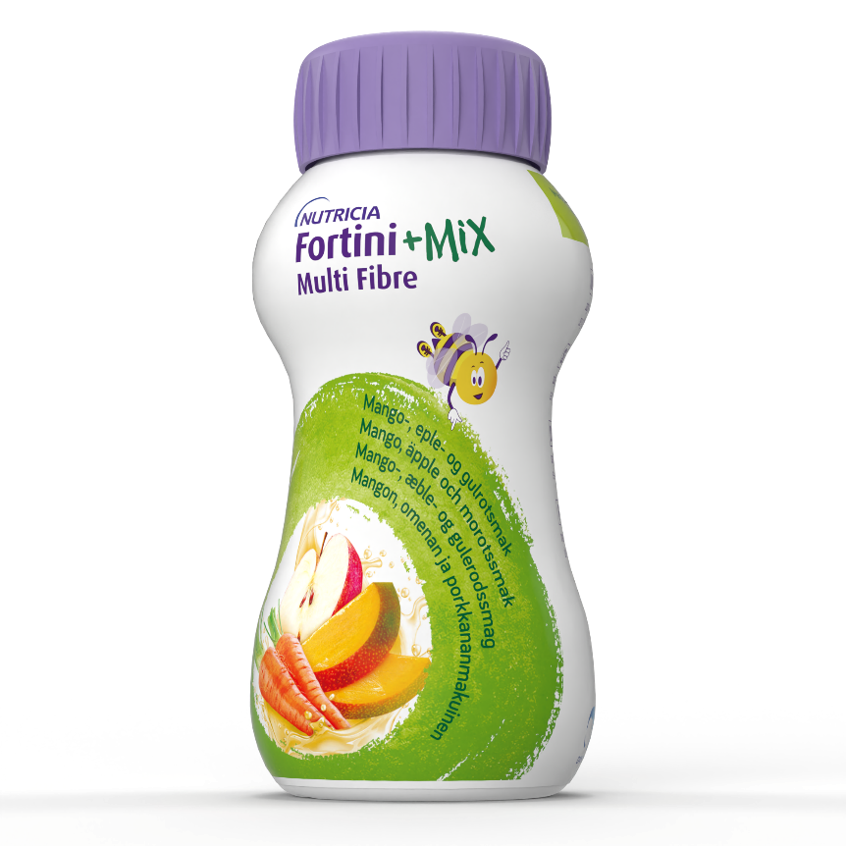
BACKGROUND & PURPOSE OF THE TOOL
A TOOL TO SUPPORT INTRODUCTION & ACCEPTANCE FOR THE FIRST TIME ONS FAMILY
BACKGROUND
ADHD workshop in 2020 with HCP and Parents
Outcome: Clear Need of Support in the ONS Introduction
A tool-kit to be handed out by HCP to the parent & patient
Low ONS Awareness among parents, whereas families’ 1st encounter with ONS through HCP prescription is critical.

Slide 4

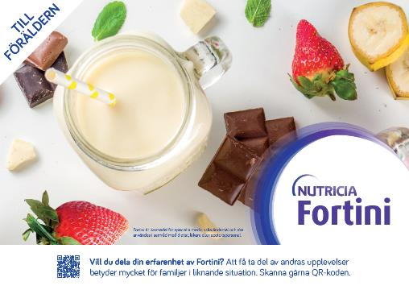
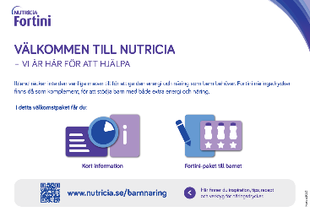
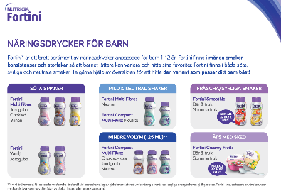
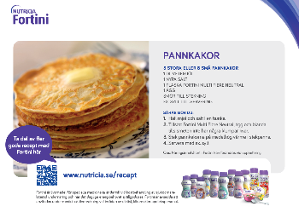


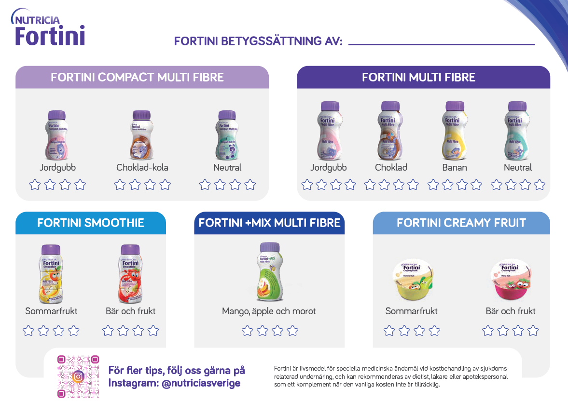
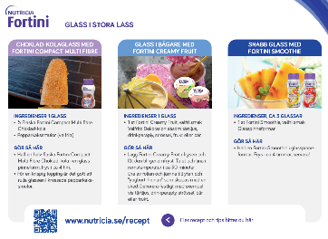
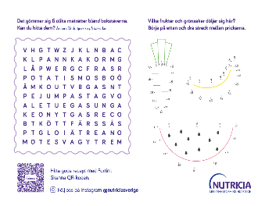
BUT WHAT IS IN THE BOX?
ELEMENTS INCLUDED
SEPARATE ENVELOPES
INTRODUCTION
ACCEPTANCE
COMPLIANCE
TO THE PARENT
TO THE CHILD

Slide 5

LEARNINGS
SINCE LAUNCH 2020 AND RE-DEFINED
VALUABLE BEYOND ADHD PATIENTS
PATIENT CENTRIC APPROACH
A NEW DOOR OPENER
Tool rooted in parents’ need, together with the challenges identified by HCP.
Take the time to listen.
Field Force new access
to previously closed customers
Great feedback from HCP and parents; extend from ADHD-specific to
Fortini ONS generic box
Do you wish your own Fortini box? Reach us out and Santa will send
Pernilla.klippberg@danone.com

