Slide 1


BEST PRACTICE: PHILIPPINES
Hospital initiation amongst CHD patients
May’24

Slide 2


Philippines Initiations – Fortini Infant
Type of initiation and TA focus | EARLY EXPERIENCE PROGRAM / OBSERVATIONAL STUDY ; Hospital initiation amongst cardiac heart disease patients
Need that was driving this / Objectives | No ENDF in the market (new product launch) Evaluate Fortini Infant experience and to gain insights into the clinical practice for product usage among infants with CHD accompanied/at risk of faltering growth. Establish early market penetration to ensure acceptance and uptake by target users upon launch
Target audience | Pedia cardios ; 25 patients suffering from CHD in Philippine Heart Center Hospital
Budget and resources spent | 5k eur for research fees + products Note: Donation is not allowed /the only way to get product in the hospital – to conduct a research
Channels used | Hospital – Philippine Heart Center
KPIs used to measure success | Approval from local ethics committee to proceed with study KOL engagement (to be part of the research team)
Outcomes | Analysing results & how Fortini Infant fits into local practice Initiate hospital access & formulary inclusion Sharing experience/case studies to other hospitals Inclusion in Medical journal
Duration of activation | 6 months for early experience program (Actual study including recruitment, data, etc) + Local/Global approvals and HCP engagement
Insights and best practices learned | KOLs part of the research team became ambassadors to the hospital and local society Identified market access opportunities within the hospital and country level

Slide 3
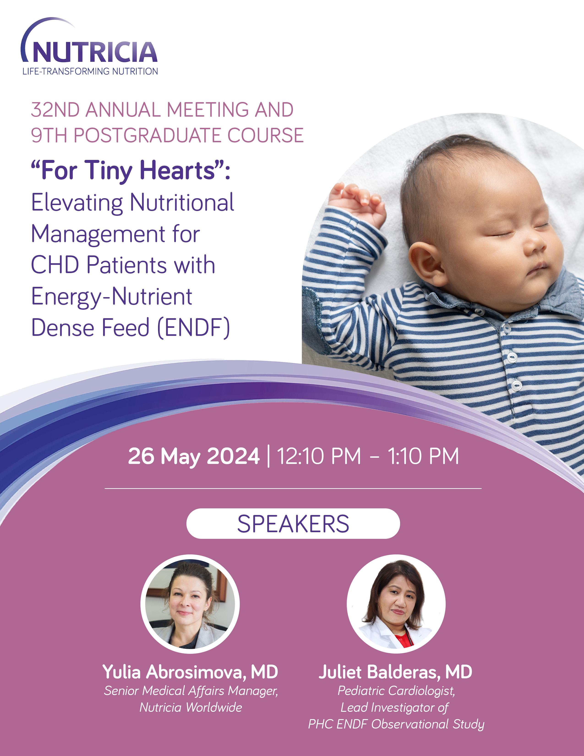

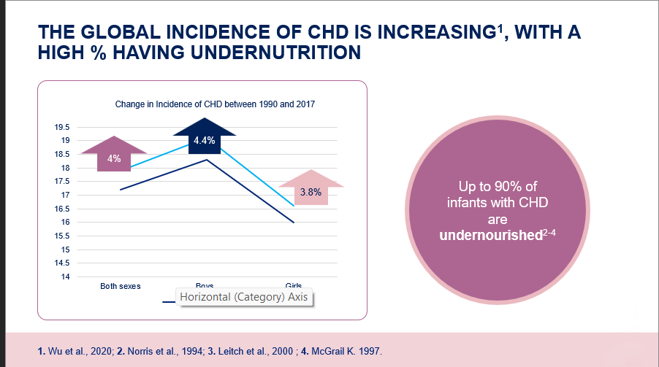
VISUALS – snippets from local pedia cardio symposium

