Slide 1



Lorem ipsu ‘Helping kids bounce back’

Slide 2


Lorem ipsu ‘Helping kids bounce back’

Slide 3

Lorem ipsulorem
Lorem ipsu toolkit is to provide a comprehensive and consistent creative
framework that enables non-EU markets to develop effective campaigns centered on the “Helping Kids Bounce Back” Big Brand
Idea (BBI) for Fortini®.
Lorem ipsu our brand ndamentals and how to apply our “Helping Kids Bounce Back” BBI for an impactful and coherent way of communication, which
The Fortini global framework will continue
to evolve and will be updated as new
assets become available.

Slide 4


Lorem iosu Lorem io
orem ioLorem iorem io
Lorem ipsu our brand ndamentals and how to apply our “Helping Kids Bounce Back” BBI for an impactful and coherent way of communication, which

Slide 5

Title
Subtitle

Slide 6
Title
Subtitle
Subtitle

Slide 7




Lorem iosu Lorem io
orem ioLorem iorem io
Lorem ipsu

Slide 8

Section Title

Slide 9

Section Title

Slide 10
Section Title
Subtitle

Slide 11

AGENDA
Subtitle
1
Lorem ipsu toolkit is to provide a comprehensive and consistent creative
framework that enables non-EU markets to develop effective campaigns centered on the “Helping Kids Bounce Back” Big Brand
Idea (BBI) for Fortini®.
Lorem ipsu our brand ndamentals and how to apply our “Helping Kids Bounce Back” BBI for an impactful and coherent way of communication, which
The Fortini global framework will continue
to evolve and will be updated as new
assets become available.
2
3

Slide 12

AGENDA
Subtitle
1
Lorem ipsu toolkit is to provide a comprehensive and consistent creative
framework that enables non-EU markets to develop effective campaigns centered on the “Helping Kids Bounce Back” Big Brand
Idea (BBI) for Fortini®.
Lorem ipsu our brand ndamentals and how to apply our “Helping Kids Bounce Back” BBI for an impactful and coherent way of communication, which
The Fortini global framework will continue
to evolve and will be updated as new
assets become available.
2
3

Slide 13

Headline
Subline
Content
1
Lorem ipsu toolkit is to provide a comprehensive and consistent creative framework that enables non-EU markets to develop effective campaigns centered on the “Helping Kids Bounce Back” Big Brand Idea (BBI) for Fortini®.
Lorem ipsu our brand fundamentals and how to apply our “Helping Kids Bounce Back” BBI for an impactful and coherent way of communication, which The Fortini global framework will continue
to evolve and will be updated as new
assets become available.
3
Lorem ipsu toolkit is to provide a comprehensive and consistent creative framework that enables non-EU markets to develop effective campaigns centered on the “Helping Kids Bounce Back” Big Brand Idea (BBI) for Fortini®.
Lorem ipsu our brand ndamentals and how to apply our “Helping Kids Bounce Back” BBI for an impactful and coherent way of communication, which The Fortini global framework will continue
to evolve and will be updated as new
assets become available.
2
4

Slide 14

Headline
Subline
Content
1.
Lorem ipsu toolkit is to provide a comprehensive and consistent creative
framework that enables non-EU markets to develop
2.
Lorem ipsu toolkit is to provide a comprehensive and consistent creative
framework that enables non-EU markets to develop
3.
Lorem ipsu toolkit is to provide a comprehensive and consistent creative
framework that enables non-EU markets to develop
4.
Lorem ipsu toolkit is to provide a comprehensive and consistent creative
framework that enables non-EU markets to develop

Slide 15

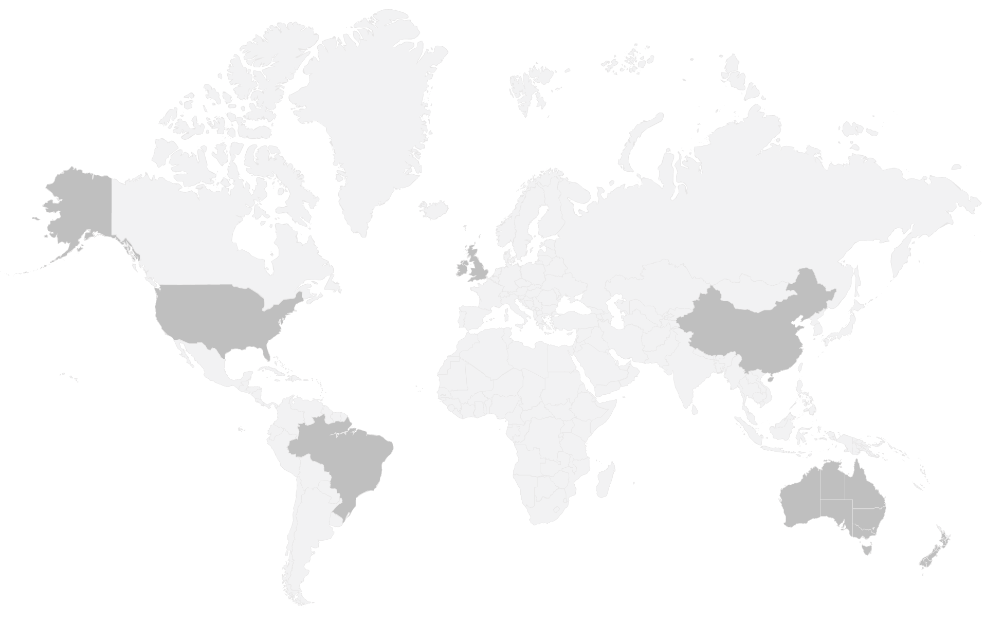





Headline
Subline
Lorem ipsu
50%
Lorem ipsu
75%
10%
Lorem ipsu
25%
Lorem ipsu

Slide 16

Headline
Subline
50%
Lorem ipsu
Lorem ipsu
75%
10%
Lorem ipsu
25%
Lorem ipsu

Slide 17





Headline
Subline
Lorem ipsu
Lorem ipsu
Lorem ipsu
Lorem ipsu
Lorem ipsu
Lorem ipsu
Lorem ipsu
Lorem ipsu
Lorem ipsu
Lorem ipsu
Lorem ipsu
Lorem ipsu
Lorem ipsu
Lorem ipsu
Lorem ipsu
Lorem ipsu
Lorem ipsu
Lorem ipsu
Lorem ipsu
Lorem ipsu

Slide 18

Headline
Subline
Lorem ipsu
Lorem ipsu
Lorem ipsu
Lorem ipsu
Lorem ipsu
Lorem ipsu
Lorem ipsu
Lorem ipsu
Lorem ipsu
Lorem ipsu
Lorem ipsu
Lorem ipsu
Lorem ipsu
Lorem ipsu
Lorem ipsu
Lorem ipsu
Lorem ipsu
Lorem ipsu
Lorem ipsu
Lorem ipsu

Slide 19



Timeline
Subline
Lorem ipsu
Lorem ipsu
Lorem ipsu
Lorem ipsu
Lorem ipsu
Lorem ipsu
Lorem ipsu
Lorem ipsu
2020
2022
2024
2021
2023
2025
Lorem ipsu
Lorem ipsu
Lorem ipsu
Lorem ipsu
Lorem ipsu
Lorem ipsu
Lorem ipsu

Slide 20


Timeline
Subline
1.
2.
3.
4.
Title 1
Title 2
Title 3
Title 4
Lorem ipsu
Lorem ipsu
Lorem ipsu
Lorem ipsu
Lorem ipsu
Lorem ipsu
Lorem ipsu
Lorem ipsu
Lorem ipsu
Lorem ipsu
Lorem ipsu
Lorem ipsu
Lorem ipsu
Lorem ipsu
Lorem ipsu
Lorem ipsu

Slide 21


Lorem ipsu Lorem ipsu Lorem ipsu
Lorem ipsu Lorem ipsu
Lorem ipsu Lorem ipsu ipsu Lorem ipsu ipsu Lorem ipsu

Slide 22
THANK YOU

Slide 23

BIG MESAGE
Lorem ipsu Lorem ipsu ipsu

Slide 24

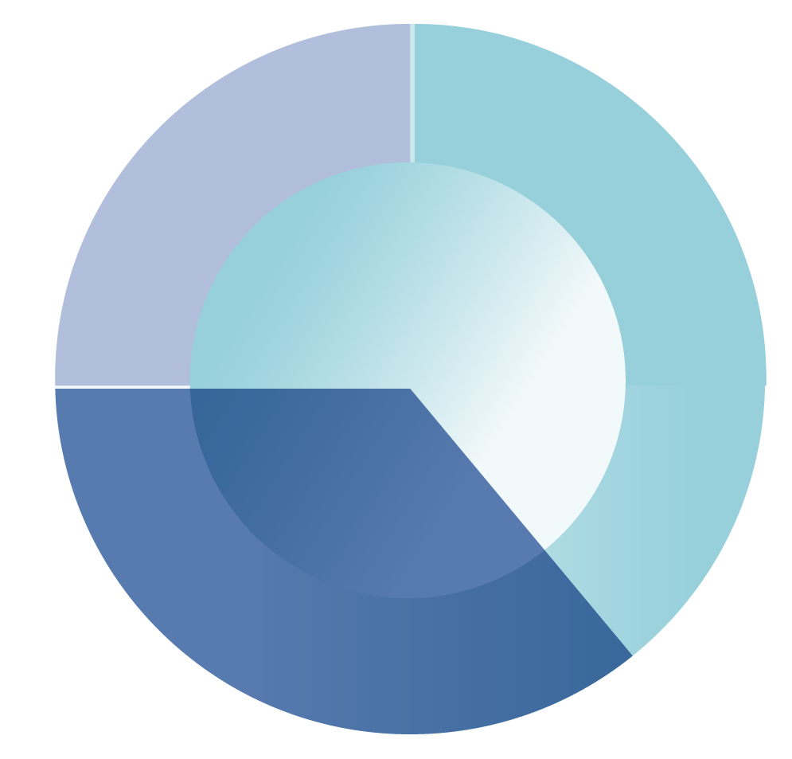


Headline
Chart Title
Title 1
Title 3
Lorem ipsu Lorem ipsu ips Lorem ipsu Lorem ipsu ipsu
Lorem ipsu Lorem ipsu ips Lorem ipsu Lorem ipsu ipsu
Lorem ipsu Lorem ipsu ips Lorem ipsu Lorem ipsu ipsu
Title 4
Title 2
Lorem ipsu Lorem ipsu ips Lorem ipsu Lorem ipsu ipsu
Lorem ipsu Lorem ipsu ips Lorem ipsu Lorem ipsu ipsu
Lorem ipsu Lorem ipsu ips Lorem ipsu Lorem ipsu ipsu

Slide 25





Headline
Chart Title
Lorem ipsu Lorem ipsu ipsu Lorem ipsu Lorem ipsu ipsu Lorem ipsu Lorem ipsu ipsu Lorem ipsu Lorem ipsu ipsu
Lorem ipsu Lorem ipsu ipsu Lorem ipsu Lorem ipsu ipsuLorem ipsu Lorem ipsu ipsu Lorem ipsu Lorem ipsu ipsu
0
Title 1
Lorem ipsu Lorem ipsu ips ipsu Lorem ipsu ipsu
0
0
Title 2
Lorem ipsu Lorem ipsu ips ipsu Lorem ipsu ipsu
0
Title 3
0
Lorem ipsu Lorem ipsu ips ipsu Lorem ipsu ipsu
0
Lorem
Lorem
Lorem
Lorem

Slide 26
Headline
Chart Title
10%
25%
75%
90%
Lorem ipsu Lorem ipsu ips Lorem ipsu Lorem ipsu ipsu
Lorem ipsu Lorem ipsu ips Lorem ipsu Lorem ipsu ipsu
Lorem ipsu Lorem ipsu ips Lorem ipsu Lorem ipsu ipsu
Lorem ipsu Lorem ipsu ips Lorem ipsu Lorem ipsu ipsu

Slide 27

Thank
you

Slide 28
Extras

Slide 29
Title
Subtitle
June 2025

Slide 30
Title
Subtitle
June 2025

Slide 31
Lorem iosu Lorem io
orem ioLorem iorem io
Lorem ipsu

Slide 32
Section Title

