Slide 1
Fortini new campaign
Paediatric growth community call

Slide 2


BEST PRACTICE: UK
Fortini new creative campaign
Nov’23

Slide 3

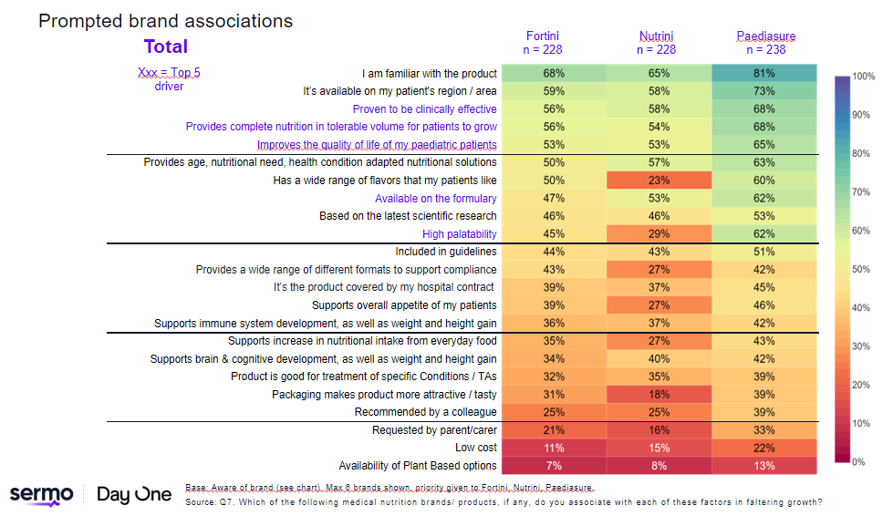
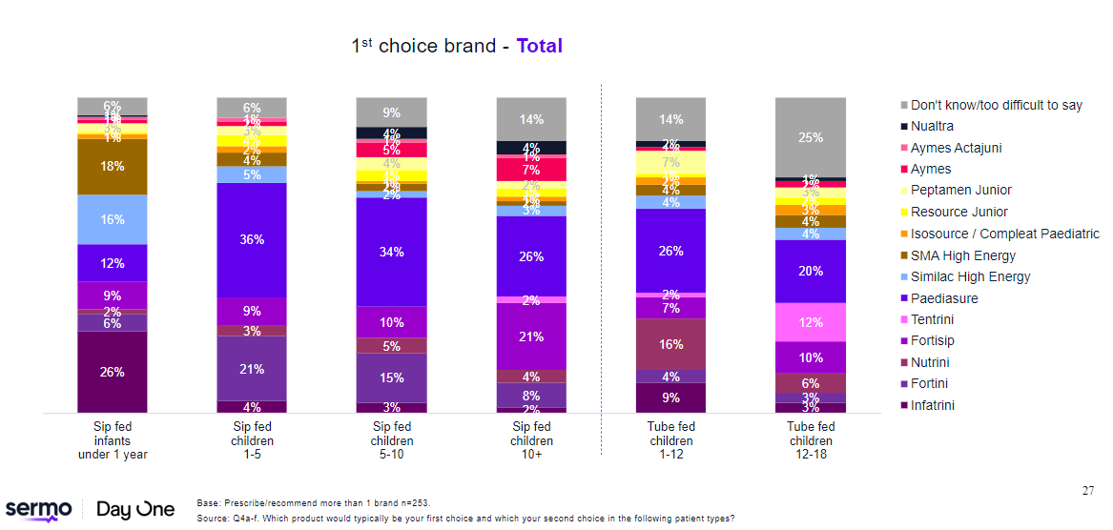
Fortini uk context in 2023
Fortini brand association falling behind key category drivers, with biggest gap in palatability, undermining potential to become BOFC
Complete nutritional
Improve quality of life
Clinical efficacy
High palatability

Slide 4
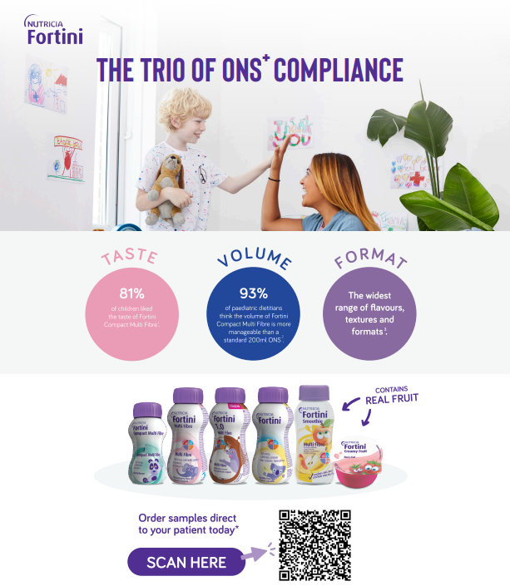
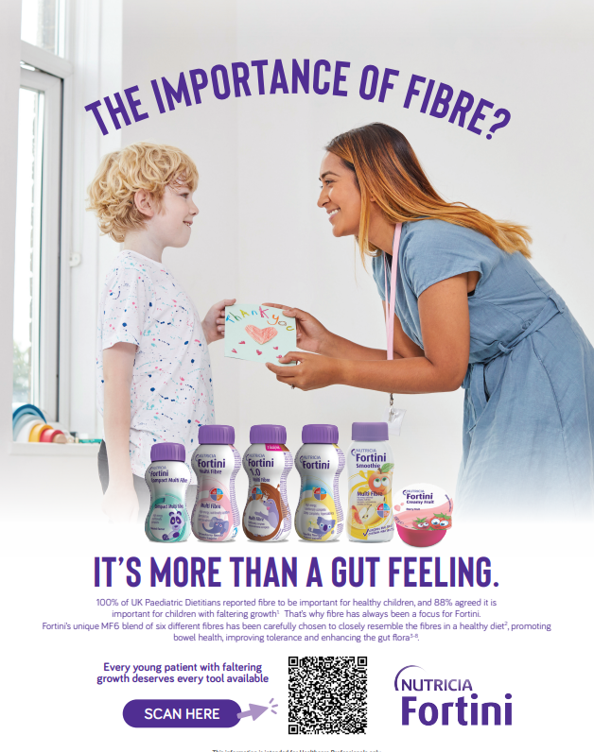
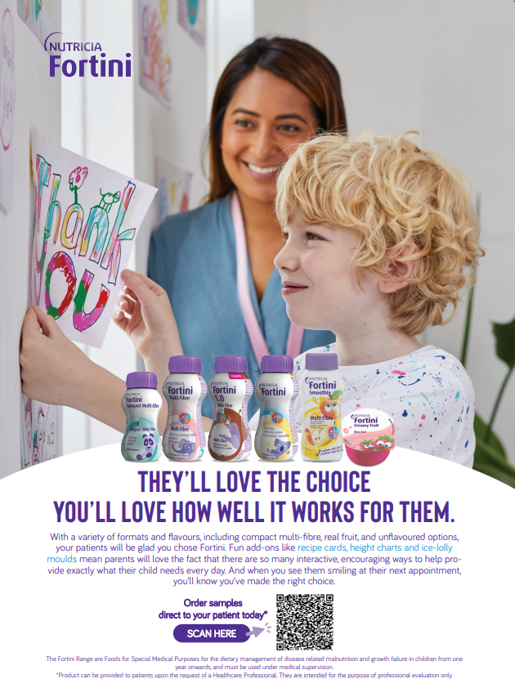
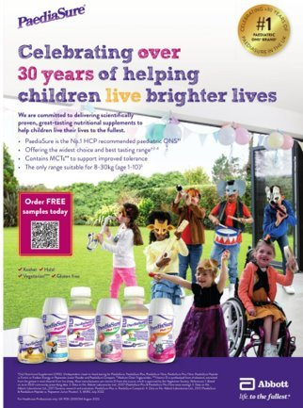
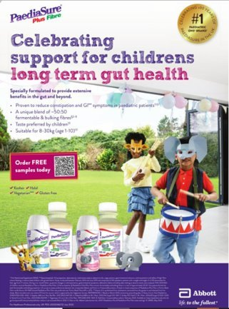
It was time TO elevate fortini with high impact creative
It was time TO elevate fortini with high impact creative
Fortini campaign 2022-2023
Paediasure campaign
2023

Slide 5
The insights guiding our communication strategic approach
INSIGHT
HCPs want a product that will provide complete nutrition so that their patients can grow.
Challenge is to ensure compliance supported by good tasting products
JTBD
Get HCPs to choose Fortini as their BOFC by strengthening brand association as the paediatric ONS that patients will enjoy whilst providing a complete nutritional solution.
NEW CREATIVE INNOVATIVE + DISRUPTIVE

Slide 6
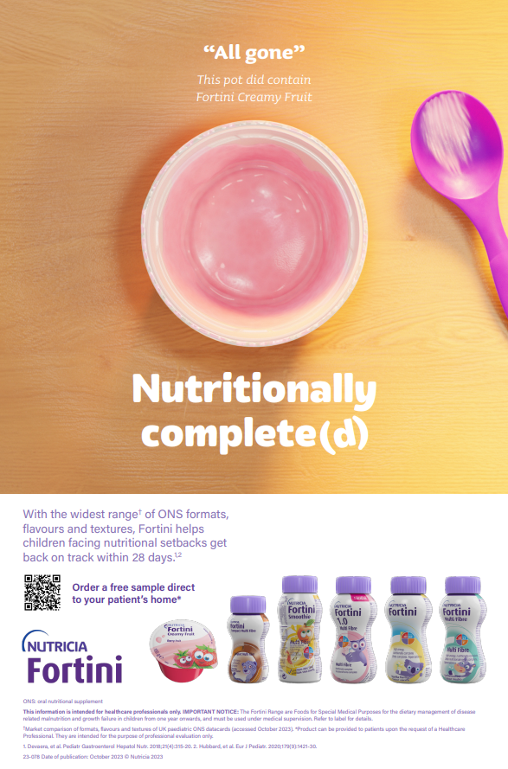
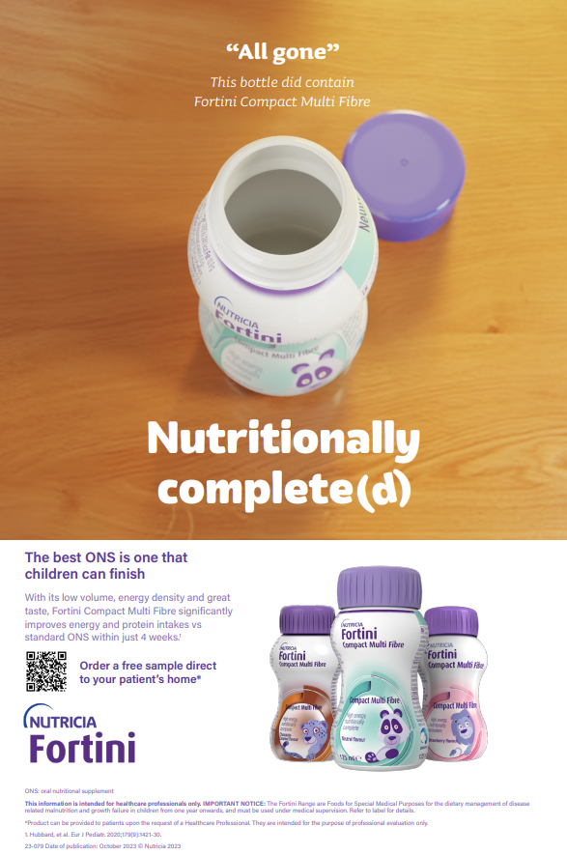

Slide 7
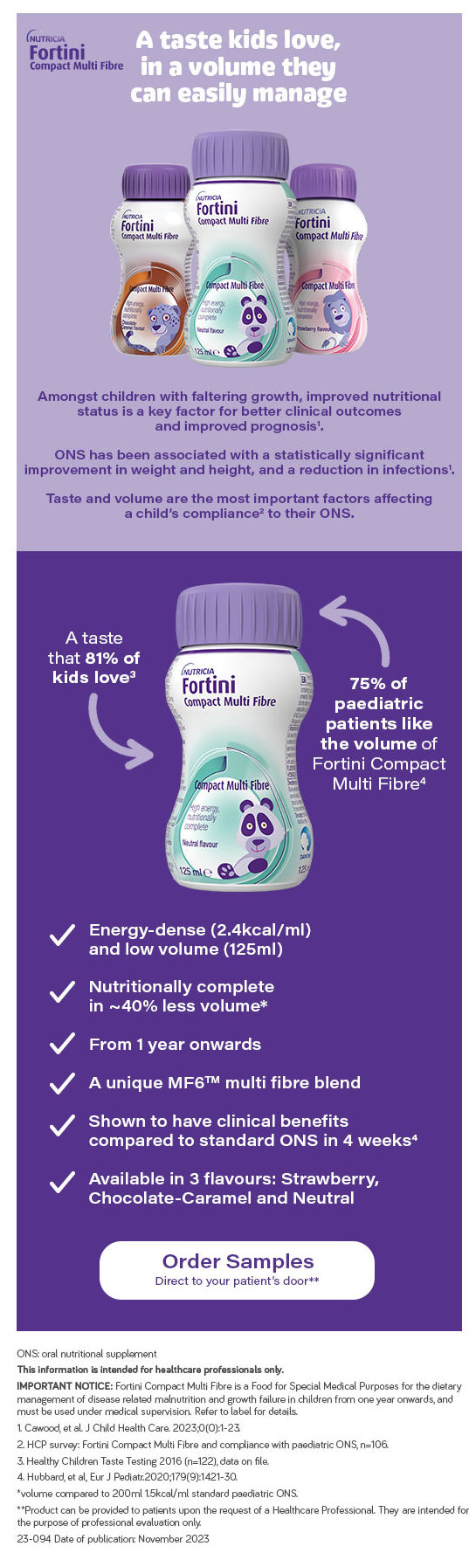
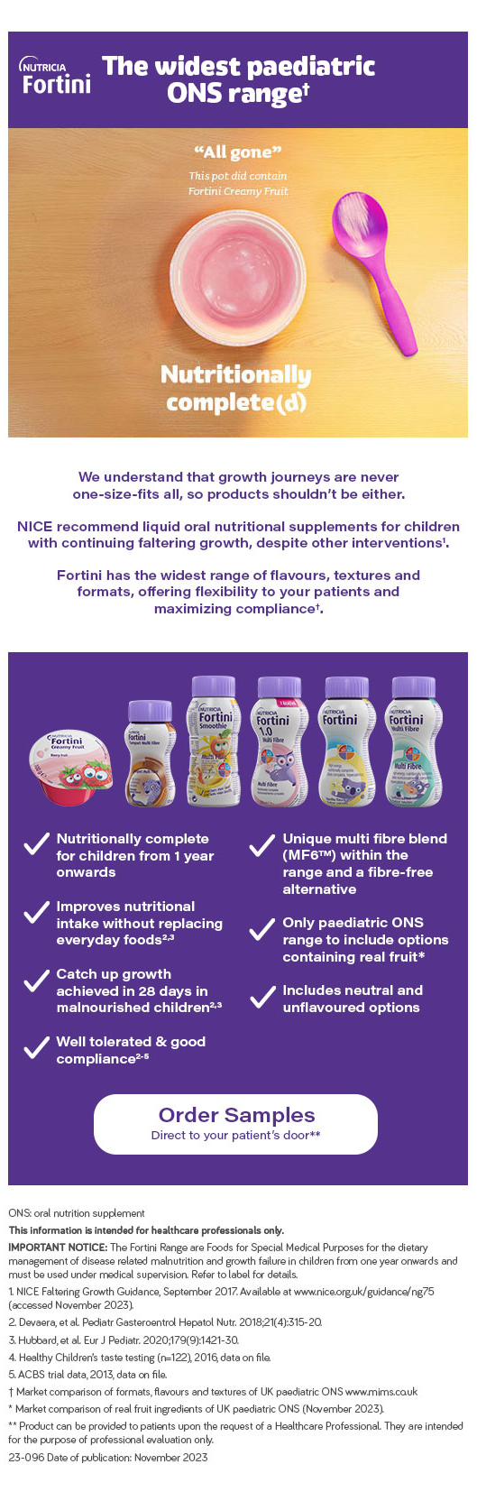
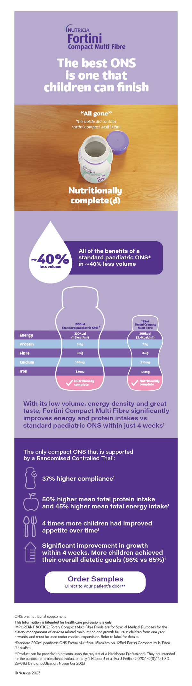
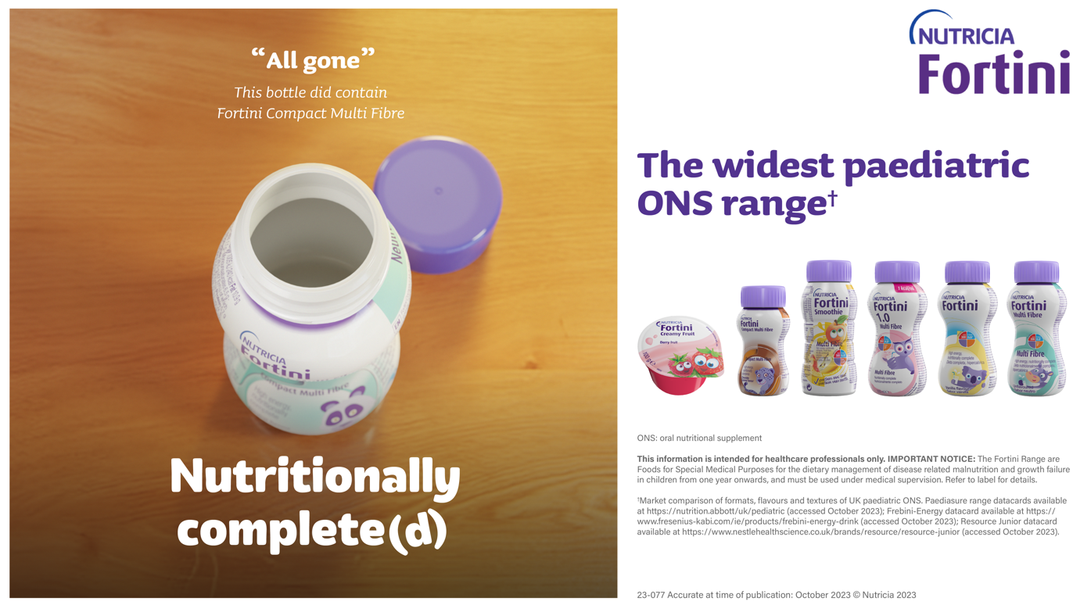
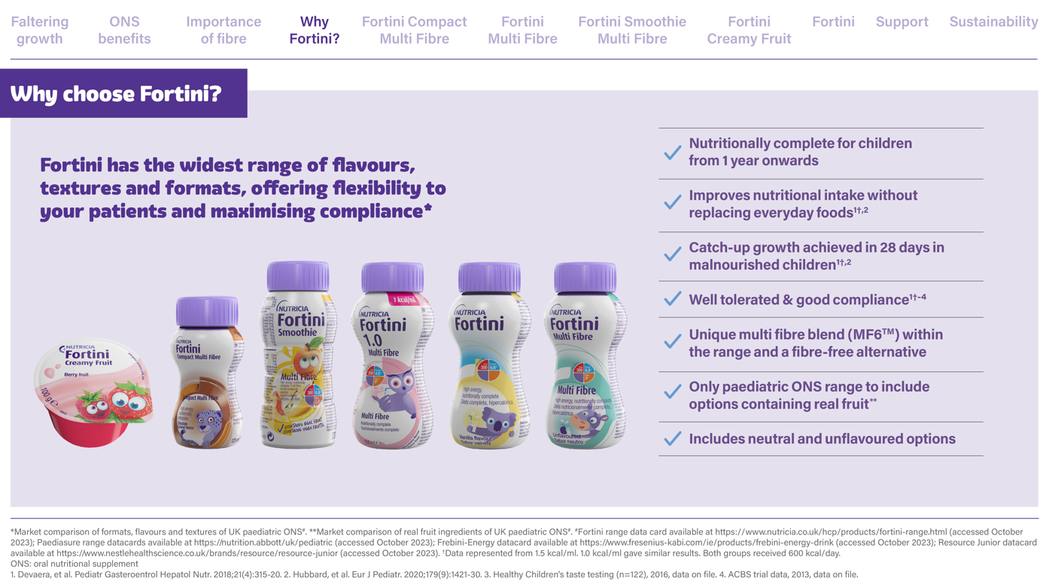
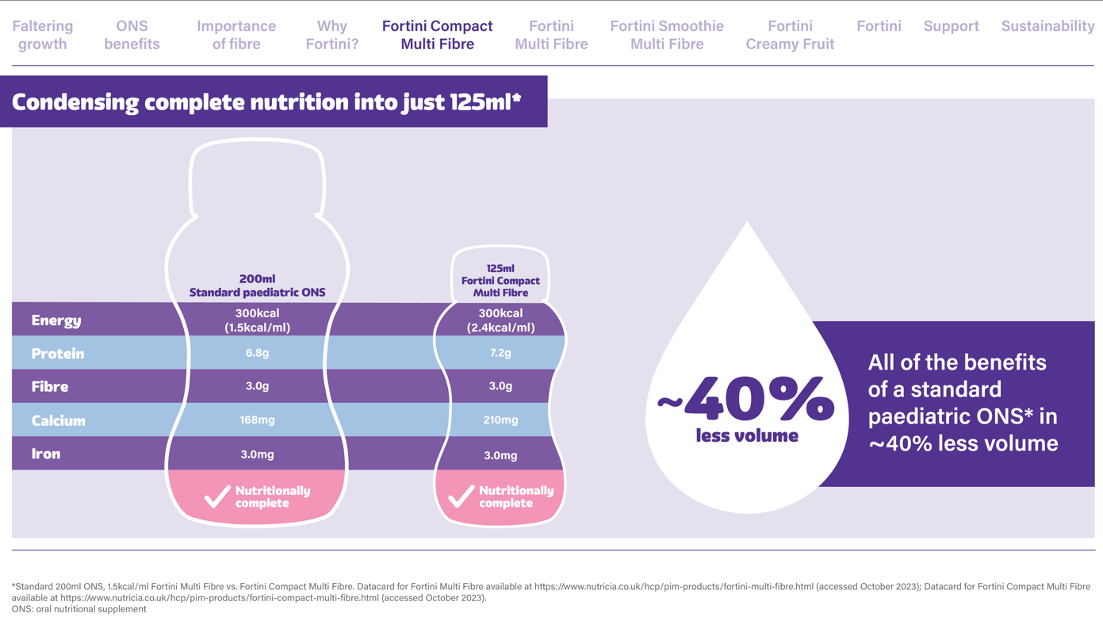
MULTI CHANNEL EXECUTION

Slide 8
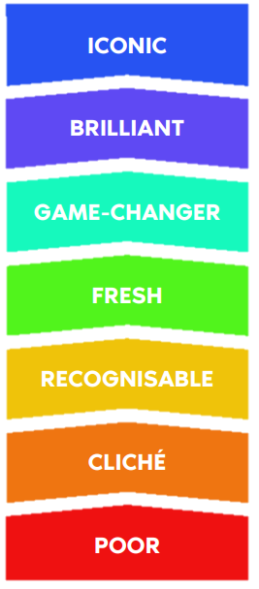
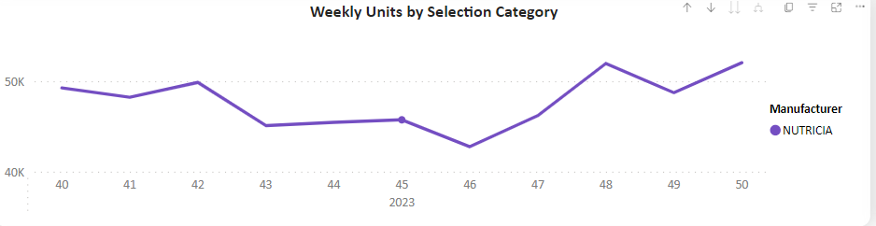
Execution & results of fortini new campaign
EXECUTION
Elevated our creative focusing on four drivers
  Impact: does it stand out, get attention?
  Insightfulness: is the insight central to the story?
  Emotion: does it evoke the right feeling? will it change the behaviour?
  Brand fame: will it elevate the brand fame, authority?
RESULTS
Net Sales: +2.1% volume growth (Nov 2023 – Feb 2024)
Paid Media Nov – Dec:
  FCMF creative: 47,616 impressions, 0.15% CTR Nov – Dec
  Fortini Range creative: 173,720 impressions, 0.09% CTR
  (average industry 0.05%)
Positive feedback from Sales team on eDetailer (storytelling, an overview of FG, why choose Fortini as 1st choice), the prescribing guide being used across all HCPs
Campaign launch

Slide 9
Key learnings
Don’t assume! Use data and insights to guide your creative
Build relationship with your agency
Say familiar things in unfamiliar ways: Nutritionally complete(d)
Use the 4 defining drivers of creativity to assess your campaign
  Is it impactful?
  Is it insightful?
  Is it emotional?
  It will help me on Brand Fame?

Slide 10
Thank you ☺

