Slide 1


BEST PRACTICE: US
Driving awareness at CHD congress
Aug’23

Slide 2

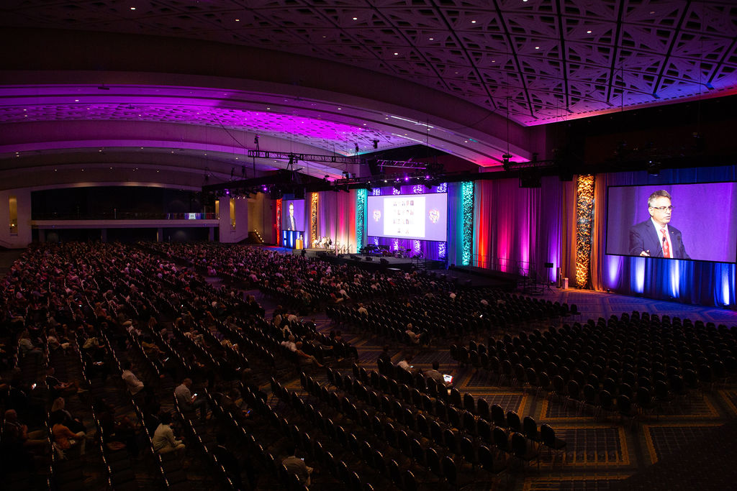
WHAT
“The Olympics of Pediatric Cardiology”
WHY
Peds Cardiologists are a key HCP target for Fortini to help manage infants at risk of failure to thrive for conditions such as CHD.
Objectives:
Drive broad awareness of Fortini Infant with pediatric cardiology community
Enhance consideration of Fortini usage with registrations for upcoming events
Generate interest and register Ped Cardiologists for our Advisory Board
Develop and capture leads to drive product trial, advocacy and case studies
Notes:
This was the team’s first time attending – truly a test and learn. Traditionally held every 4 years, the World Congress is a large international meeting with the goal of being the most comprehensive, up-to-date, and technologically advanced meeting for pediatric and congenital heart disease. Ped cards a key target – objectives listed here.

Slide 3

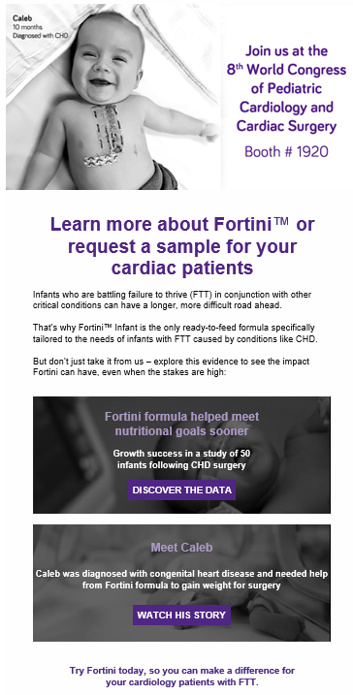
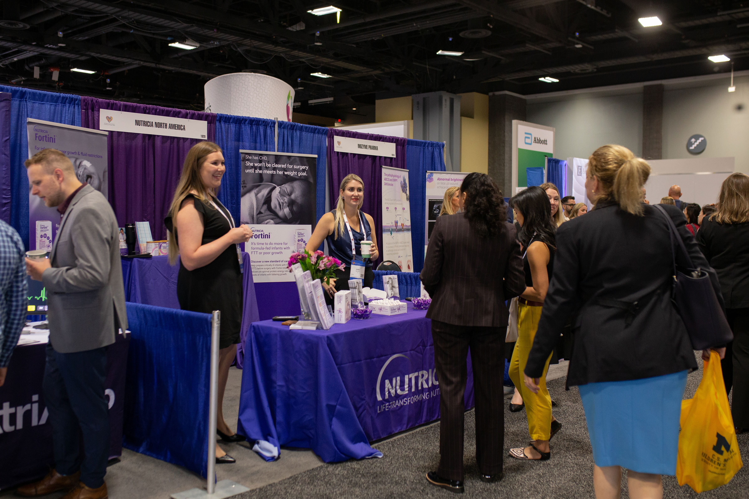
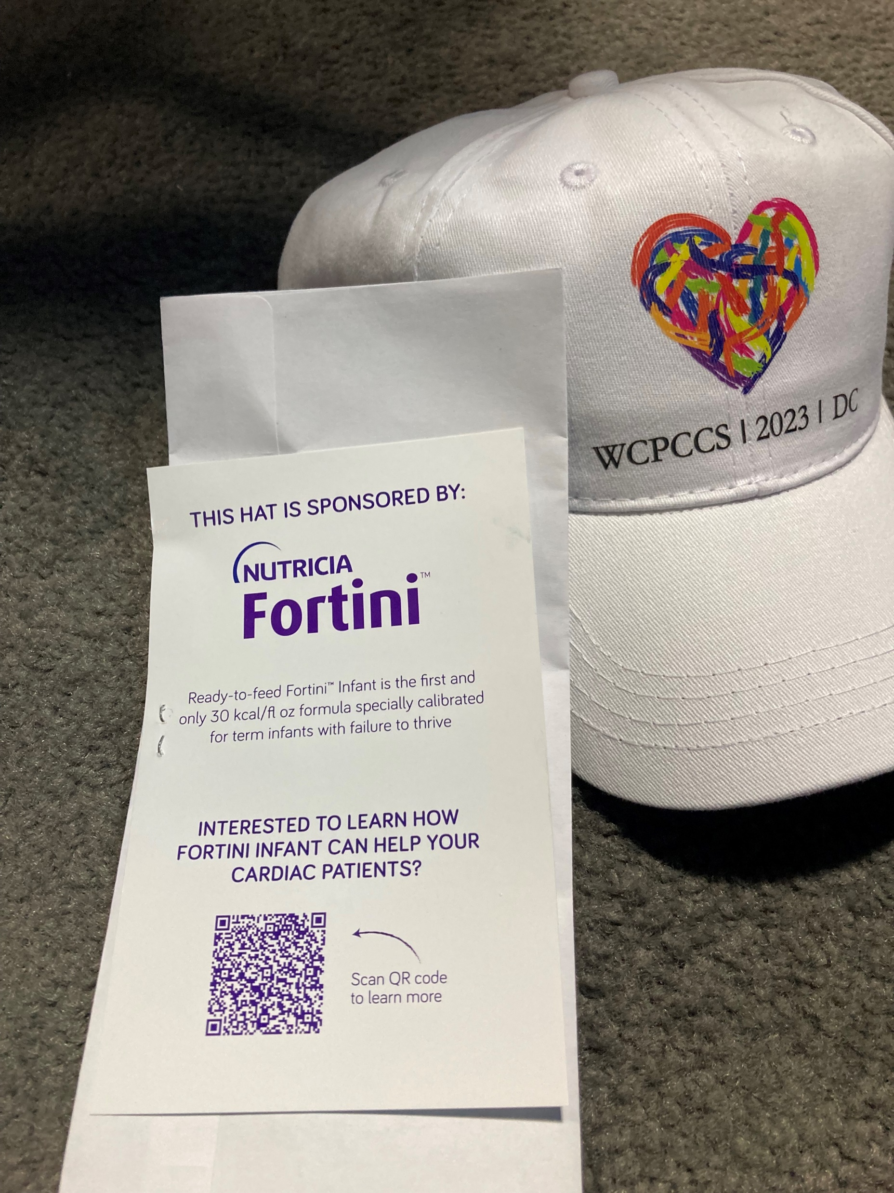
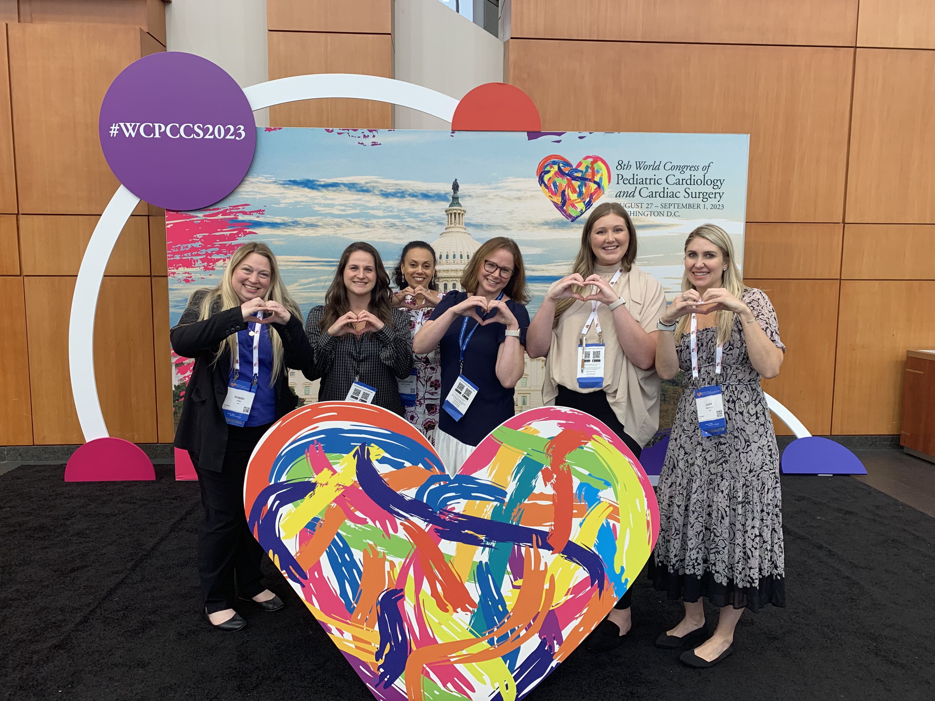
8th World Congress of Pediatric Cardiology & Cardiac Surgery 2023 (WCPCSS) – Washington, DC – Aug 27th – 31st
HOW
Nutricia Team activities & results:
Dedicated email campaign to WCPCSS attendees and Nutricia contacts pre & post congress
Exclusive Fortini sponsorship of hats to 2,000 HCP game attendees
High-traffic booth engagement over 4 days, generating 120+ leads*
Recruited 5-6 potential HCPs for Ad Board & identified KOLs for future development
Expanded presence to new audience within the Pediatric Cardiology care team
Drove qualified registrations for future Cardiology virtual event
Notes:
True collaboration between medical, sales and marketing. Jacqui, Mid-Atlantic RM for getting the ball rolling on our attendance, securing the booth and logistics and having her team represent Fortini and build connections. Nutricia attended the conference for the first time in a big way with detailed planning and strong cross-functional partnership. The mid-Atlantic sales team originally identified the opportunity, secured our booth space, and ensured a strong sales presence. The medical team, led by Sara, secured an exclusive sponsorship at the social event and build strong connections with influential KOLs. Marketing supported with amplifying the message and solidifying the sponsorship. Opportunistic message about Fortini during session – direct result of team’s efforts in EEP program and HCP engagement. Email open rate at or above our NNA average 3%

Slide 4
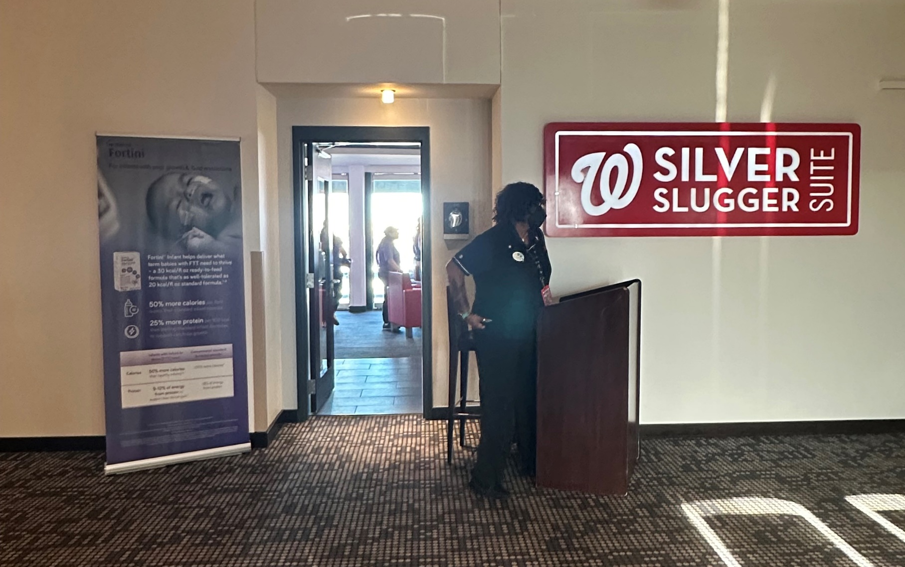
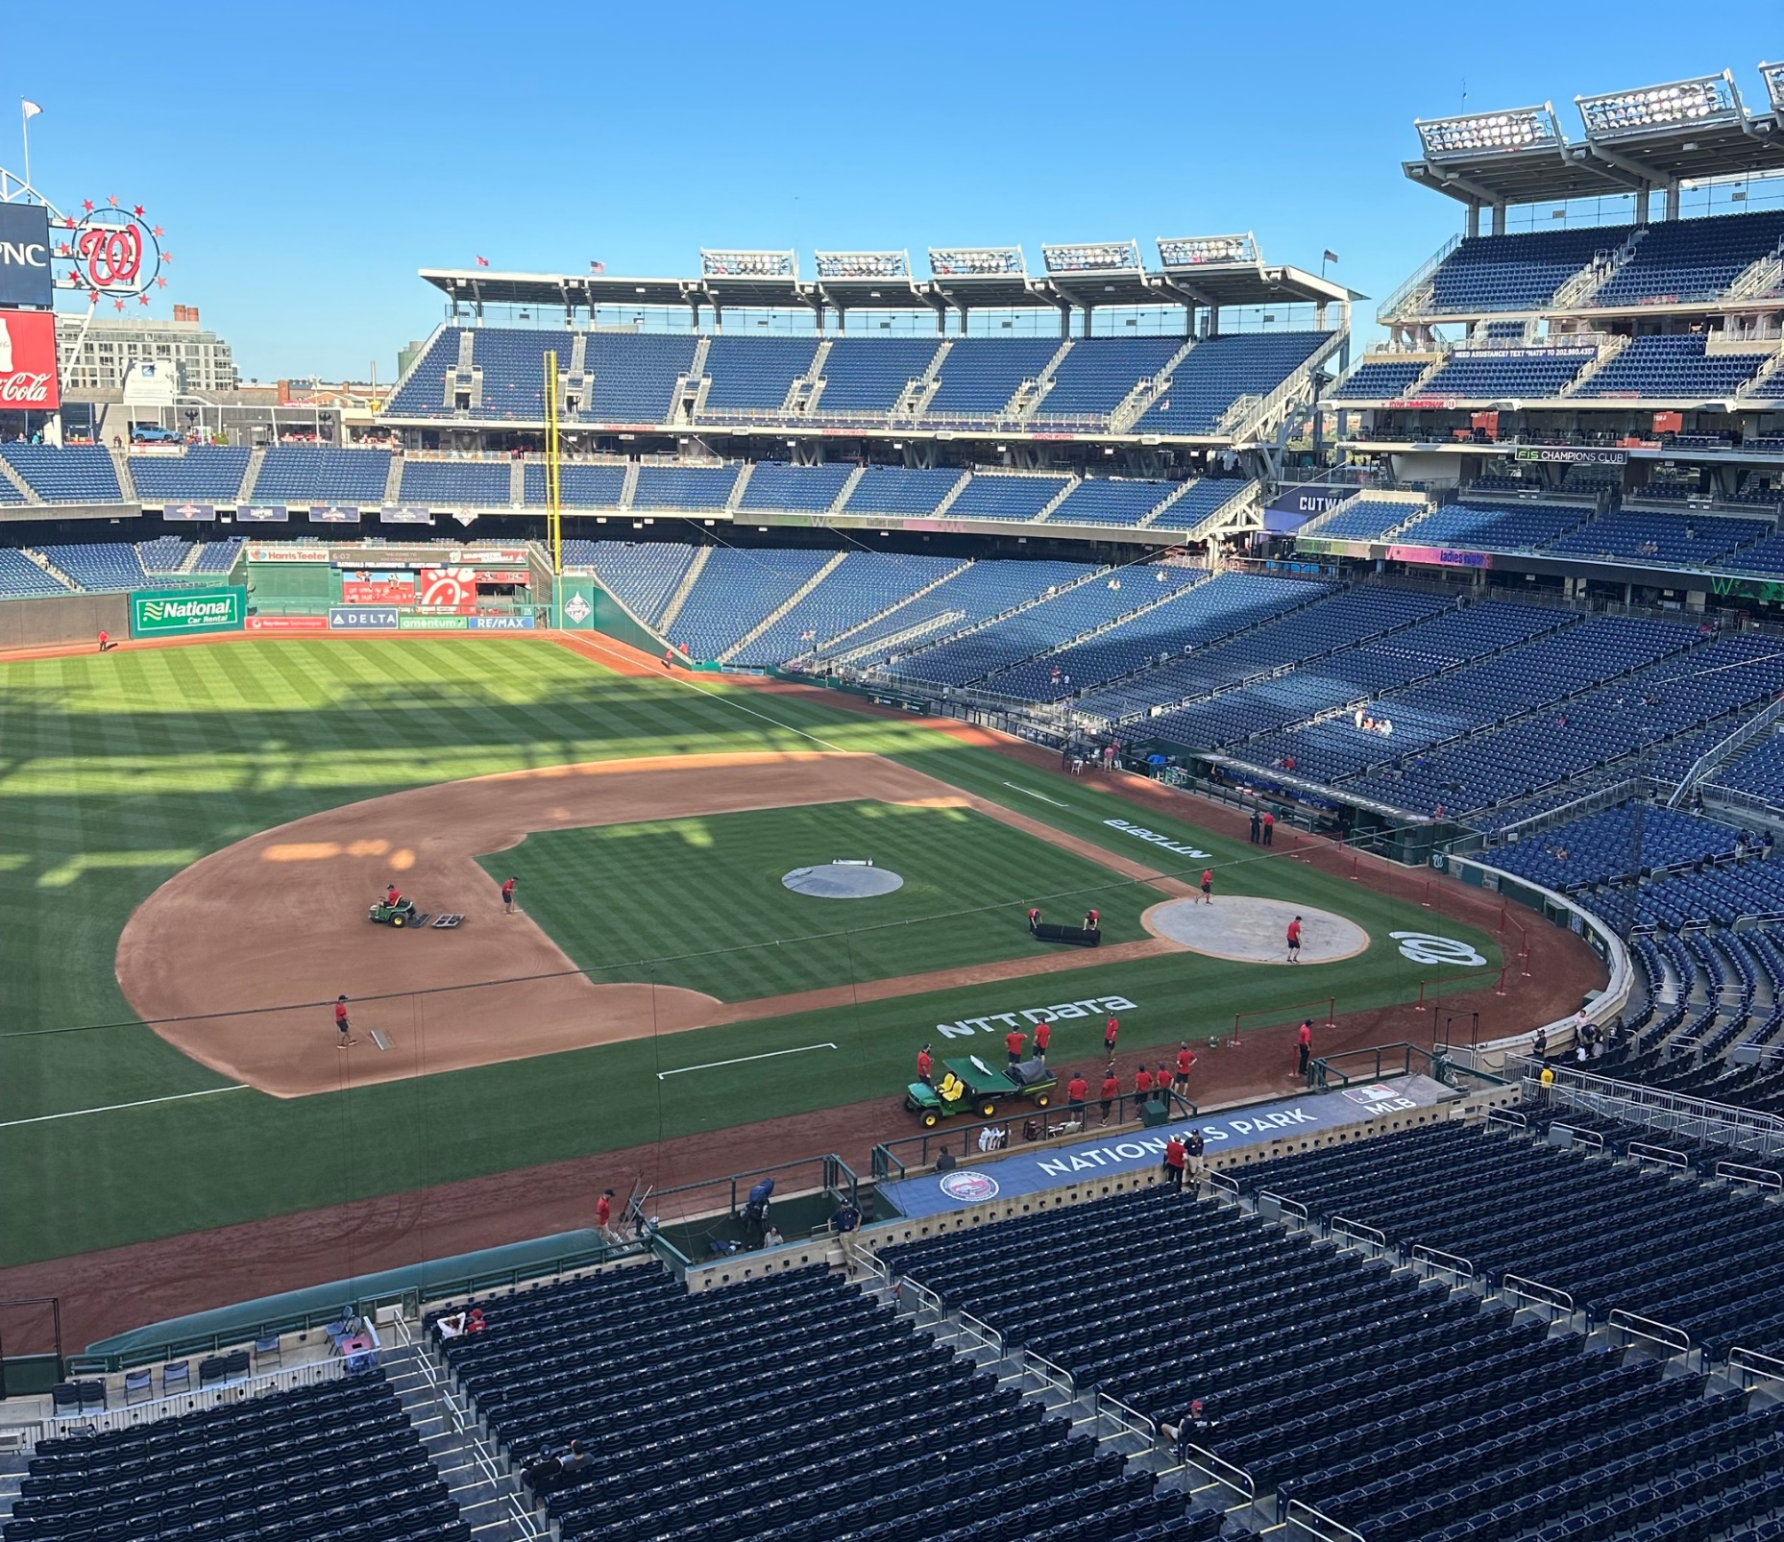
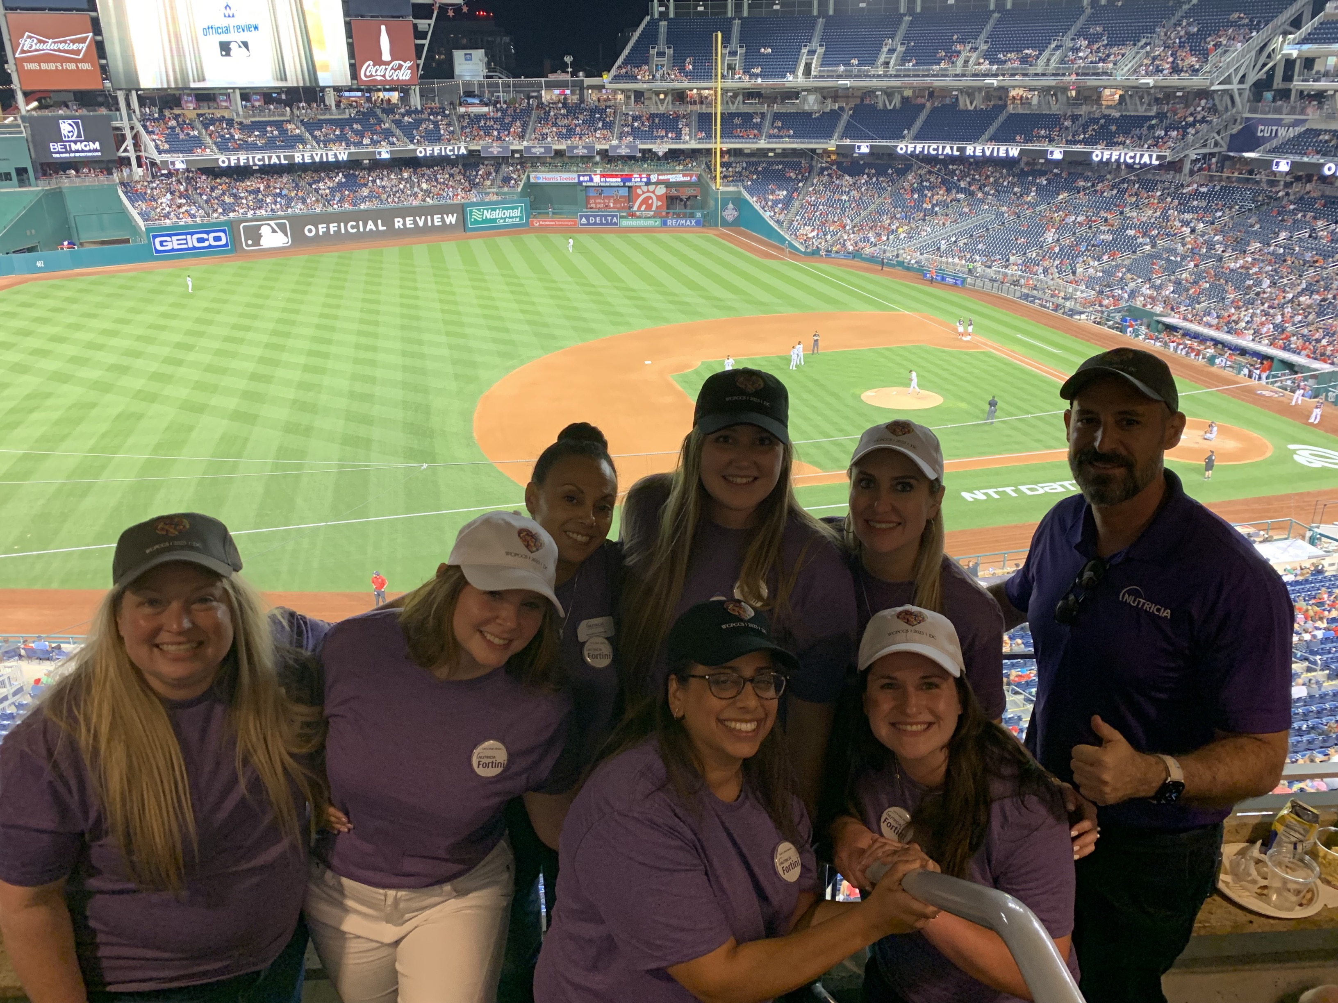
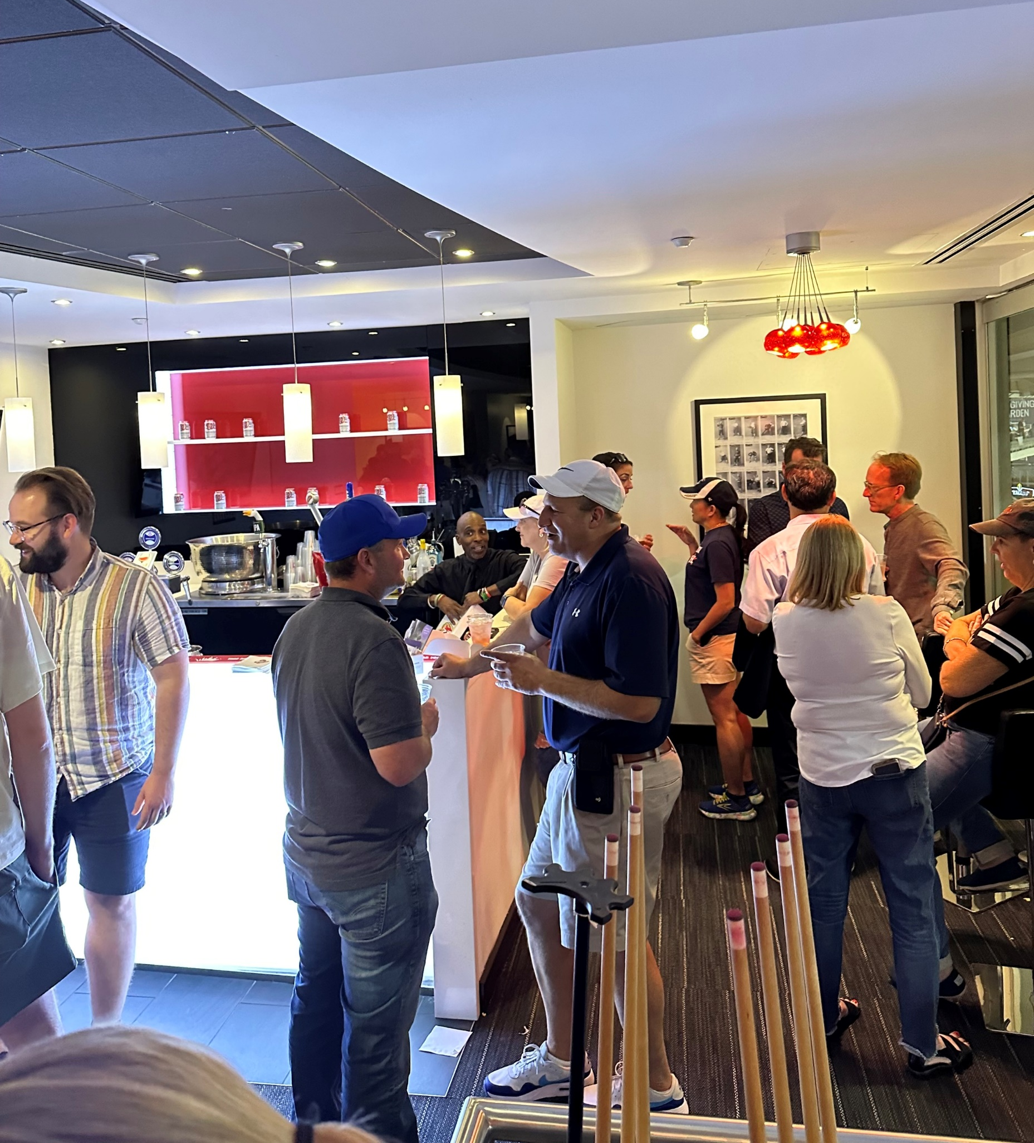
HOW
Exclusive networking event – night at the nationals game
First-of-its kind networking event hosted by Nutricia & supported by Congress organizers to connect with top Pediatric Cardiology teams in the US
Result: 50+ engaged HCP contacts in attendance → opened the doors for new relationships and unique opportunities for Fortini on-going
Don’t be afraid step outside the box for new ways to engage with HCPs!
Notes:
SARA: A huge thank you to Julie Martinez for connecting us with the conference organizers, we were the only company to sponsor a box at the World Congress Social Event which was the Nationals Game. We took a risk planning in planning a unique way to engage with HCPs that we do typically do not get the oportunity to interact with and get them excited about Fortini. Our event lasted four hours and our attendees were having so much fun we had to kick them out because the game was over. No one gets four hours a year with a pediatric cardiologist so we were lucky to have four hours at this social event and time at the conference. This event was very rewarding. We created connections with the top Cardiologists throughout the country, we even were able to get some Cardiologist to taste test Foritni We are excited for more events to come with these new connections.

Slide 5
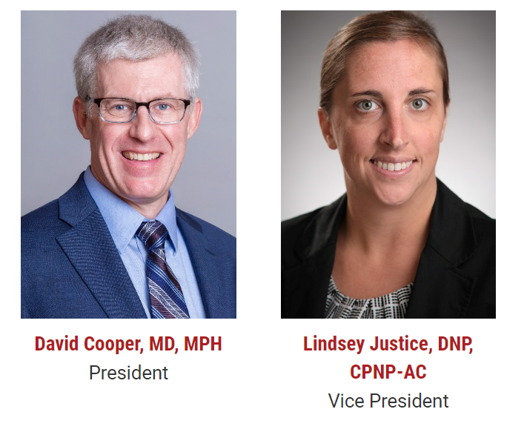
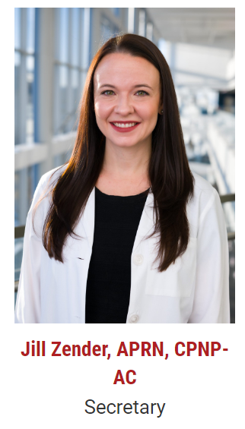

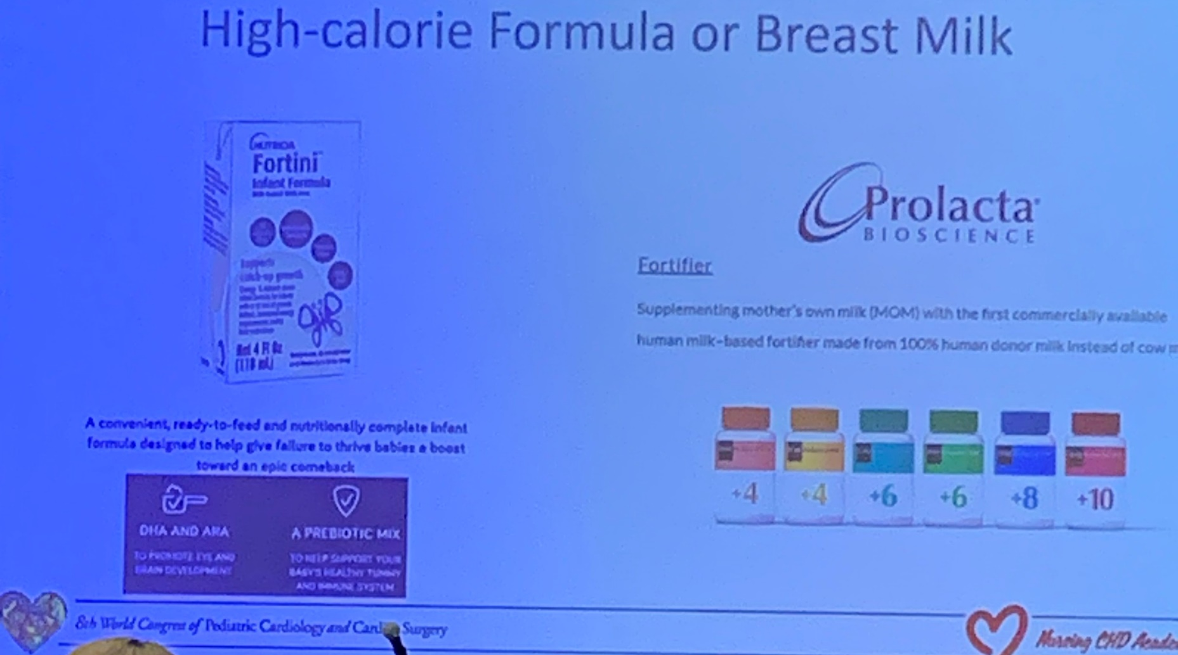

WHAT’S
NEXT?
Highlighting A Few follow-ups and connections from WCPCSS
Unique opportunity to present Fortini
Fortini medical team invited to visit and deliver education on Fortini to Pediatric Cardiology clinicians and further expand our network at one of the top children’s hospitals in the country
Next Steps: Continue to strengthen our connections with a key target audience and with the leading society for Pediatric Cardiologists
Connect with NP KOL
Fortini opportunistically highlighted for use in CHD Single Ventricle infants – product used during Early Experience program at CH Wisconsin
Next Step: Develop the relationship & grow our connection through our advocate
Notes:
Here’s the return on our investment from the event:
1) This is an important, on-going connection the team has worked to build! The pre & during conference activities, especially the baseball game networking event, secured an immediate opportunity to sponsor a Fortini lunch during the Pediatric Cardiac Intensive Care Society bootcamp and build our Nutricia connection with this societys executive membership and Top Pediatric hospital. Lindsey Justice The Vice President of PCICS invited us to tour their hospital and the Pediatric intensive care unit. Educate 50+ cardiology clinicians from hospitals nationwide on Fortini and to have dinner with key Cardiac HCP’s. Cincinnati Children’s ranks as one of the top children’s hospitals in the nation, especially for specialized pediatric care. Expanding our connection with key contacts from WCPCSS will allow for strong growth and future partnerships
2) Nancy Rudd, Pediatric Nurse Practitioner, Children’s Hospital of Wisconsin – EEP site . Highlighted using Fortini in her CHD Single Ventricle patients with only two options Fortini or Prolacta for infants with CHD

