Slide 1


BEST PRACTICE: BRAZIL
Fortini Infant HCP influencer campaign
June’23

Slide 2

WHY AN HCP INFLUENCER PROGRAM? WHY FORTINI? WHY NOW? HOW?
WHY INFLUENCERS?:
Consumers are more skeptical than ever
WHY FORTINI?:
Opportunity for increased awareness
WHY NOW?:
Product still in infancy with goal to test and learn
HOW?:
Consumers don’t trust branded messaging as much as recommendations from peers or influencers
Ratings and reviews are driving majority of purchases
Broad scale awareness and extended audience reach for <5% of A&P
Diversify channel mix
Tap into new HCPs and caregivers
Opportunity to increase awareness
Don’t have organic IG strategy as IG audience skews consumer and current brand focus is HCP – this program allowed us to capture IG audience with low level of organic effort
Program first of its kind at NNA! Huge win; many levels of approval
Strategic agency (Vivo) recommended influencer agency (CLEVER) to work directly with
Engaged DNA, local medical + regulatory to establish NNA influencer SOP
CLEVER identified influencers w/i own network; medical and marketing approved based on set of criteria
Fortini education packs sent to influencers

Slide 3


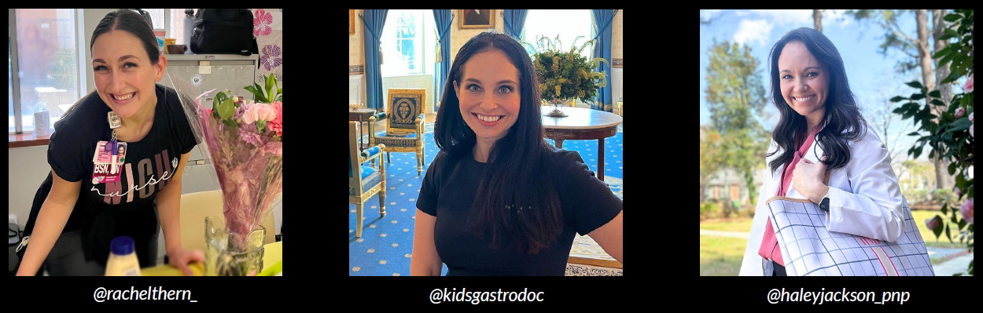
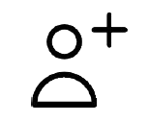

PROGRAM GOAL AND PROCESS
Objective:
          Increase awareness of Fortini Infant by having credible, HCP influencers share their thoughts on the evidence supporting the use of the product
        Campaign components:
          3 organic influencer posts on Instagram (5/1-5/10/23)
          2 weeks of paid media support on Instagram and Facebook (5/30-6/13/23)
        Influencer selection criteria:
HCP specialist managing FTT patients
10K+ Instagram followers; majority of audience HCPs
Professional account focused on credible and evidence-based content

Slide 4
TOTAL PROGRAM IMPACT
9.8M
24.5K
13.2K
$60K
IMPRESSIONS
ENGAGEMENTS
CLICKS
COST
8M guaranteed
1.8M above guarantee
19K guaranteed
Engagement= comments, likes, reactions, saves, shares, tap backs (not clicks)
+18 new IG followers
To the Fortini landing page
Organic link clicks: 109
Paid link clicks: 13,114
Influencer cost: $22.5K
Paid support: $19.5K
CLEVER fee: $18K (30%)

Slide 5
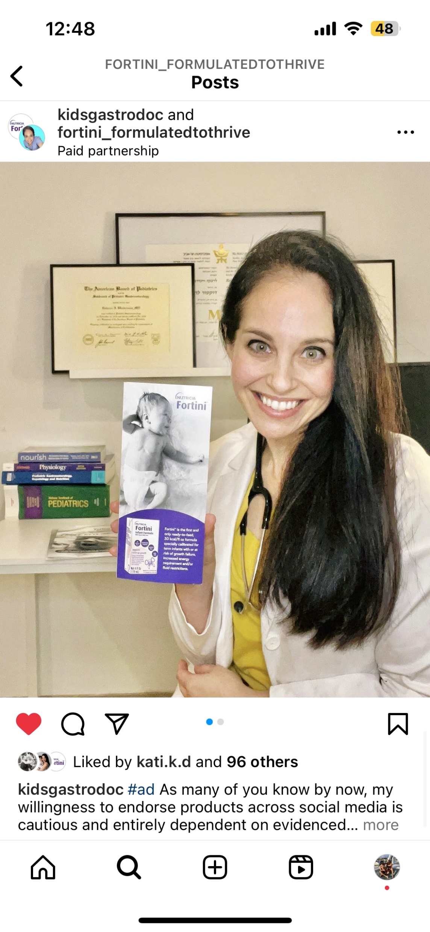
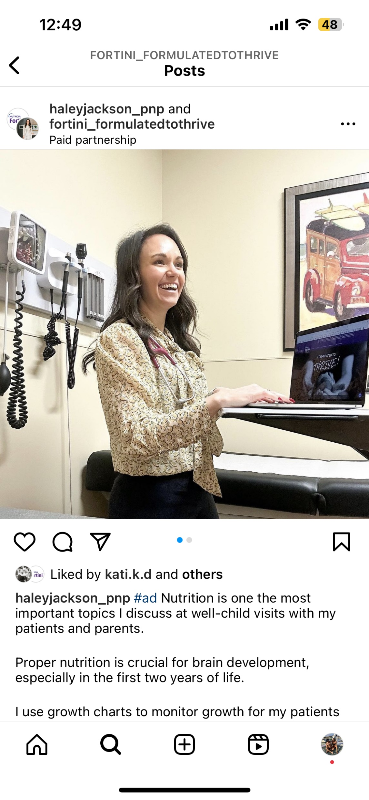
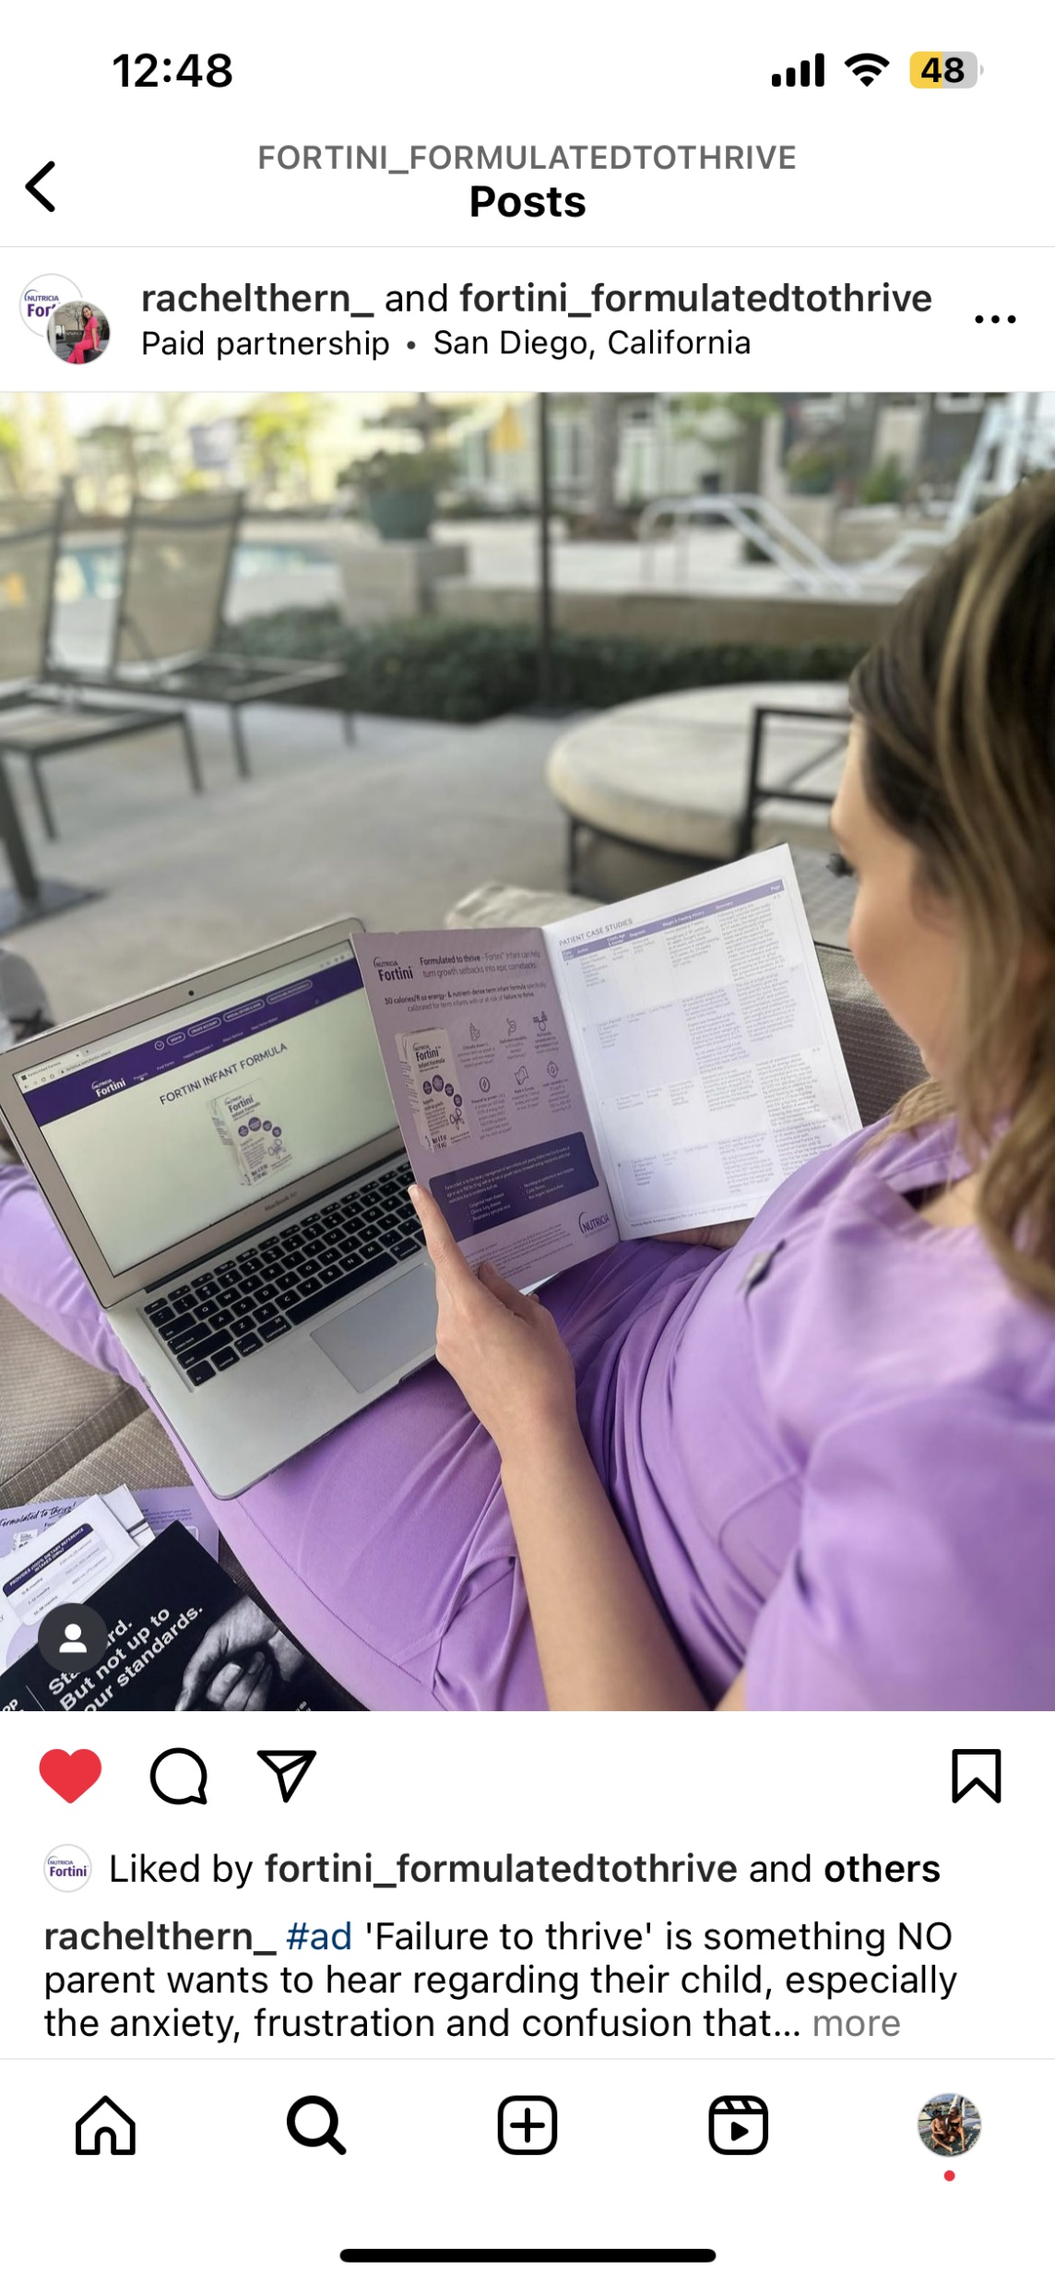
ORGANIC POSTS: DETAILS
Salesforce experienced barriers gaining access to Dr. Winderman – she’s now an advocate and has encouraged the local TM to contact her!
3 organic posts highlighting FTT, nutrition with FTT patients, and support of evidence behind Fortini
Content was intended for HCPs so required to include “#ad” and “talk to your doctor” in each post as to not confuse any parents/caregivers
At the time of posting, not all HCP influencers were recommenders of Fortini, but each are now bought in and are willing to recommend to their patient population

Slide 6
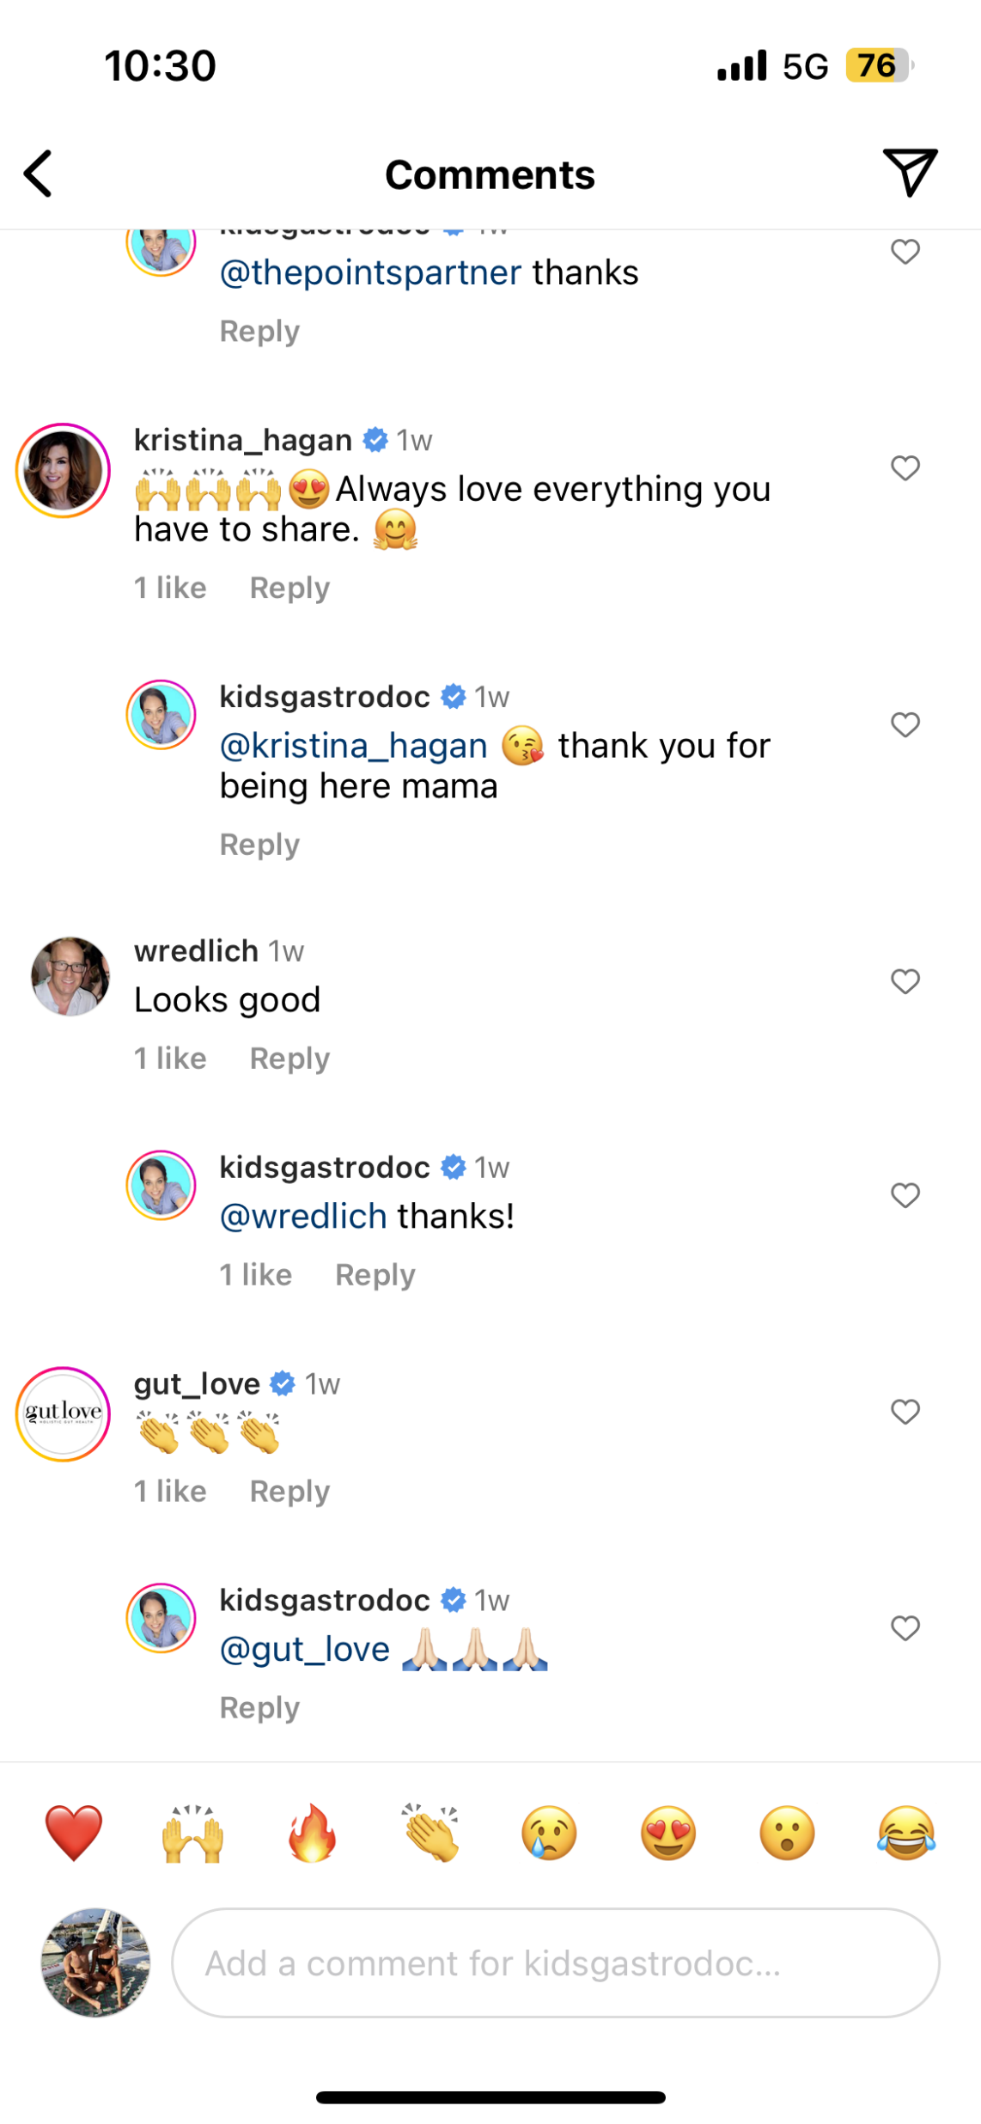
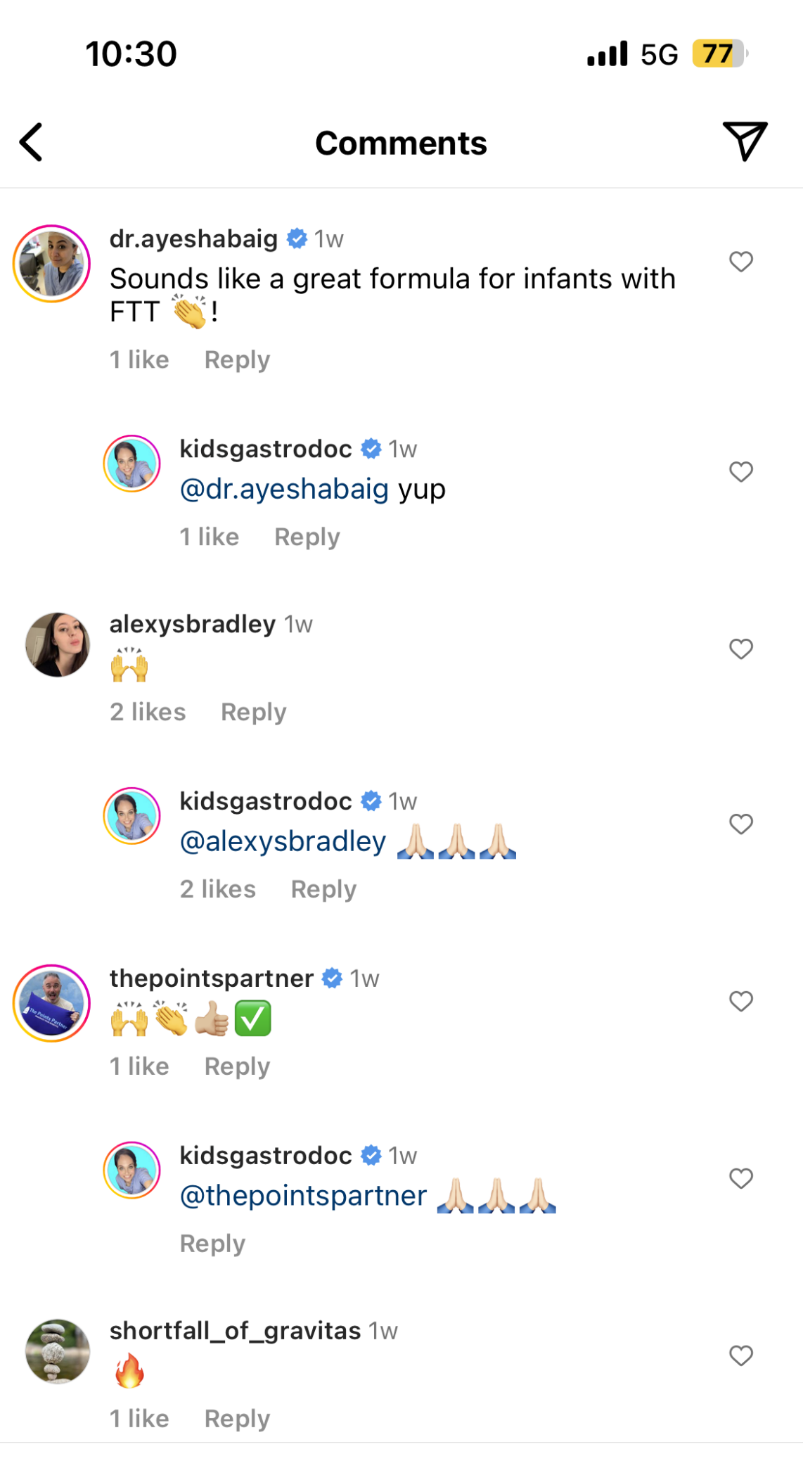
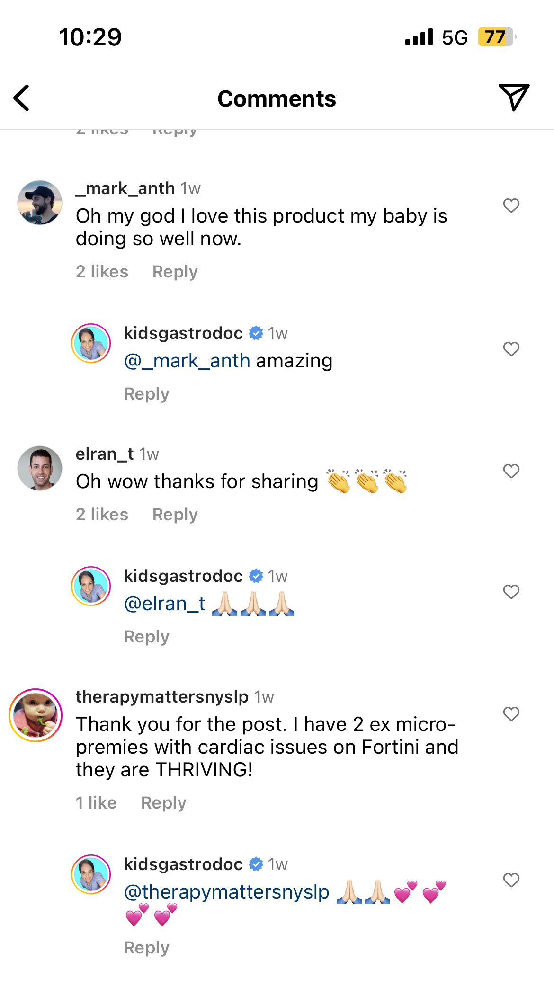
ORGANIC POSTS: COMMENT HIGHLIGHTS

Slide 7
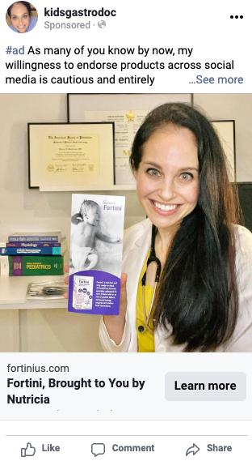
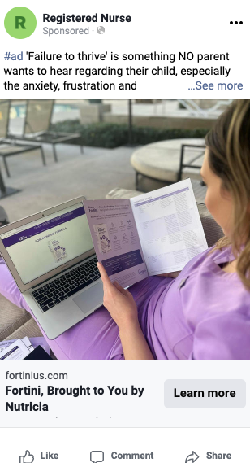
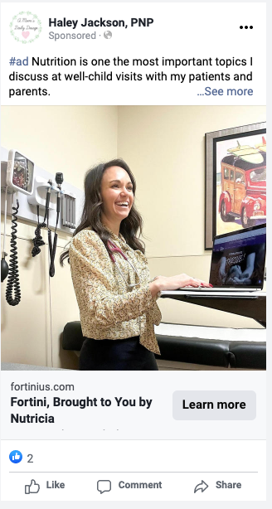
PAID MEDIA: DETAILS
Paid support targeting HCPs and consumers on IG and Facebook -- test engagement between two audiences
          HCP: interests, job title
          Consumer: interests, competitors
“Learn more” CTA driving to Fortini.com

Slide 8
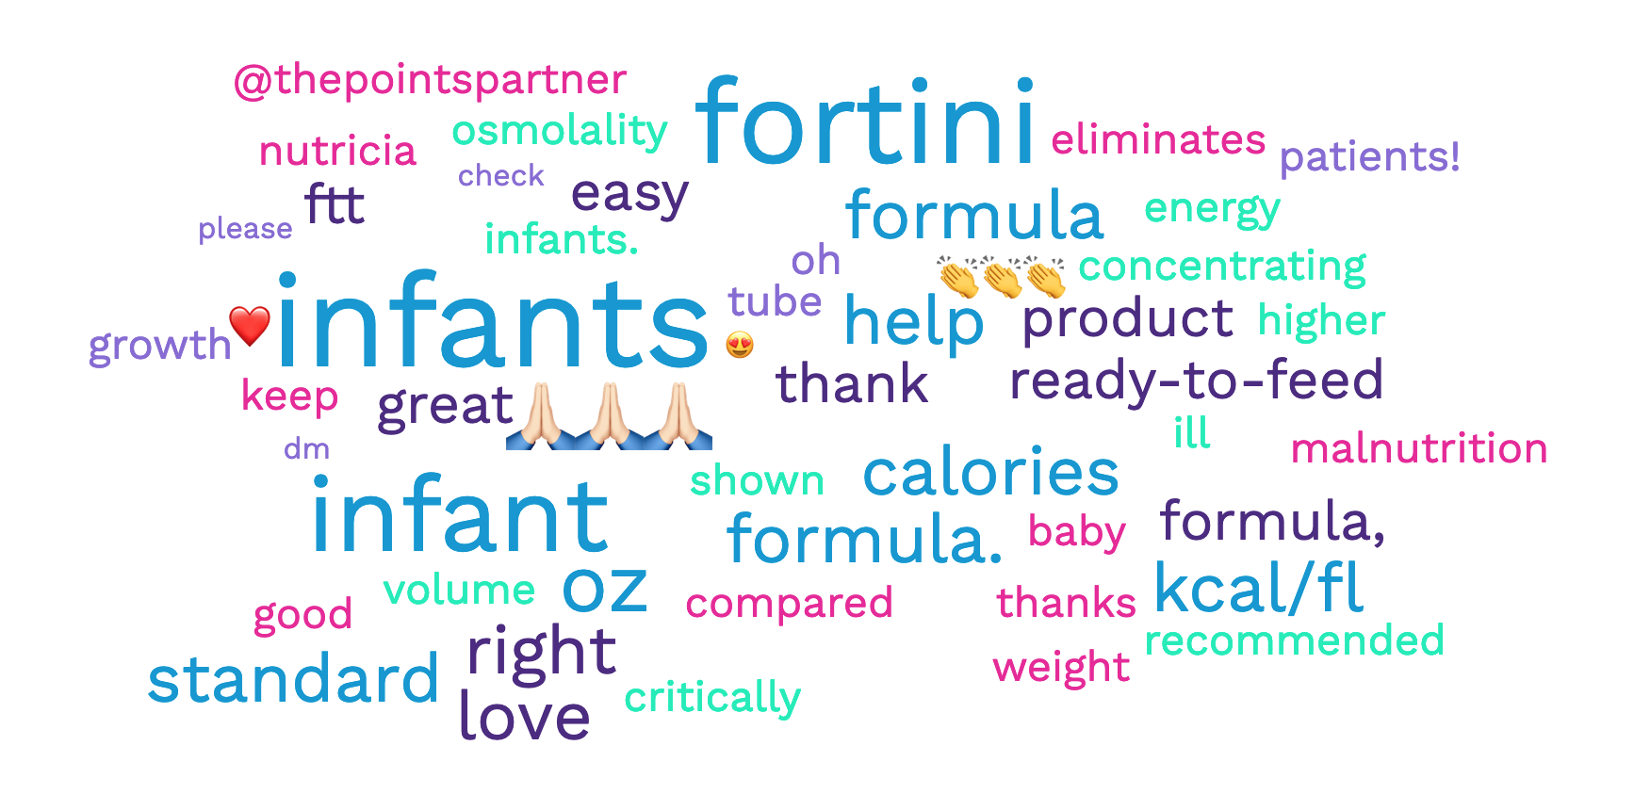
PROGRAM COMMENT ANALYSIS
Top commented words and emojis were analyzed:
The following themes were identified:
Product Efficacy: The comments indicate that users have found Fortini infant formula to be highly effective. There are reports of infants thriving on it, avoiding tube feeding, and helping in instances of Failure to Thrive (FTT). A user even called it a 'game changer' for providing needed calories.
Trust in the Brand: Some comments highlight trust in Nutricia, the company behind Fortini. One comment mentions another product from Nutricia (Neocate) that had helped their baby.
Product Innovation: There's an appreciation for product innovation within the comments, indicating that the audience appreciates the company's efforts to create specialized solutions like Fortini.
Ease of Use: There are repeated mentions of the ease of use of this product, particularly in a medical or healthcare setting.
Emotional Response: The comments show a strong emotional response to the product. Users express love for the product and gratitude for its effects on their babies' health. They also show excitement about the product and its benefits.
Encouragement & Positivity: There's a consistent theme of encouragement and positivity running through the comments, with numerous emoticons expressing approval and applause.

Slide 9
PROGRAM LEARNING, RECOMMENDATIONS, AND NEXT STEPS
Insight:
Paid support results show strong interest from a more general consumer audience
Action:
Insight:
IG audience shows higher engagement in stories and videos vs. static images
Consider leveraging video content such as Instagram reels to give audiences a real-life look into different use cases or to encourage creators to authentically share their thoughts on the formula
Even though this program was intended for HCPs, able to engage directly with consumers
Action:
Expand influencer parameters – test general Peds and mommy/parent influencers in 2024 campaign

