Slide 1


BEST PRACTICE: US
Fortini activations
Dec’24

Slide 2

US market - Strong yoy growth in 2024
Aug – DEC stock instability impacting the Momentum gained in the 1st Half
2024 Fortini Infant Projected YE NS
$7M
YTD vs. AOP
YTD vs. PY
+27%
+85%

Slide 3
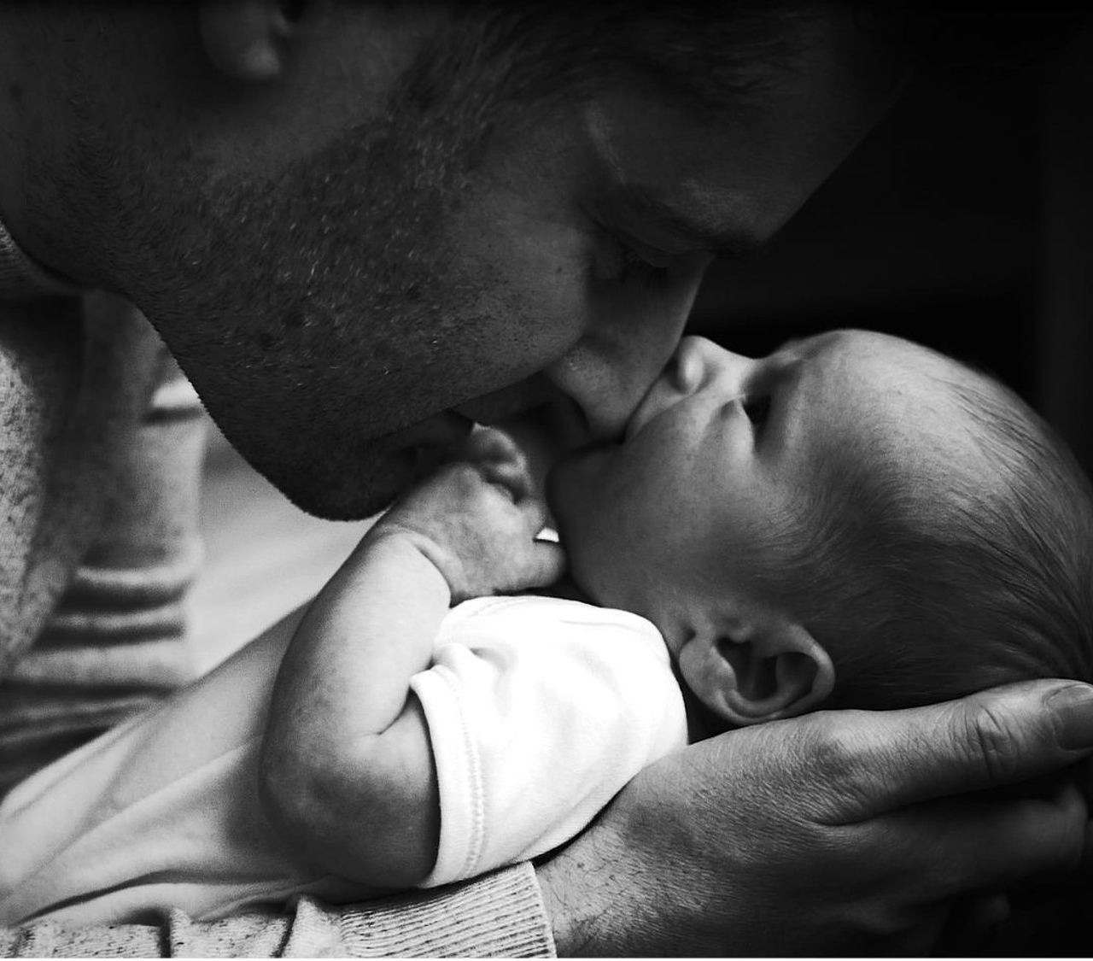

Marketing
Activities
US Best Practices

Slide 4
Fortini strategic house
CATEGORY VISION
Be the Change Catalyst to Defeat Malnutrition
Secure a world free from children suffering from growth setbacks
  Brand Vision/Ambition
Elevating the standard of care for faltering growth in the US to gives every child the right to thrive !
  Net Sales 2025: $9.2M
  Business objectives
  Marketing objectives
Drive trial & recommendation of Fortini
GROW MENTAL AVAILABILITY
INCREASE HOSPITAL PENETRATION
EXPAND INTO THE COMMUNITY
ENSURE PHYSICAL AVAILABILITY & REIMBURSEMENT
Strategic Priorities
Drive widespread HCP awareness of Fortini
Get target consumers to ask about and find Fortini
Get more targeted hospitals to use Fortini
Get converted hospitals to expand usage of Forini
Get high FTT volume Peds to recommend Fortini for catch-up growth
Unlock access barriers to support WIC, Self-pay, and reimbursed path to purchase
Jobs to be Done
Robust Innovation Pipeline: Expand infant portfolio & Enter 1+ Market

Slide 5
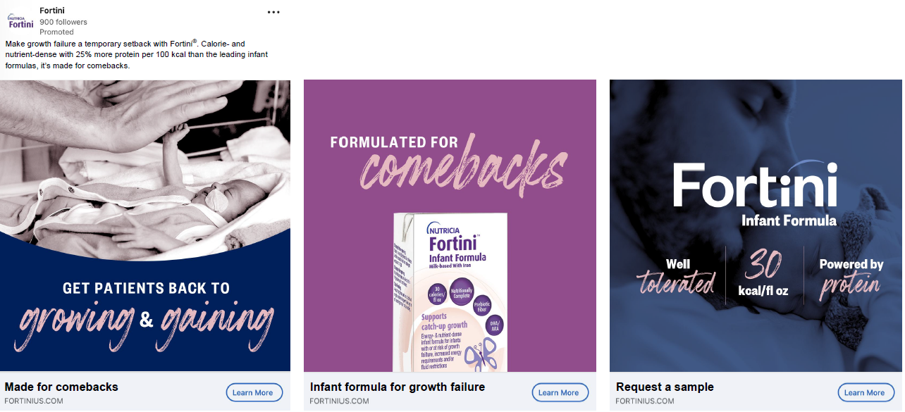
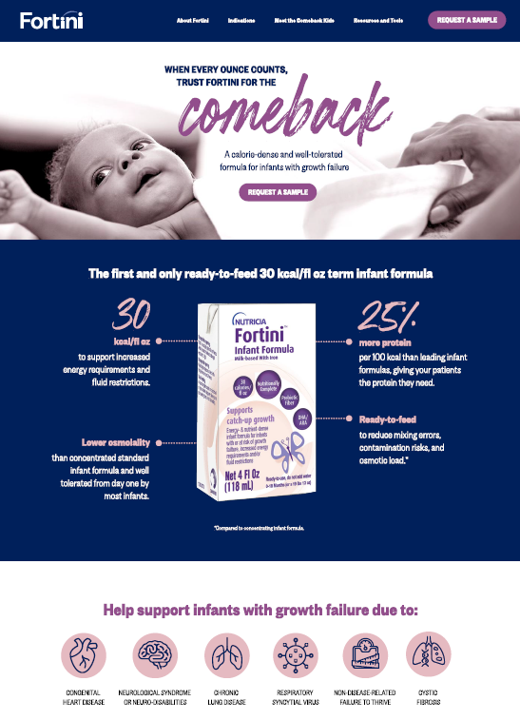
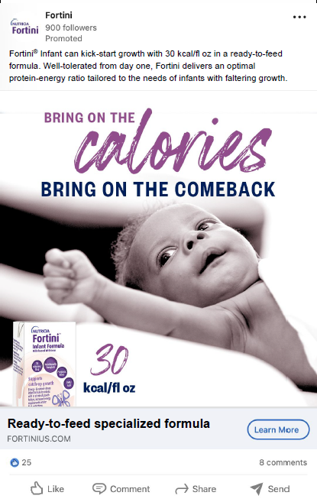
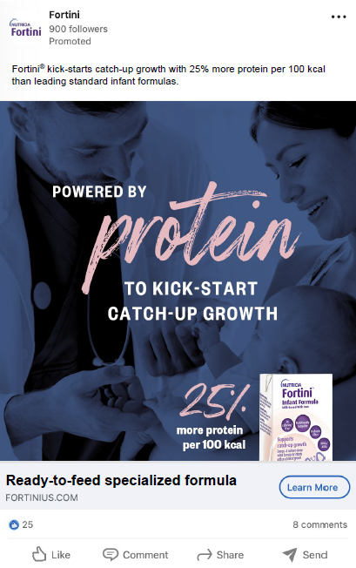
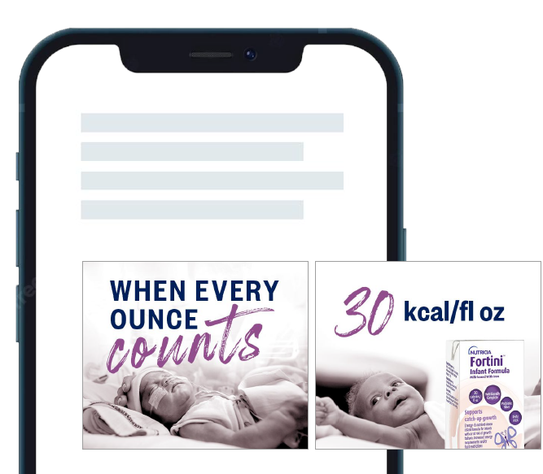
Specialists landing page & digital ads optimized with
new VI and messaging
Digital Ads
Landing Page
Go Live
Mid-Sep

Slide 6
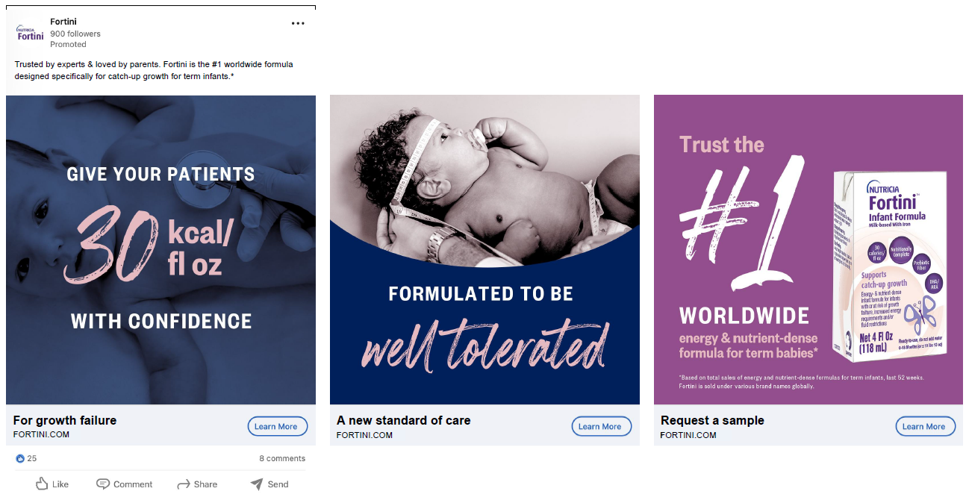
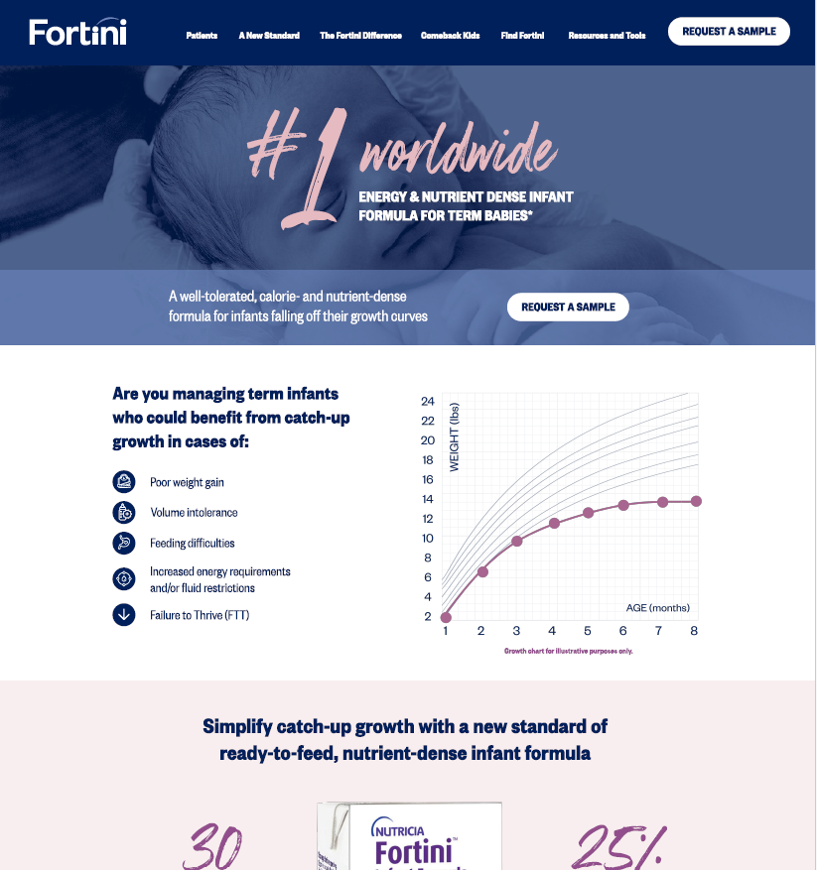
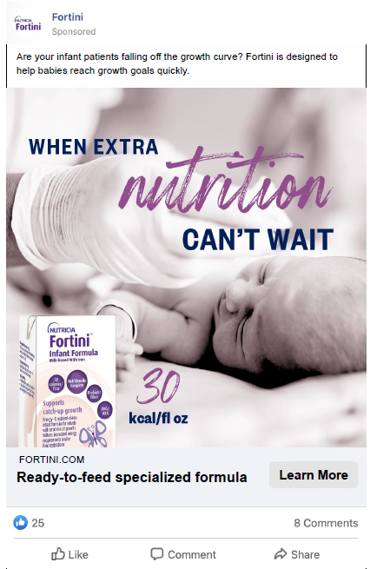
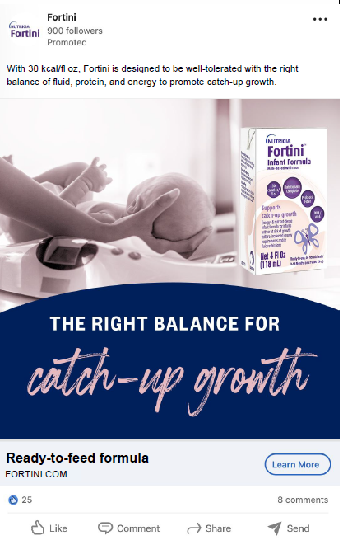
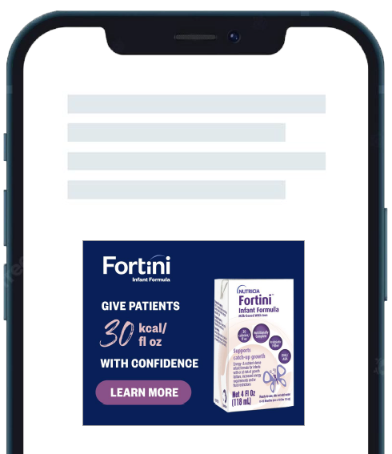
Pediatric landing page & digital ads
Digital Ads
Landing Page
Go Live
October
Activating new heritage claim to build credibility

Slide 7
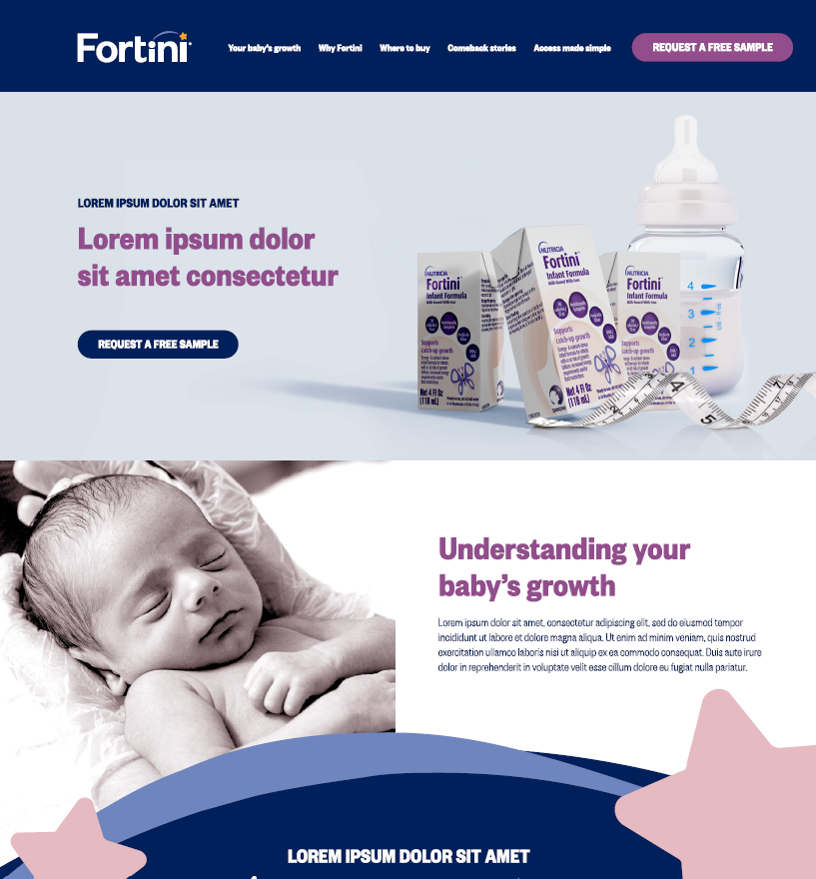
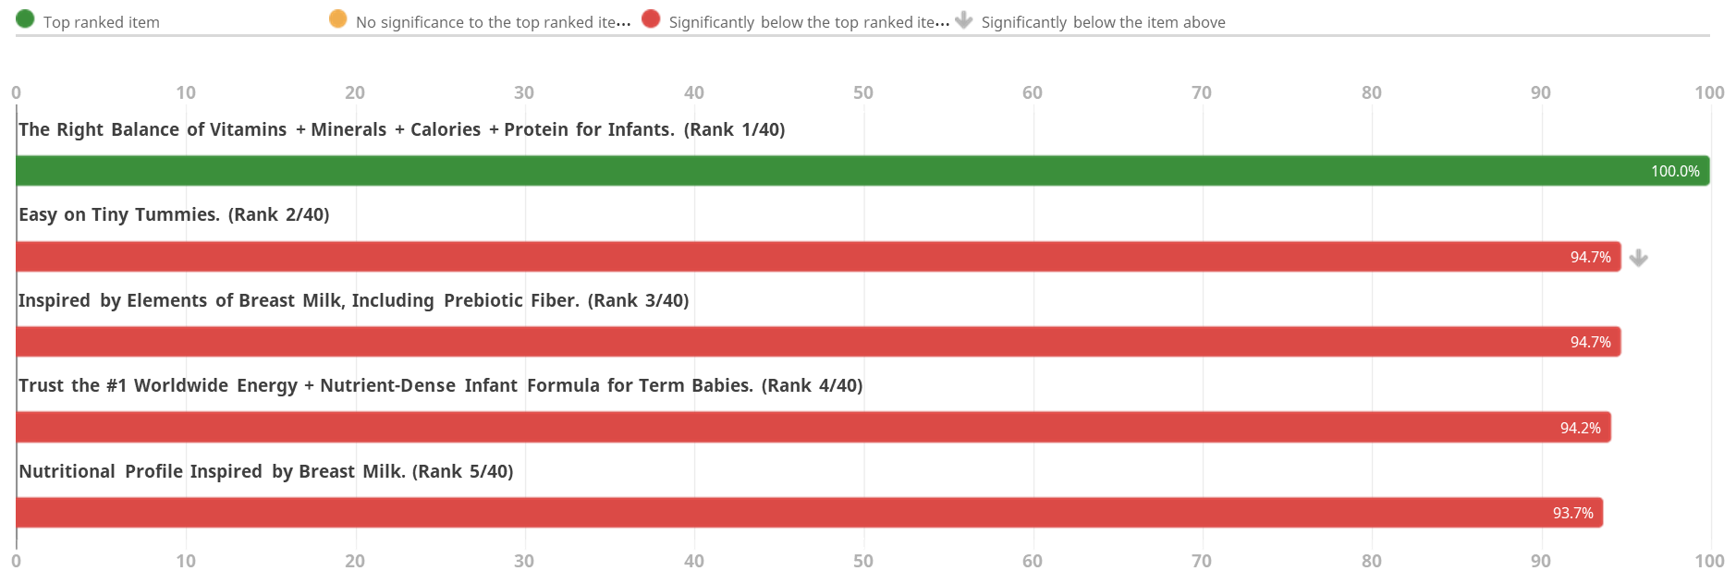
Consumer creative refresh in-progress– Early feb 2025
Consumer creative has not been updated since launch:
Adding Consumer sampling – NEW!
Landing page draft complete
New Ad statements tested with Consumers
Final creative will also be tested with Consumers

Slide 8
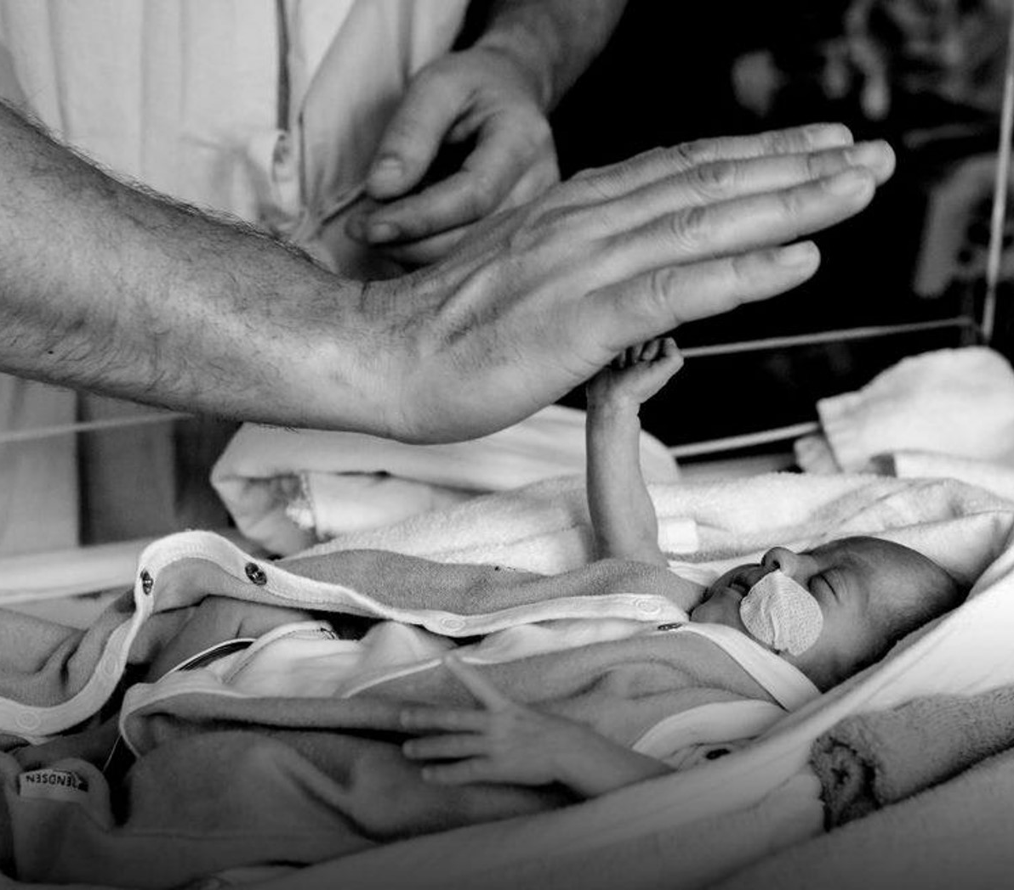
Medical Activities
US Best Practices

Slide 9

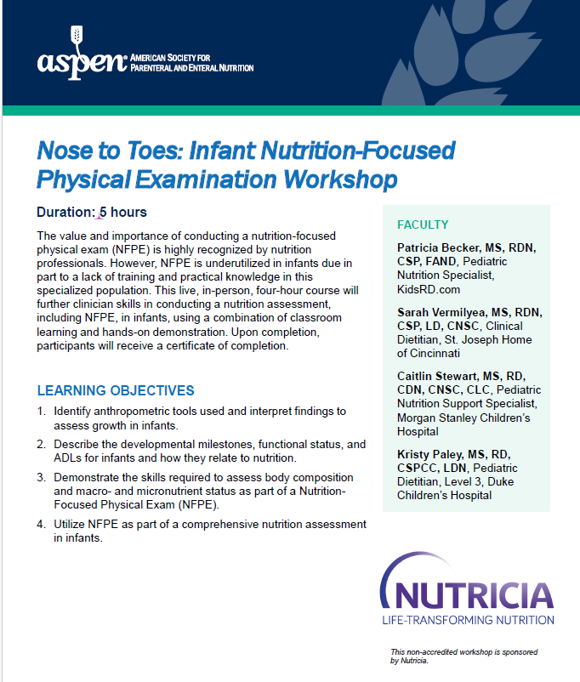
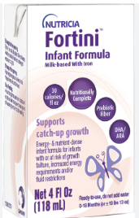
Partnership with credible professional organization to
achieve goals of educating on malnutrition
Problem
Solution
Pediatric malnutrition underdiagnosed in US
Failure to thrive ~23.3.% in children
Clinicians are hesitant in diagnosing malnutrition in infants due to lack of knowledge
Diagnosis of malnutrition is necessary when recommending Fortini
ASPEN is leading professional organization in malnutrition diagnosis guidelines
Nutricia partnered with ASPEN to develop a solution to educate clinicians on diagnosing malnutrition
Nutricia and ASPEN have common goals of providing quality, credible education for HCPs.
6 Months to develop workshop with ASPEN
4 Top experts from aspen created content & presenters
5 hour educational course including hands-on sessions
Hands-on equipment provided by perspective equipment
Recording of session on ASPEN’s website –December 2025

Slide 10
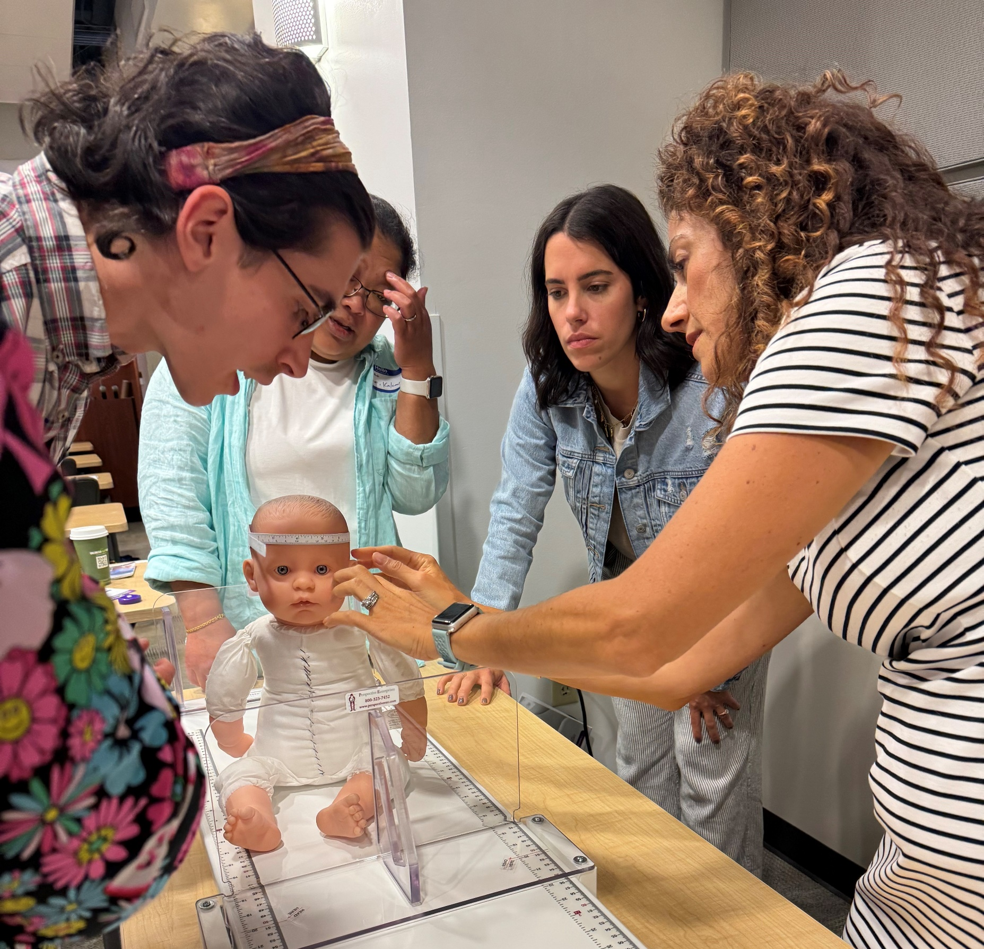
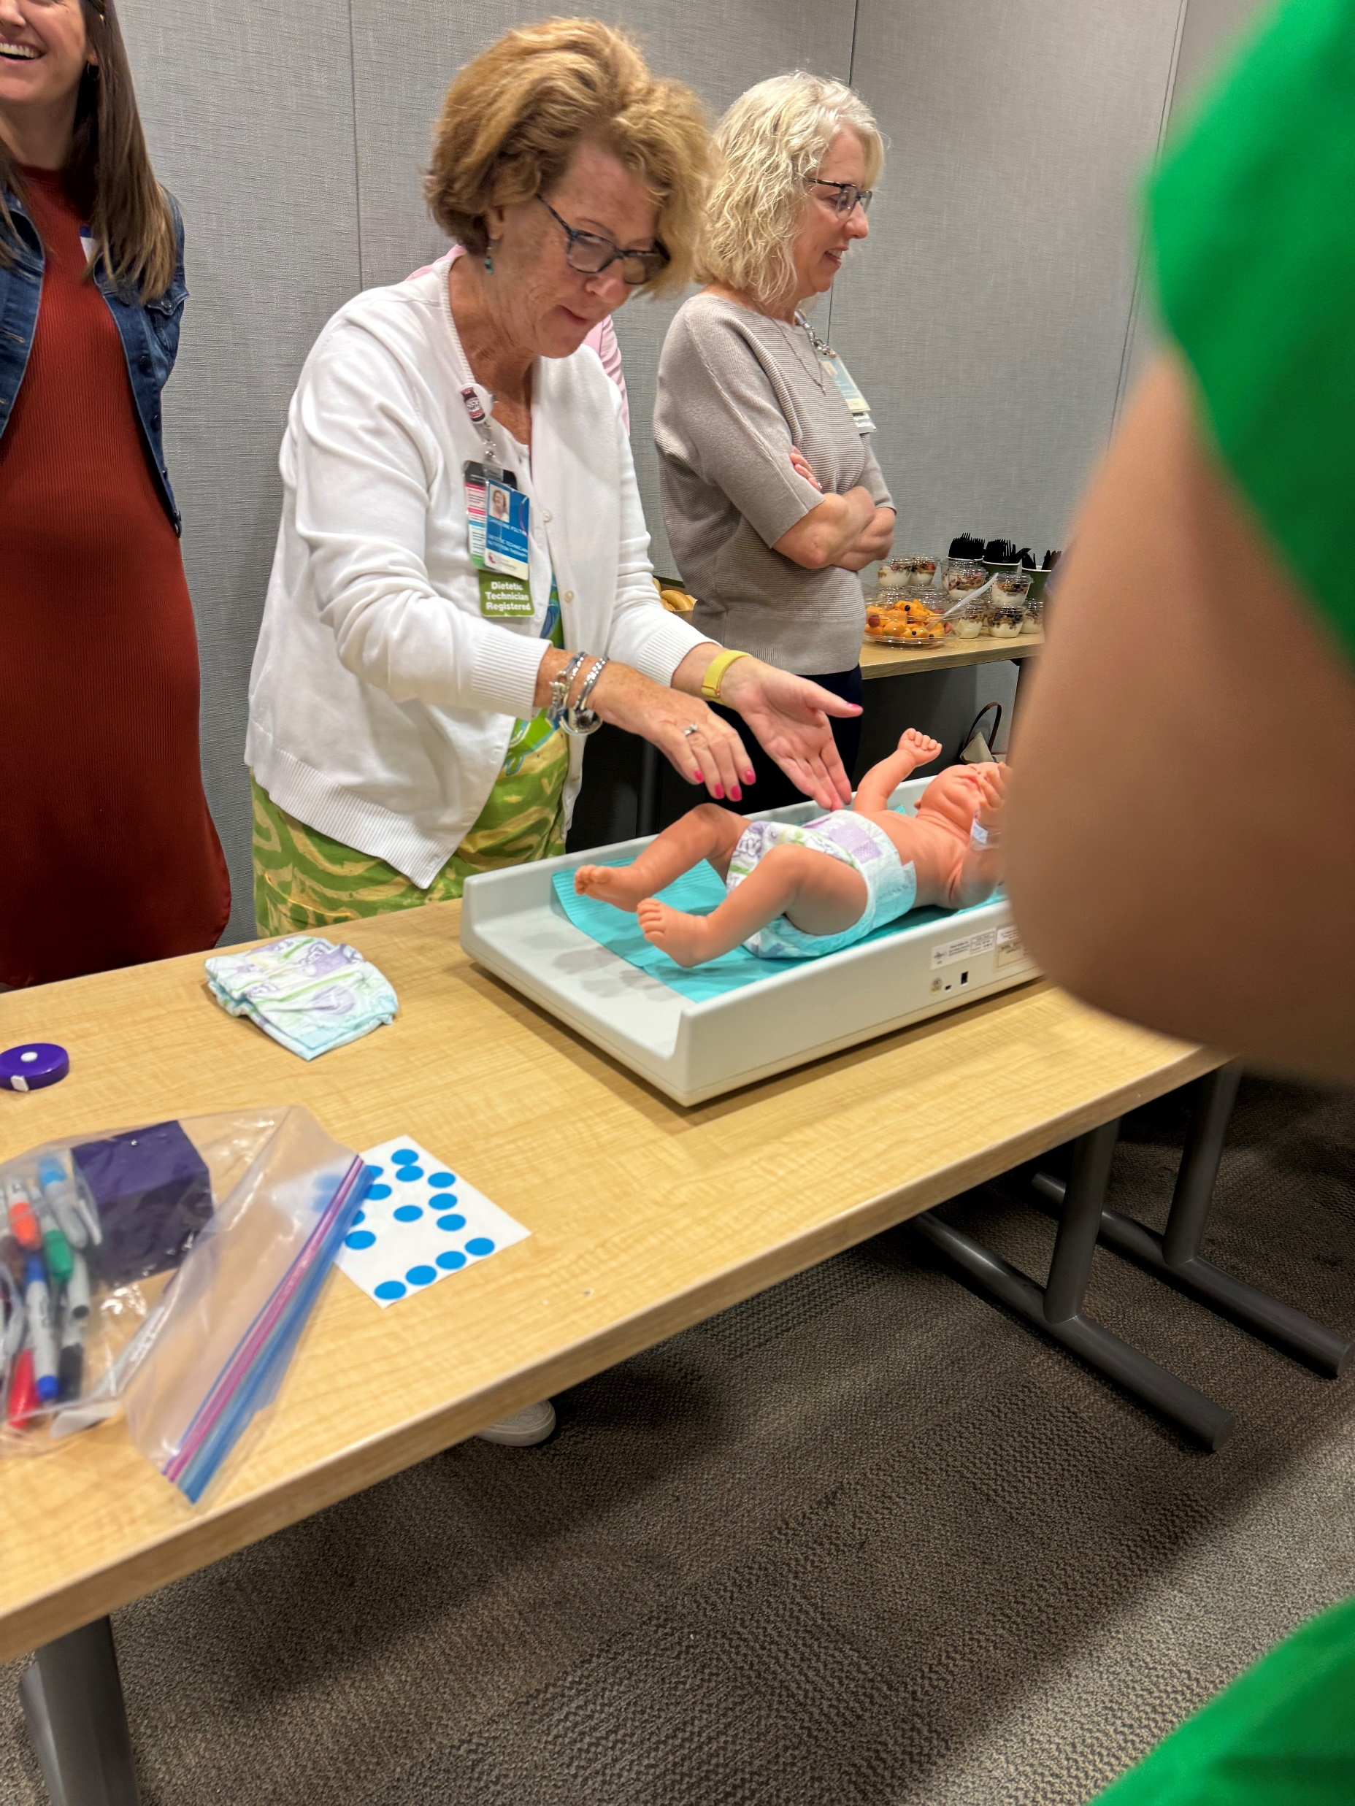



Positive Outcomes from collaborative
educational event from aspen & nutricia
ASPEN & Nutricia hosted workshops at most prestigious hospitals across US to educate providers on diagnosing malnutrition.
Cincinnati
Dallas
Los Angeles
Atlanta
Children’s National
Educated 219 HCPs from 47 hospitals
5 Star rating
95% will implement changes in practice
Virtual follow-up event for attendees:
ASPEN & Nutricia to host 1-hour session
Provide education on how to use ASPEN’s malnutrition tools which were sponsored by Nutricia
Nutricia to provide education on ENDF
ASPEN to address questions now that clinicians are implementing nutrition focused physical exam January 2025
(3) Events tentatively planned for 2025!

Slide 11




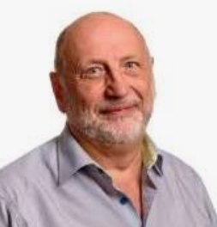
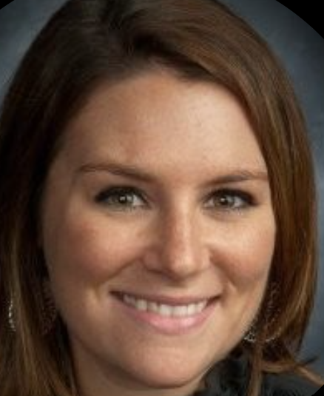

Third annual Pediatric Nutrition Masterclass: exceeding expectations through
medical education 5-Hour course focusing on Allergy and Challenged growth
100% of participants stated:
Met learning objectives
Valid content
Free of commercial bias
Satisfied with program
96% of participants:
Program influenced understanding of allergy & growth
2,281 QR code downloads in 24 hrs
Top downloads:
#1 Sorensen et al 2021 -Highlighting Neocate Syneo data
#2 CMA Flow chart
#3 Supplementation Guide to mix Fortini with Human Milk
Opening Session
Results
647 attendees
15 countries
150+ sample requests
Continued Follow-up
Email to attendees:
Medical Resource guide
QR codes linking to published data and medical tools
Dr. Rubin
Digital Opinion Leader
1.5 M Social Media Followers
Other influential speakers:
Yvan Vandenplas
Caitlyn Stewart
ASPEN Speaker
Maggie Jerome

