Slide 1


BEST PRACTICE: FRANCE
Infatrini HMO launch
Sep ’25

Slide 2
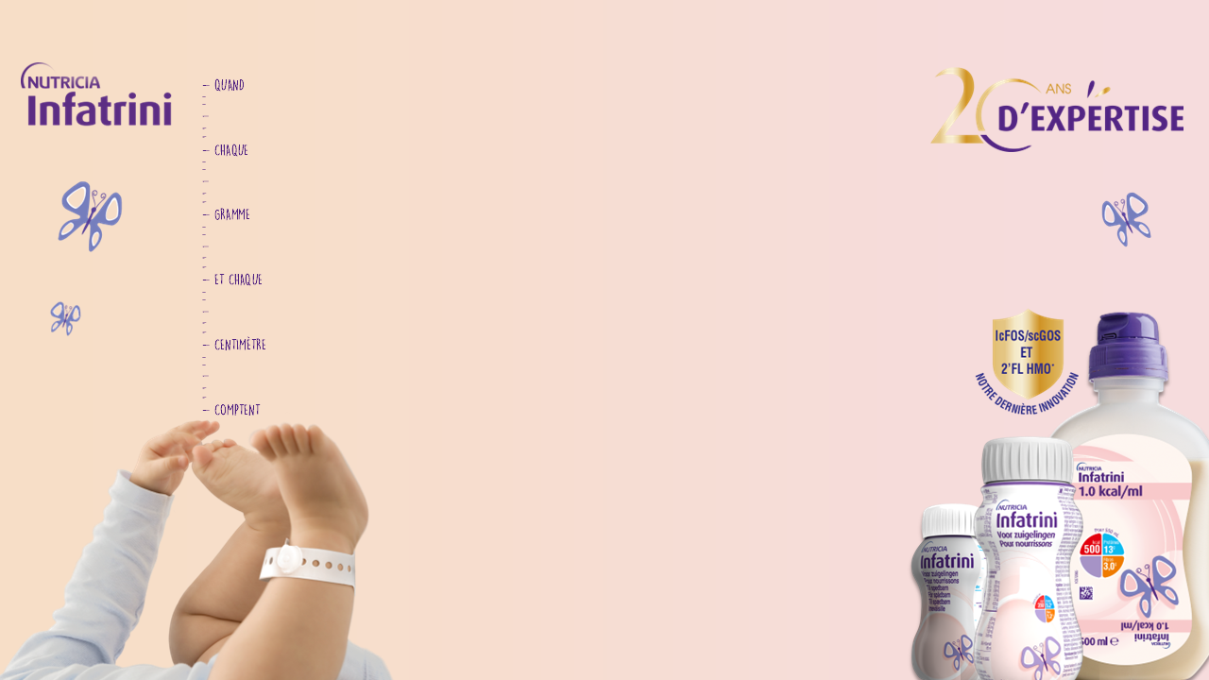
INFATRINI HMO LAUNCH IN FRANCE

Slide 3
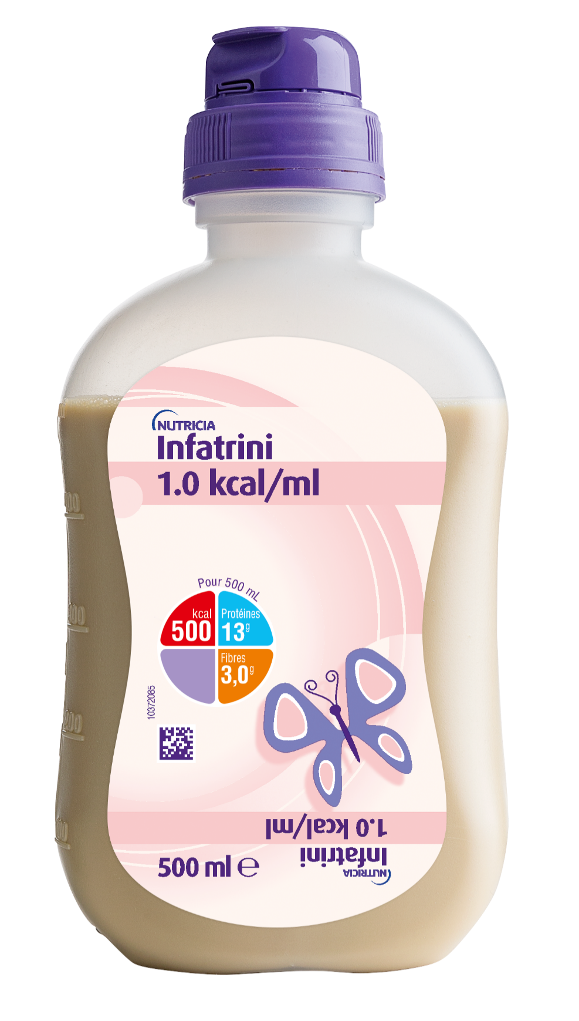
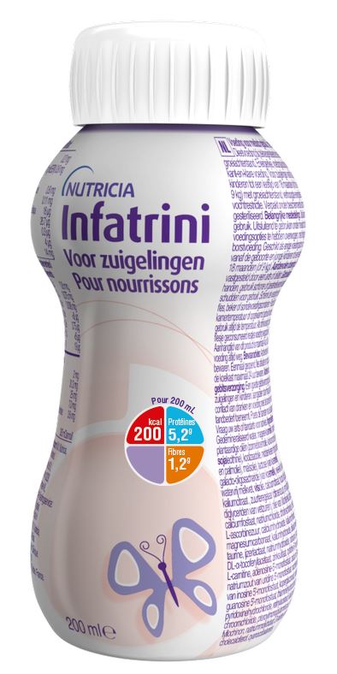
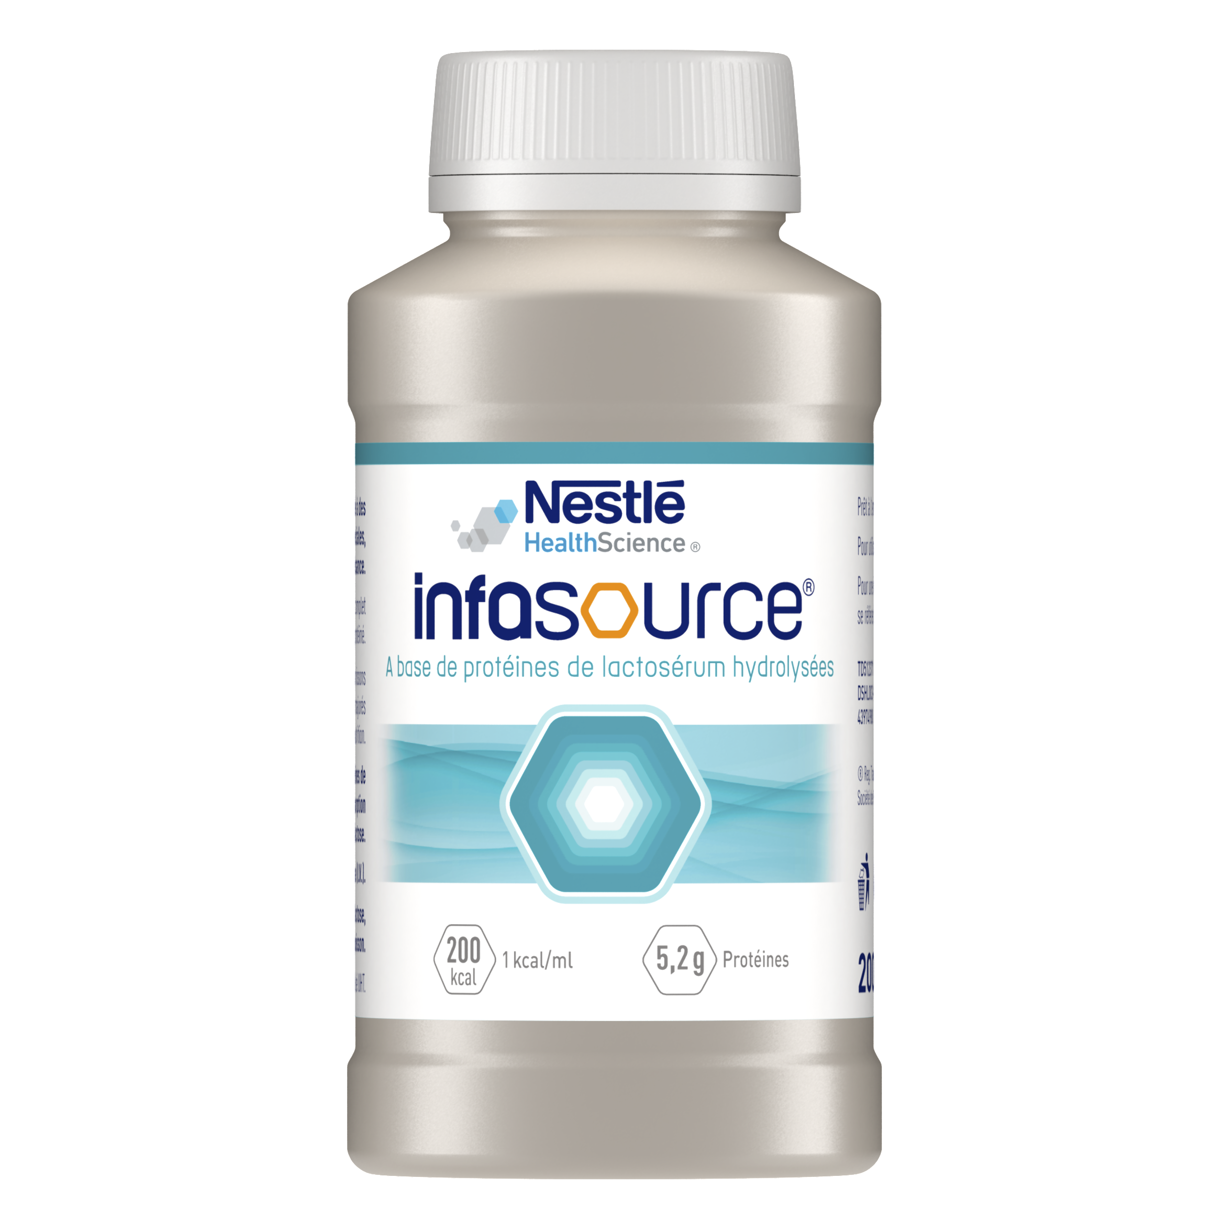
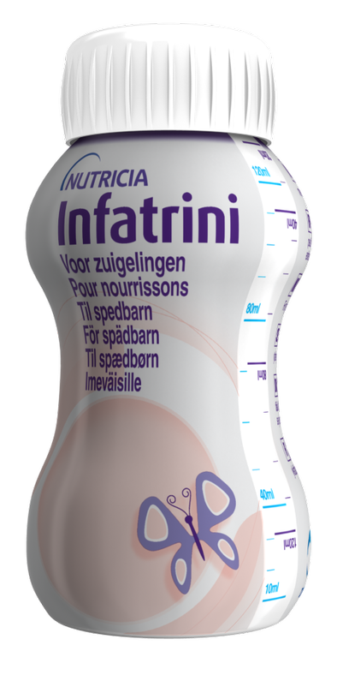
FR BUSINESS CONTEXT BEFORE RENO : INFATRINI IS THE PIONEERING LEADER, CHALLENGED BY nestlé INFASOURCE SINCE 2020
2023 :
94% MS
2,8 M€ NS
Nestlé Infasource : 6% MS
→ high defense plan since 2020 to refine its positioning between Infatrini & Infatrini Peptisorb
Market growth 23 vs 22 = +4%
BUSINESS OBJECTIVE WITH HMO RENOVATION =
Drive category steady growth, supporting infant malnutrition diagnosis & maintain Infatrini undisputed leadership

Slide 4




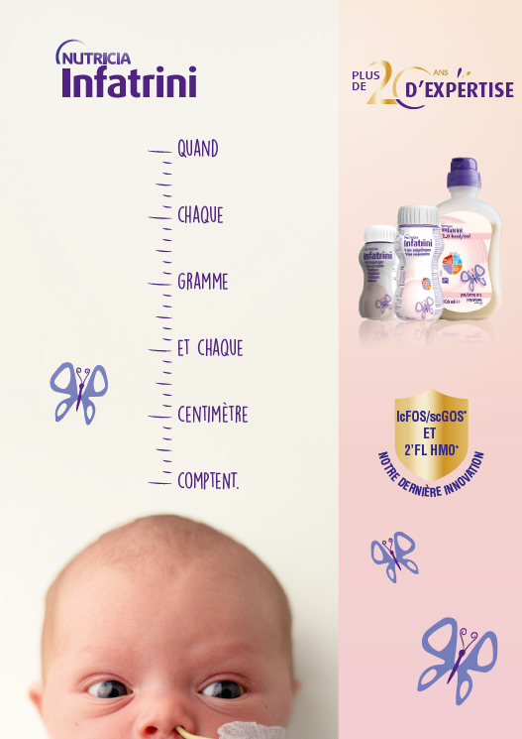
RENOVATION LAUNCH PLAN: SHOWCASE INFATRINI high expertise & LEGACY
ACTIVATION PLAN :
Sept 24 :
Internal birthday party animation at SN field force seminary
Q4 2024 :
Field force
+ MCE activation
FY 2025 :
MCE campain joint with NutriniDrinks
We capitalized on Global campain
Key messages :
Strong legacy, years of expertise & formula improvements for infant care
Clinically proven efficacy & tolerance

Slide 5
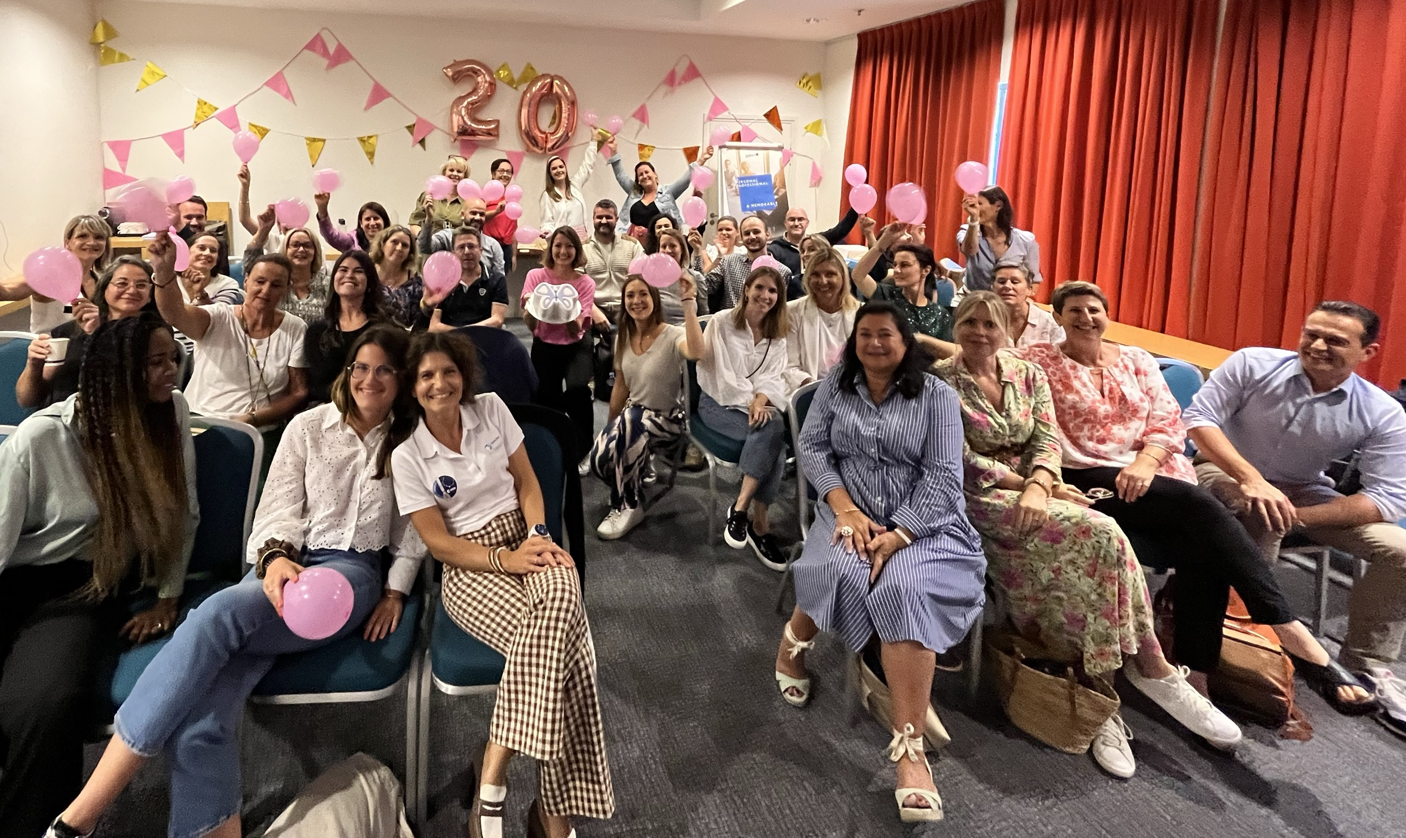
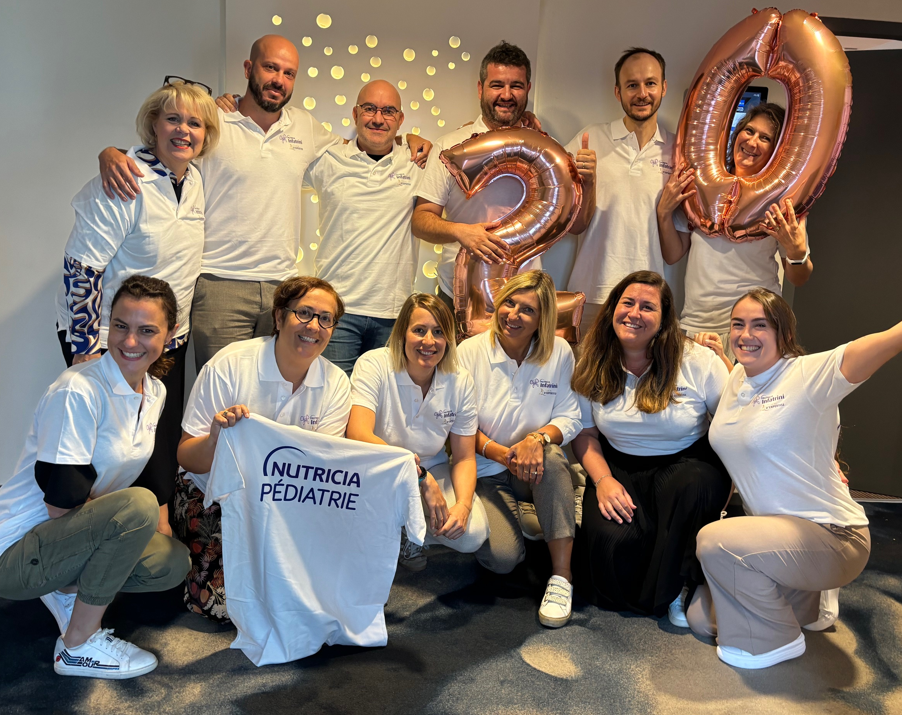
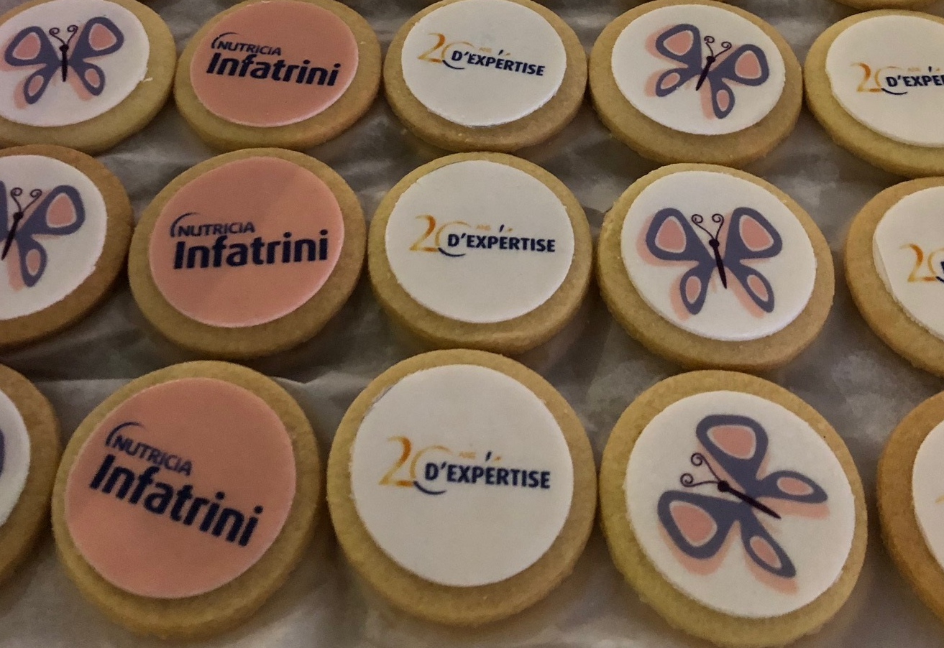
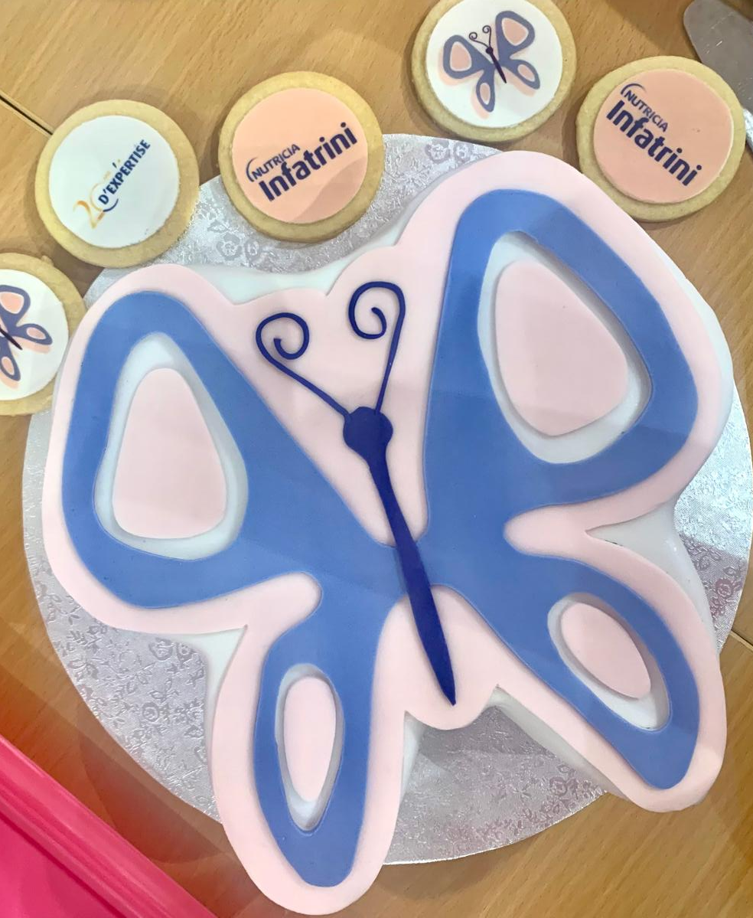
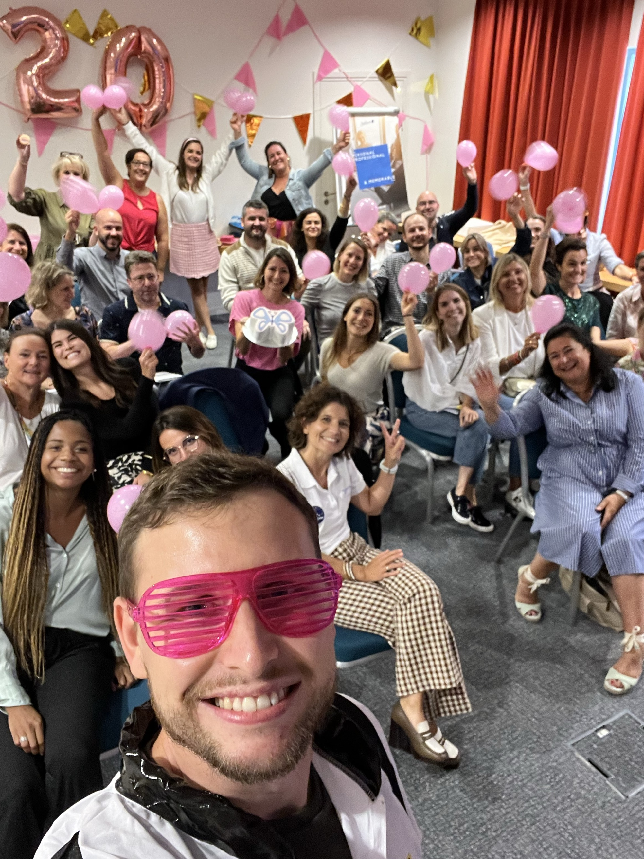
SEPT 24 : BirthDay party FOR INFATRINI at SN SALES FORCE SEMINAR

Slide 6
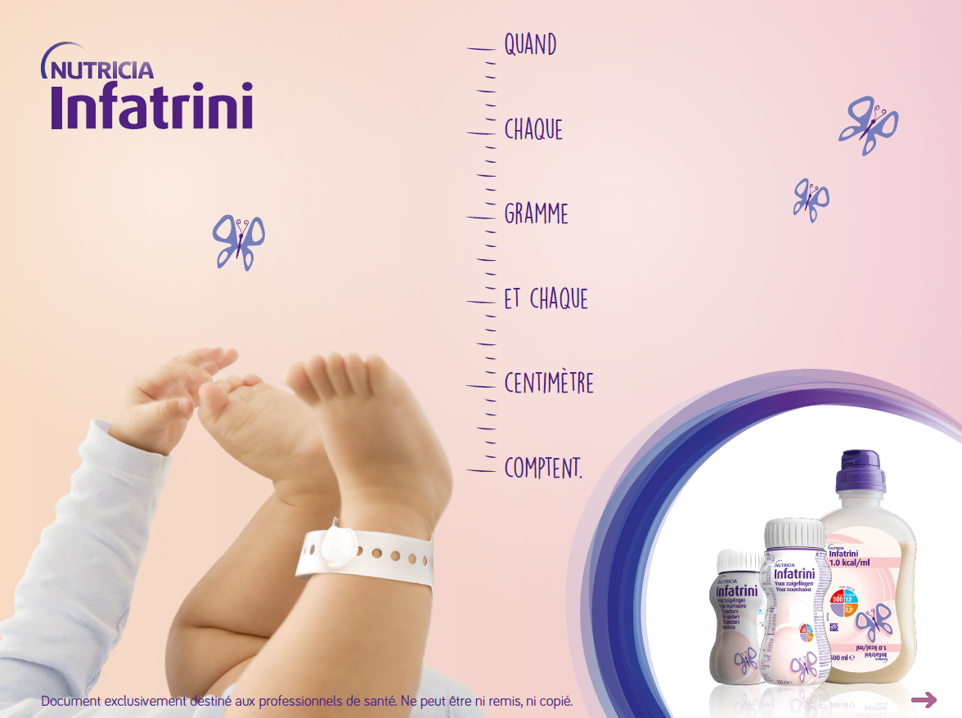


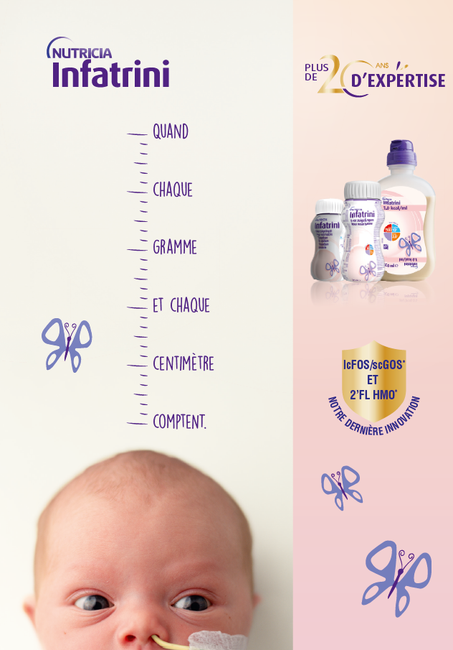


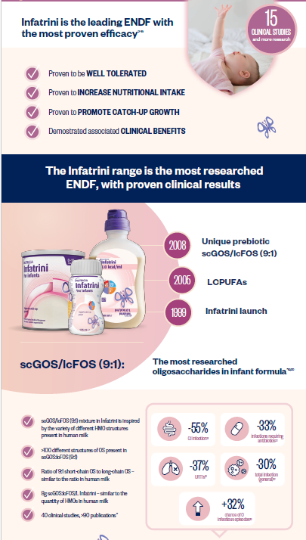




Q4 24 : RELAUNCH CAMPAIN FOR INFATRINI + 2 ’FL HMO
Targets : Paediatricians (Community + Hospital) & dieticians (Hospital)
SALESFORCE TOOLS FOR HCPs VISITS
MCE ACTIVATION WITH PAID MEDIA
eDetailer
HCPs newsletter
Web banners
Salesforce CRM emailing
Booklet of evidence (updated with Delsoglio study)
Leaflet

Slide 7

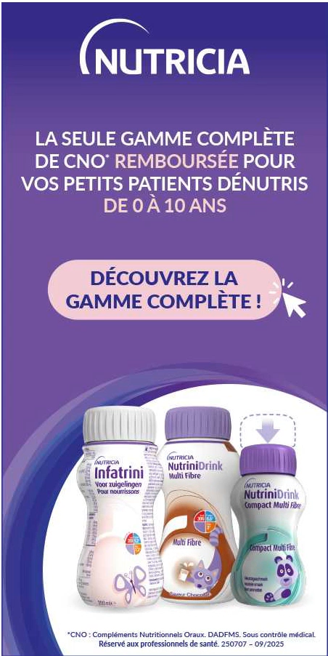




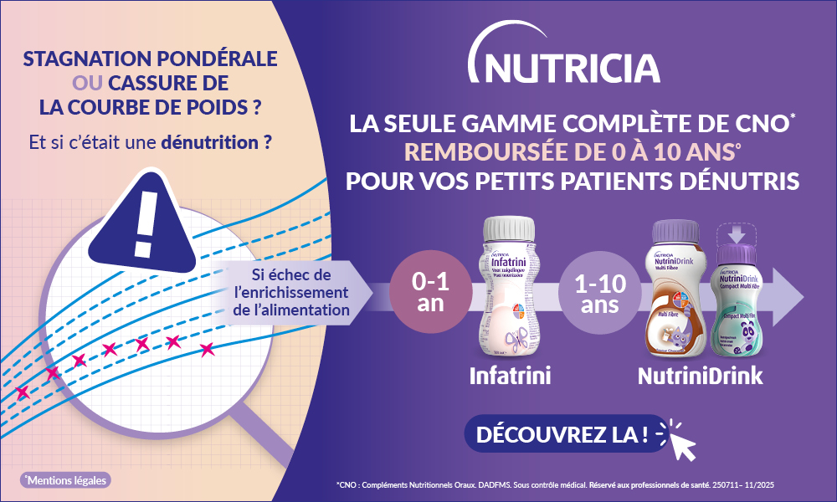



FY 25 : ONS PEADS MCE CAMPAIN FOCUS ON AWARENESS & CONSIDERATION
Targets : Paediatricians (Community)

Slide 8

2025 ACTUAL SITUATION : WE SUCEED TO MAINTAIN OUR MS & DRIVE GROWTH
Thanks to halo effect of NutriniDrink Rx on 2024 and HMO activation
2024 :
94% MS
3,5 M€ NS (+28% vs 23)
YTD 2025 :
94% MS
2,5 M€ NS (+7% vs 24)
Great switch execution on each channels,
but warnings on CSL since july to secure

